Slide 1
Roles and Responsibilities of Different Actors
Webinar for the GCCS2015
Myriam Dunn Cavelty
16 March 2015

Slide 2
Key Questions
What type of actors have traditionally had what kind of roles and responsibilities?
How have expectations about them changed over the years?
What are the problems that we encounter from a human rights perspective?
How can / should civil society get involved?

Slide 3
Aims of this Presentation
To further our understanding of different expectations and positions in the cybersecurity debate
To enable us to better identify common grounds between the different actors going forward
To enable us to understand the main problems arising from this and to design strategies for optimal civil society input
Notes:
"

Slide 4
Structure of Webinar
A Short History of Cybersecurity Policy Concerns
The Main Actors:
State
Private Sector / Businesses
Citizens (Civil Society)
The Main Issues at the Interface:
Public-Private Partnership (State – Private Sector)
Surveillance (State - Citizens)
The Way Forward

Slide 5
Short History of Cybersecurity Policy Concerns

Slide 6
Policy Dynamics in the 1980s
„Hacking“ comes to the attention of the policy community
Cyber-crime interlinked with foreign intrusion/espionage → elevated to a national security issue!
Main concern: prevention of damaging disclosures of classified information
But: Problem rather limited due to nature of the information infrastructure (no mass phenomenon)
Main actors: Government (law enforcement) & tech community

Slide 7
Policy Dynamics in the 1990s
Increasingly networked systems, rapid technological development (commercialisation)
Quantitative increase in cyber-incidents (statistics)
Gulf War 1991/92, development of Information Warfare ideas
Critical infrastructures become focal point
Information revolution leads to novel vulnerabilities (interdependent software-based control systems)
Capabilities of “new” malicious actors seem enhanced: inexpensive, ever more sophisticated, rapidly proliferating, easy-to-use tools in cyberspace (buzzword: Cyber-terror)
Asymmetry as defining feature
Liberalization! (moves national security relevant assets away from the government)
Main actors: government (military and homeland defense), private sector

Slide 8
Policy Dynamics in the 2000s
Increasing quantity, quality, attention of/on attacks
Stuxnet
Flame
«Mega»-Hacks
Targeted attacks
Non-state (Hacktivism)
Organized crime
State (APTs)
Cyber-«Arms Race»
Security Dilemma
Increasing Securitization!
= even sub-issues are turned
into national security issues

Slide 9
Main Actors

Slide 10
Roles & Responsibilities in Cybersecurity
State:
Responsibility to protect own assets (i.e. government functions)
Responsibility to provide security & safety
Private Sector:
Responsibility to protect own assets
Responsibility to provide additional security for critical infrastructures
Society:
Responsibilty to protect own assets (home computers)
Responsibility to be «aware» of the risk
Responsibility to be a «good» cyber-citizen
Not everyone’s security is the same

Slide 11
The Dilemma of the State
Power to resist vulnerability and to exploit vulnerability disappears
downwards (localisation),
upwards (trans- or supranationalisation), or
sideways (privatisation)
State can no longer „go it alone“ – private actors increasingly important
Non-state actors threaten
Non-state actors directly threatened
Non-state actors needed for definition AND enactment of security policy

Slide 12
Bureaucratic Power Politics
Cybersecurity is seen from different perspectives
IT-security issue
Economic issue
Law-enforcement issue
National security issue
Overlaps and no clear-cut boundaries
Different groups within the government do not necessarily agree on what the problem is and what needs to be protected
The differing positions demand different allocation of responsibility and countermeasures
Notes:
We can roughly distinguish between the following perspectives:
Cyber-security is an IT security issue: cyber-security can be approached as an IT security or information assurance issue, with strong focus on internet security. Policies are thus aimed at countering threats to the information infrastructure by technical means such as firewalls, anti-virus software, or intrusion detection software.
Cyber-security is as an economic issue: cyber-security is seen as relevant to business continuity, and especially to e-business, which requires permanent access to ICT infrastructures and permanently available business processes to ensure satisfactory business performance.
Cyber-security is a law enforcement issue: cyber-security is seen as relevant to (cyber-) crime. “Cyber-crime” is a very broad term with various meanings, and definitions can include everything from technology-enabled crimes to crimes committed against individual computers.
Cyber-security is as a national security issue: Society as a whole and its core values are seen as endangered, due to their dependence on ICT. Action against the threat is aimed at several levels (the technical, legislative, organizational, or international levels).
While all typologies can be found in all countries, the emphasis given to one or more of them varies to a considerable degree. The dominance of one or several typologies has implications for the shape of the protection policies and, subsequently, in determining appropriate protection efforts, goals, strategies, and instruments for problem solution
In accordance to the different perspectives, information infrastructures are seen as competitive edge over business adversaries, as technical-operational systems, as objects of criminal activities, as defense-relevant strategic assets, or more general, as objects of national and international security policy.
In the majority of countries, the law-enforcement/cyber-crime perspective has emerged as the most prominent one
The question of criticality in the socio-political context is always inextricably linked to the question of how damage or disruption of an infrastructure would be perceived and capitalized politically. Actual loss (be it monetary or loss of lives) stands next to political damage or loss in the basic trust among the citizenry for the mechanisms, which govern it, and loss in confidence in inherent government stability
Seen this way, the criticality of an infrastructure can never be identified preventively based on empirical data alone, but only ex post facto, after a crisis has occurred, as result of a normative process.

Slide 13
Companies: a diverse bunch
«At the forefront»
Exposed to cyberthreats daily
Some shape use of cyberspace considerably
Some directly shape cybersecurity landscape (i.e. Anti-Virus companies)
There is a lot of power in the hands of a few
Diverse bunch of actors! Diverse set of interests
Different sectors
Some are Critical Infrastructure Providers
Some are Small and Medium Sized Enterprises
Some are norms shapers
Some earn money from cyber-in-security
….

Slide 14
Society: Empowered?
“On one side are the traditional, organized, institutional powers such as governments and large multinational corporations. On the other are the distributed and nimble: grassroots movements, dissident groups, hackers, and criminals. Initially, the Internet empowered the second side. It gave them a place to coordinate and communicate efficiently, and made them seem unbeatable. But now, the more traditional institutional powers are winning, and winning big. How these two sides fare in the long term, and the fate of the rest of us who don't fall into either group, is an open question -- and one vitally important to the future of the Internet.”
Bruce Schneier, The Battle for Power on the Internet

Slide 15
The Main Issues

Slide 16
Expectations
States expect private companies to help them guarantee national security
The private sector expects to make money (i.e. with our data)
Society expects the state to provide security for everyone
State
SECURITY
Society
Private Sector

Slide 17
State Response Strategies
State-state
Coordination within the public sector in order to foster coherent responses (state – state inside)
International cooperation (state – state outside)
Cyber-crime
Confidence building measures
Arms control?
State-private sector
Public-private collaboration to
enable a better exchange of information
enhance level of security
provide incentives?
State-society
Public awareness campaigns
Increasing surveillance of digital content

Slide 18
State – Private Sector

Slide 19
Different PPPs – Different Rationales for their Formation
Information-sharing about incidents and potential countermeasures
Early warning
Mutual support during incidents
Prosecution of attackers
Joint funding of R&D or awareness-raising campaigns
Joint policy development and strategy building
Notes:
The picture is further complicated by the fact that there are many different rationales that can lead to the formation of PPPs. I listed here some of the reasons why public and private actors join their forces. One of the most frequently mentioned reasons is information-sharing. This can be information on incidents and potential countermeasures or information about new and emerging threats and risks, in order to enhance early warning capabilities.
Collaboration is of course also crucial in case of an incident and is essential for the prosecution of attackers. Other forms of collaboration are the joint funding of research and development or of awareness-raising campaigns. Finally, public-private collaboration can also often be observed when it comes to policy development and strategy building.
Again there are often more than one of these rationales behind the formation of a PPP. In short, there are very different organization that are all subsumed under the label public-private partnerships and the differences are all too often neglected.

Slide 20
Public Private Partnerships
PPP concept originally developed in a completely different context: in the field of administrative reform in the 1980s (New Public Management)
Subsequently, PPP concept adopted uncritically by many governments for CIP policy at the end of the 1990s
Cooperation programs following the PPP prototype are part of all existing initiatives in the field of CI(I)P
Some successfully facilitate i.e. the exchange of information between both sides
Others, however, have scarcely generated more than joint statements of intent of the actors involved
This causes a number of problems in the implementation of such forms of cooperation and causes feelings of disillusionment

Slide 21
4 Problems
Diverging interests
Trust
Costs
Voluntary character

Slide 22
State – Citizens

Slide 23
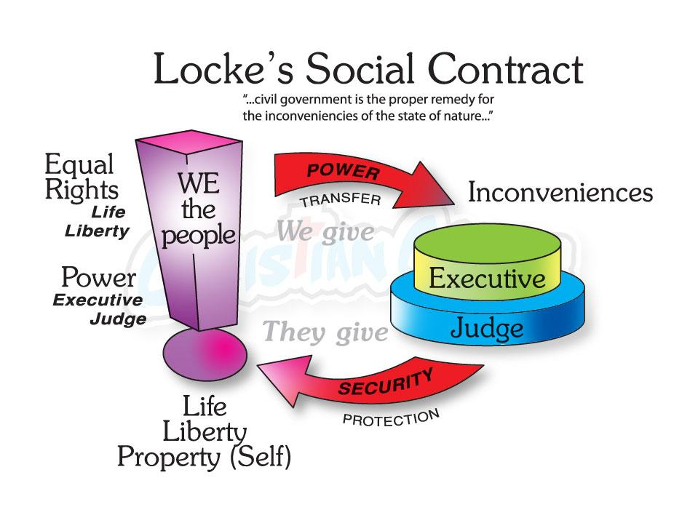
The Social Contract
Notes:
Individuals must give away some liberties for the security of all
Freedom needs Security, but Security must protect Liberty and not abolish it
as little security as possible but as much as necessary
Liberties should only be given up if that means more security

Slide 24
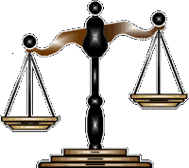
Liberty
social and political freedoms guaranteed to all citizens
Security
power and privileges given to state
Balance is chosen in a process of social/political negotiation

Slide 25
The End of Certainty
Cold War: Threat direct, intended, knowable/known
Today: Threat indirect, unintended, uncertain, unknown
No longer Threats but diffuse Risks
Security paradigm changes from defense towards risk prevention
State reaction:
Focus on vulnerabilities (of society / infrastructure)
Data collection
Target: anyone, because everyone is potentially dangerous
Actor
?
Potential
Intention

Slide 26
The Surveillance «Dilemma»
Data hunger!
Easily collectable data about the behavior of everyone
Most people generate this data willing (convenience, beneftis, etc.)
New algorithms that try to predict behavior
Fundamentally insecure technologies that penetrate more and more parts of our lives
Increased insecurities in security politics (risks)

Slide 27
Security Dilemma
National security considerations in and through cyberspace are increasing in (strategic) importance
Data collection in and through cyberspace is increasing due to national security reasons
The focus on the state and “its” security crowds out consideration for the security of the individual citizen.
The type of security currently produced is often not security (directly) relevant to the people = A problem for human security is created

Slide 28
The Way Forward

Slide 29
Role for Civil Society
Given range of legitimacy and normative concerns, even deeper engagement of civil society than in other areas seems desirable
Civil society organizations can rally together to help break down barriers to engagement and ensure more qualitative and inclusive multi-lateral processes.
Should focus on enhancing their role with regards to:
i) Engaging Effectively;
ii) Fostering Transparency and Accountability; and
iii) Deepening Knowledge.

Slide 30
Role for Civil Society
Combined, these measures can
strengthen the legitimacy and sustainability of on-going processes;
ensure that broader normative concerns are attended to, and that the right technical expertise is leveraged when solutions are being sought; and
ultimately help build trust between states and between state and society.

Slide 31
Contact Information
Thank you!
Dr. Myriam Dunn Cavelty
Center for Security Studies, ETH Zurich
CH-8092 Zürich
Switzerland
dunn@sipo.gess.ethz.ch

