Slide 1
Business and Human Rights in the Digital Environment
GLOBAL PARTNERS DIGITAL
Notes:
1. Introduction and Objective:
Introduction: Hi there! Welcome to this first of four webinars on business and human rights in the digital environment. My name is XXX, XXX at Global Partners Digital.
Objective: These webinars have been developed by Global Partners Digital, in cooperation with the Global Network Initiative, InterNews, New America’s Open Technology Institute, and Ranking Digital Rights in order to introduce some of the key issues related to human rights and business in the digital environment.

Slide 2
Webinars
1. Introduction to Business and Human Rights (BHR)
2. BHR in the Digital Environment
3. Key Priority Issues: Privacy
4. Key Priority Issues: Free Expression
Notes:
2. Webinars:
Agenda: I’m going to quickly explain the structure of this webinar series. It comprises four webinars on different issues,and 2 interactive question and answer sessions.
In the first webinar, we’ll look at business and human rights the major developments in the field, and the key actors. Then, we’ll look at the relationship between business and human rights and the digital environment. Finally, we’ll have two further sessions on key priority issues in the field of business and human rights. One on privacy and another on issues related to free expression.
By the end of the series, you should - hopefully: understand the key concepts, terminology and principles in the business and human rights field, and the links between human rights and digital environment.

Slide 3
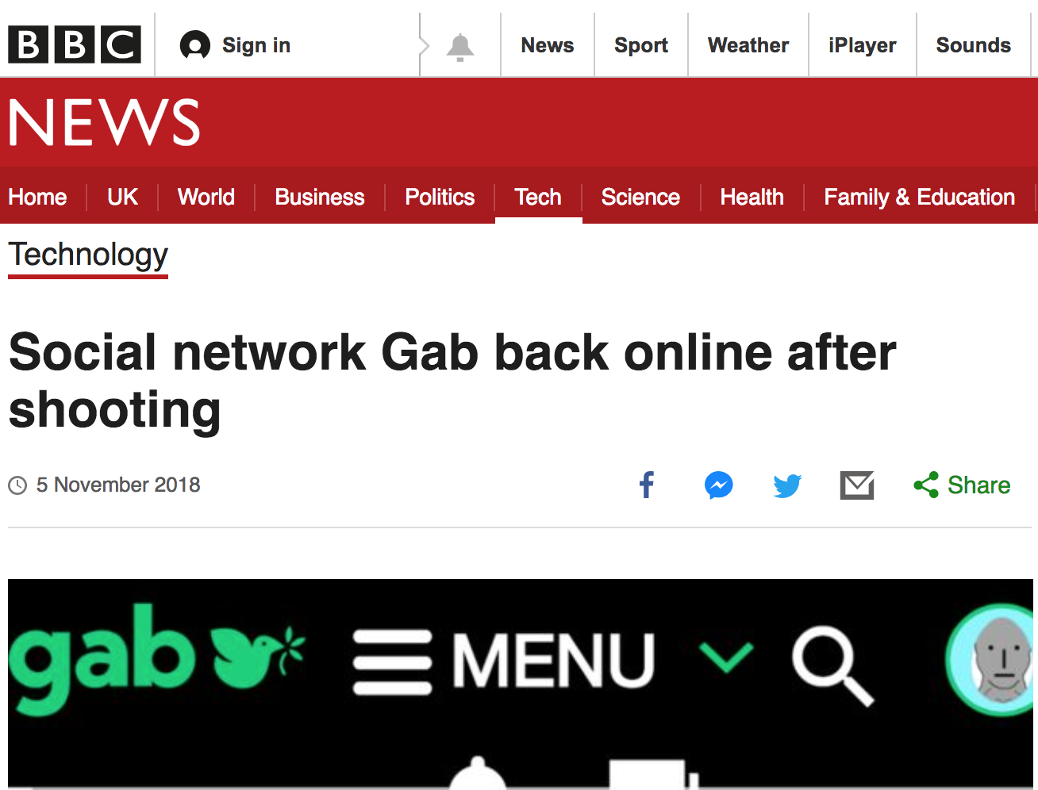
Business and Human Rights
Notes:
3. Introduction to Business and Human Rights:
Businesses impact human rights wherever and however they operate. These impacts can be positive or negative.
These days, many companies operate globally — and that means their impact are too.
There have been a number of recent high-profile instances of data breaches, of companies sharing data without users’ consent, of censorship by online platforms, and companies assisting governments in online surveillance. All of these instances demonstrate the significant and widespread impact that companies’ actions can have on human rights.
Historically, the international human rights system has not said much about the role of businesses when it comes to human. This mainly because businesses do not have legal obligations under international human rights law. Since the 1970s, the UN has been concerned about the impact of businesses on human rights. Now, it is widely accepted that businesses have a responsibility to respect human rights. A key milestone occurred in 2011, when the United Nations Human Rights Council endorsed a set of principles that define the responsibilities of governments and businesses in the field, also known as the UN Guiding Principles on Business and Human Rights. A set of Principles that are not binding but which generate duties for states and responsibilities for companies.

Slide 4
Business and Human Rights
Notes:
So what do these principles say? There are three pillars.
The first pillar – Protect - says that governments have to make sure that businesses don't violate anyone's human rights. This usually means passing laws that prevent human rights violations and making sure those laws are implemented.
The second pillar – Respect - says that businesses have to refrain from violating human rights wherever and however they do business. That means it's not enough for companies to simply follow the law where they operate. Even in countries where the government doesn't take up its own duty, companies have to know their human rights impacts and take concrete steps to address any adverse impacts.
The third pillar is about what happens when something goes wrong. If a company breaches human rights, governments have to make sure that the court system or some other legitimate process allows victims to file a complaint and that the complaint is investigated and settled. Companies also have an obligation to make sure they have some process in place for these issues too.

Slide 5
Pillar 1: State duty to protect
The foundational principles under pillar one say that states:
Must protect against human rights abuses by third parties (including business enterprises).
Should set out clearly the expectation that business enterprises domiciled in their territory and/or jurisdiction respect human rights across their operations
Notes:
Each pillar have a set of foundational or content principles and a set of operational ones. The 'foundational' principles under pillar one say that states: Must protect against human rights abuses by third parties (including business enterprises) within their territory and/or jurisdiction by taking appropriate steps to prevent, investigate, punish and redress such abuse through effective legislation, policies, regulation and adjudication (Guiding Principle 1).
Should set out clearly the expectation that business enterprises domiciled in their territory and/or jurisdiction respect human rights across their operations (Guiding Principle 2).

Slide 6
Pillar 1: State duty to protect
The ‘operational' principles under pillar one say that states:
General state regulatory and policy functions (Guiding Principle 3)
The state-business nexus (Guiding Principles 4, 5 and 6)
Ensuring policy coherence (Guiding Principles 8, 9 and 10)
Supporting business respect for human rights in conflict-affected areas (Guiding Principle 7).
Notes:
Apart from the foundational principles, there are also 'operational' principles of pillar one which address:
General state regulatory and policy functions (Guiding Principle 3): States are required to take appropriate steps to prevent, investigate, punish and redress business-related human rights abuses through effective legislation, policies, regulation and adjudication.
The state-business nexus (Guiding Principles 4, 5 and 6): The UN Guiding Principles expect states to take additional steps to protect against human rights abuses by business enterprises that are owned or controlled by the state, or receive substantial support from state agencies. If they do not, this may entail a violation of the state’s international obligations. States should also include human rights considerations in their procurement of goods and services.
Ensuring policy coherence (Guiding Principles 8, 9 and 10): The UN Guiding Principles emphasise that within their national law and policy framework, states are obliged to ensure law and policy coherence. For example, a state should make sure that the trade and investment agreements it negotiates are in line with its human rights obligations.
Supporting business respect for human rights in conflict-affected areas (Guiding Principle 7): Because of the heightened risk of gross human rights abuses in conflict-affected areas, states are expected to take extra steps to ensure that businesses operating in conflict-affected contexts are not involved with human rights abuses.

Slide 7
Pillar 1: State duty to protect
NATIONAL ACTION PLANS:
1. Embedded in government
2. Relevant stakeholders
3. National Baseline Assessment
4. 3 Pillars
5. Transparent
6. Review Process
Notes:
Pillar 1: National Action Plans:
With the Guiding Principles in hand, in 2011 the UN Human Rights Council went a step further and recommended that each State develop a strategic framework called a “National Action Plan” to put the Guiding Principles into action.
Since 2014, the UN Human Rights Council has strongly encouraged all states to develop, enact and update a NAPs as part of the state commitment to disseminate and implement the UN Guiding Principles.
The UN Working Group on Business and Human Rights, the Danish Institute for Human Rights and the International Corporate Accountability Roundtable (ICAR), highlight 6 criteria for NAPs:
It is a process that should be embedded in the government and be adequately resourced
The process should involve all relevant stakeholders
One of the first steps should be to create a National Baseline Assessment to understand existing gaps
The NAP should address all the three pillars of the UNGPs
The NAP process should be transparent
The NAP should be followed up by a monitoring and review process involving all relevant stakeholders

Slide 8
Pillar 1: State duty to protect
NATIONAL ACTION PLANS:
Good practices
Weaknesses
Include various government entities
Some form of consultation with stakeholders
Follow-up and implementation actions
Disempowered or at-risk stakeholders
Lack of transparency in the drafting period
Usually there is a lack of National Baseline
Notes:
Pillar 1: National Action Plans:
Since 2011, 21 governments have developed a NAP on business and Human rights and many more are currently in progress. So far, States have completed NAPs through different processes.
Good practices:
Most of them have included various government entities during the drafting process including the creation of inter-ministerial working groups
Another continuing trend across NAPs processes is the inclusion of some form of consultation with stakeholders.
Also, NAPs appear to be including information in relation to follow-up and implementation of the planned future actions included in the NAP.
But also, there are a number of weaknesses in terms of process:
NAPs usually don’t include processes to facilitate participation by disempowered or at-risk stakeholders.
NAPs tend to lack transparency regarding the drafting process. Overall, there is a general failure by states to provide a timeline for their NAP processes or publish terms of reference.
Another significant weakness in the drafting process of most assessed NAPs is the failure to conduct national baseline assessments (NBAs) to inform the content of the NAP.
Overall, National Action Plans are important because they can provide an opportunity for the constructive collaboration and dialogue between stakeholders that is needed for the effective implementation of the UN guiding principles on business and human rights

Slide 9
Pillar 2: The Corporate Responsibility to Respect
3 ‘As’
Avoid infringing on human rights
Address any adverse human rights impacts
Applies to all businesses of all sizes in all situations
Notes:
Pillar 2: Corporate Responsibility to Protect
Pillar two of the UN Guiding Principles outlines the corporate responsibility to respect human rights.
The responsibility to respect human rights requires business enterprises to avoid infringing on human rights and to address any adverse human rights impacts with which they are involved (responsibilities established in Principle 11 of the UN Guiding Principles). This principle applies to all businesses of all sizes in all situations (as recognised in Principle 15 of the UN Guiding Principles).

Slide 10
Pillar 2: The Corporate Responsibility to Respect
Know and Show
Policy Commitment
Human Rights Due Diligence
Grievance Mechanism
Notes:
Pillar 2: Know and Show:
According to UN Guiding Principle 15, in order to “know and show'” that they respect human rights, businesses should have in place:
A policy commitment to respect human rights,
An on-going process of human rights due diligence process, and
Processes to enable the remediation of any adverse human rights impacts they cause or to which they contribute.

Slide 11
Pillar 2: The Corporate Responsibility to Respect
Due Diligence
Human Rights Impact Assessment
Integrating and acting upon findings
Tracking and monitoring responses
Communicating and reporting
Notes:
Pillar 2: Due Diligence:
Human rights due diligence needs to cover different types of adverse impacts on all internationally recognized human rights this includes:
Impacts that the business causes
Impacts that the business contributes to
Impacts that are directly linked to business operations products or services
Actual and potential human rights impacts should be avoided and addressed through human rights due diligence which includes 4 key steps:
Assessing human rights impacts
Integrating and acting upon the findings in the impact assessment. To do so, the company should integrate these findings into the company policies and create internal capacity opportunities.
Tracking and monitoring responses: this should be an ongoing process. It is important to involve affected right-holders and other stakeholders
Communicating and reporting: Information about due diligence and impact assessments should be publicly communicated that are accessible, provide sufficient and relevant information and that do not pose risks to rights holders or others

Slide 12
Pillar 3: Remedies
Judicial mechanisms
State
Non-judicial mechanisms
State and non-state
Notes:
Pillar 3: Remedies (Judicial and non-Judicial)
Under pillar three of the UN Guiding Principles, both states and businesses are obliged to ensure access to effective remedy for victims of business-related human rights abuses. This includes access to both judicial and non-judicial remedy
On judicial remedies, the UNGPs highlight that that a state needs to take appropriate steps to ensure that its legal system including its national courts is effective in addressing business-related human right abuses.
So, governments need to consider how to reduce legal and practical barriers that could prevent victims from accessing and effective remedy.

Slide 13
Pillar 3: Remedies
Non Judicial Mechanisms:
State-based non-judicial mechanisms
Example OECD and NHRIs
Non-state-based, non-judicial mechanisms
legitimate, accessible, predictable, equitable, transparent, rights-compatible, a source of continuous learning and engagement – and dialogue-based
Notes:
Pillar 3: Non-judicial mechanisms:
Non-judicial remedies for business-related human rights abuses can be divided into state-based mechanisms and non-state based mechanisms.
Non-judicial mechanisms should complement rather than replace or undermine judicial mechanisms
State-based non-judicial mechanisms include, for example, National Contact Points under the OECD guidelines for multinational enterprises. state-run Ombudsman offices, and National Human Rights Institutions
In addition to state-based non-judicial mechanisms, the guiding principles emphasise the role of non-state based grievance mechanisms. These could be for example mechanisms provided by an industry association, a multi-stakeholder group, a financial institution or a company.
UN Guiding Principle 31 outlines eight effectiveness criteria for non-judicial grievances mechanisms, indicating that such mechanisms should be: legitimate, accessible, predictable, equitable, transparent, rights-compatible, a source of continuous learning and engagement – and dialogue-based.

Slide 14
Other International Standards and Mechanisms
Other Voluntary standards:
UN Global Compact
The Voluntary Principles on Security and Human Rights and
The Global Network Initiative
Notes:
Other Voluntary Standards:
Apart from the UNGPs, there are a number of other principles that build from these standards.
There are several voluntary initiatives addressing business and human rights-related issues in different sectors and regions. Some examples include:
The UN Global Compact: Before the adoption of the UNGPs, the UN embarked on an effort to address the corporate sector, leading to the eventual development of the UN Global Compact in 2000. The Global Compact established ten nonbinding principles to guide businesses in the development of socially and environmentally sustainable practices.
The Voluntary Principles on Security and Human Rights: Building from the UNGPs and as collaborative effort by governments, major multinational extractive companies, and NGOs, the Voluntary Principles on Security and Human Rights provide guidance to companies on tangible steps that they can take to minimize the risk of human rights abuses in communities located near extraction sites.
On similar grounds, the Global Network Initiative is a multi-stakeholder initiative which aim is to protect and advance freedom of expression and privacy in the ICT industry by setting a global standard for responsible company decision making and by being a leading voice for freedom of expression and privacy rights.

Slide 15
Next…
Webinar 2
Business and Human Rights in the digital environment.
Webinar 3
Key Priority Issues: Privacy
Webinar 4
Key Priority Issues: Freedom of Expression
Notes:
Wrapping-up and next steps:
We hope that you have obtained a good overview of business and human rights with a focus on the UN Guiding Principles on Business and Human Rights.
On the next webinar, we will apply this framework to the digital environment looking at key examples of good and not so good practices from governments and tech companies.
Then in the third and fourth webinars, we will look at key priority areas on Privacy and free expression.

