Slide 1
Privacy in the Digital Age
DRL Business and Human Rights
February 2019
Open Technology Institute
Ranking Digital Rights
Notes:
Hi everyone, thank you for joining us today. This is Spandana Singh from New America and today we will be conducting a webinar which provides an introduction to privacy in the digital age

Slide 2
Privacy in the Digital Age
Privacy: The right to be free from unwarranted intrusion and to keep certain matters from public view.
Article 17 of the International Covenant on Civil and Political Rights (ICCPR) recognizes the right to privacy
Data Security: Governing how your information is collected, used, shared and managed, and having protections that uphold these decisions.
Notes:
As technology has developed it has opened up a number of opportunities for individual expression and coordination including for human rights activists and defenders. However, it has also made individuals susceptible to surveillance and vulnerabilities which threaten their privacy and security.
Privacy can be defined as “the right to be free from unwarranted intrusion and to keep certain matters from public view.” Privacy has long been recognized in international law, but the combination of rapidly evolving digital technologies, the expansive applications of these technologies and the aggressive collection of personal information by states and corporations has eroded these privacy rights and undermined their enforcement. International frameworks such as the The International Covenant on Civil and Political Rights recognizes the right to privacy, stating that “no one shall be subjected to arbitrary or unlawful interference with his or her privacy, family, home or correspondence, nor to unlawful attacks on his or her honour and reputation” It further states that “everyone has the right to the protection of the law against such interference or attacks.”
As access to private information online has grown, with and without consent, security has also emerged as a key concern. Protecting data security means allowing individuals to control who has access to their data, how the information is collected, used and stored, and implementing safeguards to protect against data breaches through unwarranted access methods such as hacking.

Slide 3
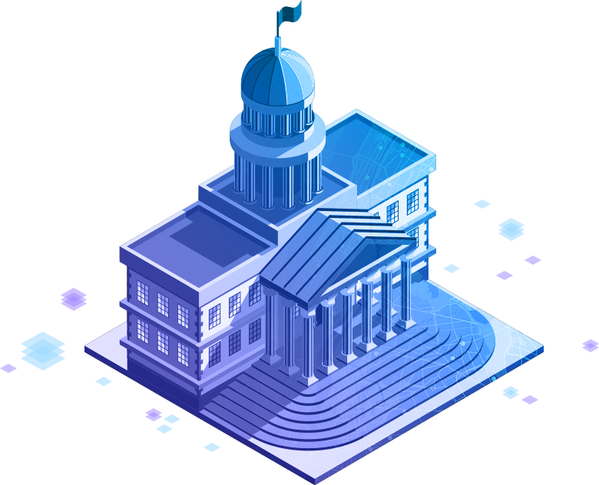
Privacy in the Digital Age
Privacy from government
Privacy from companies
Notes:
When we think about privacy in the digital era, there are two diverging streams that arise. The first is privacy from companies, who regularly collect and use our data to target individuals with specific advertisements and otherwise tailor their individual experiences. The second is privacy from governments who regularly gather data through surveillance programs and can use this data in a criminal prosecution or misuse it to stifle the free speech of political opponents. The risks of an intrusion into your privacy and the legal frameworks that apply to both of these streams are very different. For example, although the ICCPR applies to both privacy from companies and privacy from the government, the EU’s new GDPR framework only applies to companies. In the United States, we do not have a data privacy regime yet, and the 4th Amendment says nothing about what a company can and cannot do, but rather only applies to the government.
Picture links: https://www.esri.com/en-us/industries/government/overview
https://www.collectivecampus.com.au/blog/why-big-companies-choose-not-to-innovate

Slide 4
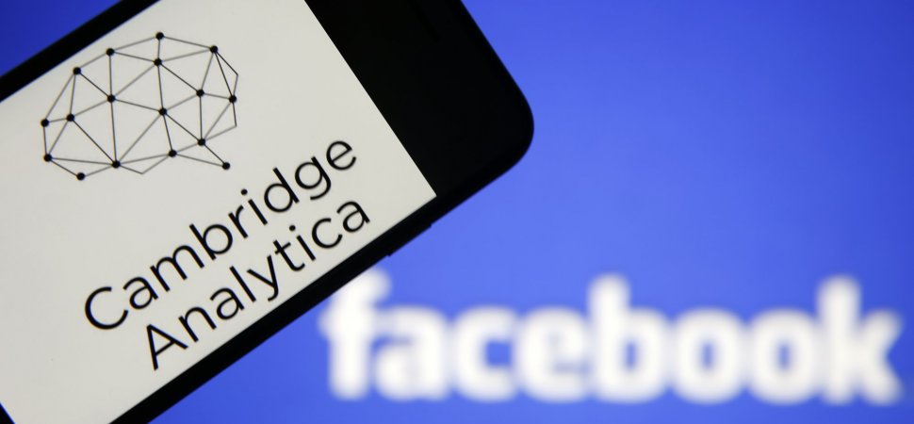
Privacy and Security in the Context of Business and Human Rights
Notes:
Over the past few years, we’ve seen just how integral strong privacy and security protections are for users, companies and governments alike. Events such as the the Cambridge Analytica scandal in which political data firm Cambridge Analytica gained access to the private information of over 50 million Facebook users and the Yahoo scandal in which 3 billion user accounts were compromised have highlighted just how vulnerable user data is to being accessed by third parties through hacks as well as through weakly enforced corporate policies.
Images links: https://tinyurl.com/y8zmywnj and https://tinyurl.com/ya87sh7e

Slide 5
Data Protection
There are a variety of frameworks for corporate best practices on data protection, but there are four rough categories of safeguards that trend across those frameworks: data collection, data use, data retention, and data security.
Companies that collect data about their consumers need to have clear, transparent policies that address these four key data protection issues:
Notes:
As technology adoption increases dramatically, whether it is through use of connected consumer devices or engagement with online services or platforms, companies have become responsible for dramatically larger troves of their users’ data. They have also begun to collect new types of data, which pose particular risks in cases of data breach, like biometric data, location data, communication data and audio and video recordings. This information, combined with traditional sources of data, can paint a highly detailed portrait of a user’s life.
This raises a variety of issues surrounding the collection of data, the use of data, the retention of data, the security of data. In order to protect their users’ data privacy and security while maintaining consumer trust, companies need to develop clear policies around each of these issues and then ensure that those policies are effectively communicated to all users of their products or services.

Slide 6
Data Collection
What user information a company is collecting
When and how they are collecting that information
For example, is information collected that is not needed for the product/service to function (contacts, photographs, audio data, etc.)?
As a best practice, companies should minimize the amount of data they collect and maintain transparency about their data collection practices
Notes:
Best practices around data collection are two pronged: First, in order to protect user privacy and security, companies should minimize the amount of data they collect. Ideally, companies would not collect information beyond what is necessary to use a product or service. This data minimization protects the privacy of users by not over-collecting, for example requiring address book or microphone access to play a mobile game, or a platform requiring constant access to a user’s photo library. Any information collected by a company is vulnerable to accidental breach or hacking, and provides more opportunities for a user’s privacy to be violated. Second, it is a best practice to make it clear to consumers what information is being collected and when. This can be done through tools like a terms of service, but requiring users to affirmatively authorize collection (through a request or notification) and using tools like a light identifying that a camera is recording or some other indication that information is being actively collected at that time, are important steps toward protecting users’ privacy and security.

Slide 7
Data Use
Ways in which a company uses the information it has collected
For example, are companies using information collected from users to provide customized advertising?
As a best practice, users should be notified about all ways their data is used, and have the ability to opt in or out
Notes:
Best practices for data use involve notifying consumers about the ways in which their data is used, and the parties or services that use that data. For example, if data is going to be used for any purpose other than those required by the device or service, like direct marketing, this is something that consumers should be notified about. Ideally, they will also have the option to opt out of this type of data use and control other settings. Similarly, if user data will be sold to or shared with any third parties, including government actors, it is a best practice that users be notified of the potential that their data may be shared and who with.

Slide 8
Data Retention
How long a organization retains each type of information
For example, how long are private messages between users stored in the system?
As a best practice, organizations should be transparent about data retention practices, and retain data for only short periods
Notes:
Best practices for data retention involve short periods for how long each type of user information is retained and disclosure of those timelines. Companies should not be keeping information for much longer than is necessary, and should delete all user information when users terminate their account or remove service from a device. Similar to concerns about over-collection of user data posing security problems, retaining data for longer periods of time than necessary can pose greater risk of security breach or misuse of information by the company holding that information. Some governments have regulations that require organizations to retain information for a certain amount of time, which should also be clearly disclosed to users.

Slide 9
Data Security
The process for data protection (security practices and tools)
Breach notification policies
For example, are companies using encryption or password protection tools to help secure their user data? What type of communication does the company use in case of data breach, and what are its mitigation practices?
Notes:
Data security practices are extremely important for all products and services that collect information about their consumers. With the amount of personal data that many companies gain through the use of their products there is an obligation to take steps to protect that data from accidental leaks or data breaches. Key security best practices include encrypting user data at rest and in transit, authentication processes requiring strong and customizable passphrases from all users, providing regular patches or security updates to protect users from bugs or threats, and some sort of vulnerability management program that allows for the reporting of vulnerabilities to the company maintaining the product. As well, these data security practices should be accompanied by a transparent process for notifying consumers if their data gets breached. Best practices are that a company clearly discloses its process for notifying data subjects who might be affected by a data breach, as well as what kinds of steps it will take to address the impact of a data breach on its users.

Slide 10
Best Practices Models
Different types of business models or companies can benefit from different models of data security best practices.
For example, The Digital Standard is an open source methodology used to evaluate the privacy and security impacts of a given piece of IoT software or hardware.
Other models include: Do The Right Thing, the GNI Principles, and Who Has Your Back?
More models will be discussed in Webinar 2
Notes:
When developing or refining a company’s privacy and security best practices, it is helpful to look to existing evaluation systems for guidance. Depending on the company’s specific products and concerns, there are different tools that can be helpful.
For example, The Digital Standard, a collective effort led by Consumer Reports, Disconnect, Ranking Digital Rights, and The Cyber Independent Testing Lab, with assistance from Aspiration, is a set of individual tests that taken together form a methodology for evaluating the privacy and security impacts of a given piece of connected software or hardware - generally IoT products or the software they can use. It was created to define and reflect important consumer values that must be addressed in the development of software and hardware products. The Standard is underpinned by a set of guiding principles: electronics and software-based products should be secure, consumer information should be kept private, ownership rights of consumers should be maintained, and products should be designed to combat harassment and help protect freedom of expression. So far the Digital Standard has been used to evaluate Smart TVs and payment apps and report the results to consumers, but the possibilities are endless.
Other organizations or collaborations of organizations have developed their own best practices guides or evaluation metrics that apply to specific types of companies or models.
The Open Technology Institute’s “Do the Right Thing” report focused on the historical conditions required for companies to adopt three different security best practices: transparency Reporting, two-factor authentication, and transit encryption by default. These case studies can be useful to companies looking at when and how others in their industry chose to adopt security best practices.
The GNI Principles provide direction and guidance to the ICT industry and its stakeholders in protecting and advancing the enjoyment of global human rights. They also stress the value of collaboration between the ICT industry, investors, civil society organizations, academics and other stakeholders.
The Electronic Frontier Foundation’s “Who Has Your Back?” project provides annual evaluations of how internet platforms and services protect the rights of their users

Slide 11
Privacy from Government
UDHR, ICCPR, and other international frameworks and instruments have recognized privacy as a fundamental human right.
Infringements or curtailments of the right to privacy, such as government surveillance, must be prescribed by law, necessary to achieve a legitimate aim, and proportionate to the aim pursued.
Laws permitting government surveillance and collection of personal information vary from country to country.
Notes:
The laws governing surveillance vary from country to country, and involve different safeguards to ensure that government surveillance does not unduly infringe on individual privacy. In addition, governments collect vast quantities of personal data on their citizens for other purposes, ranging from financial information collected for tax purposes to personnel information on government employees, to sensitive health information. The four categories of safeguards -- collection, use, retention, and data security -- are also applicable to government collection of personal information.
In the context of surveillance, at the targeting stage, rules limit who may be targeted for surveillance, what prior review or approvals are required before a government may conduct surveillance, what standard must be demonstrated to initiate surveillance, and the purposes for which surveillance may be conducted. For example, under the U.S. Foreign Intelligence Surveillance Act (FISA), surveillance may only be conducted to seek “foreign intelligence information,” a broadly defined term, and depending on the target and nature of surveillance, certain prior approvals must be obtained from the FISA court. Robust safeguards are necessary to ensure that governments focus their collection efforts on legitimate targets.
Once information has been collected, additional rules -- sometimes called minimization procedures -- will limit how information may be used, the length of time information may be retained, and what safeguards must be applied to secure data. These safeguards are especially important to safeguard the privacy rights of individuals whose information is collected “incidentally,” because they were in communication with a target of surveillance.

Slide 12
Government Requests for User Data
1) Establish clear policies for processing and responding to legal and government requests
Establish a process for tracking requests and their status
Review and classify requests for accuracy and validity
Respond to requests using a previously established playbook
Create clear guidelines for providing user notice
Ensure data is kept secure
Challenging requests where necessary and appropriate
Provide public overview of policies and procedures
Notes:
Government law enforcement and intelligence agencies may seek or compel the assistance of internet and telecommunications companies to obtain access to communications data in connection with their investigations. If a company or organization collects and stores data, the likelihood of receiving such a government request is high. As a result, it is vital that these companies prepare for handling such requests, and that users hold these companies accountable when managing their data. Before responding to a government request, companies should ensure that it is authenticated and complies with applicable law -- in other words that it is really coming from a legitimate government entity, and that entity is entitled under law to seek the data. There are a number of best practices companies can implement and users can push for in order to ensure the process of engaging with and responding to legal requests for user data is transparent and respectful of human rights. The first best practice is to develop clear policies for processing and responding to government requests. This is a critical but challenging process and must involve consultations with legal counsel. Only a lawyer can help a company identify lawful requests and develop effective compliance mechanisms. Based on our conversations with companies, we have identified a few broad considerations for ensuring procedures and policies are transparent and efficient. Tracking Requests: Companies should have a single, centralized process in place to track and tag requests and their status. Classifying Requests: Companies should have an established procedure including trained staff for reviewing incoming requests, classifying them and ensuring their validity. Responding to Requests: Companies should work with their legal counsel to develop a playbook for responding to requests before they receive them. This will prevent errors and promote greater safeguarding of privacy and security. Providing User Notice: Government requests are increasingly accompanied by a gag order which prevents companies from informing the target user of the investigation. For requests without gag orders, companies must decide whether and under what circumstances they will provide notice to their users. For requests with gag orders, companies must decide whether to challenge the other and/or inform users after the gag order has been lifted. Companies will also need to identify processes for contacting users.
Keeping Data Secure: Information about law enforcement and intelligence requests is sensitive information in itself. In order to keep this information secure, companies should carefully consider how this data is maintained and who has access to it. Challenging Requests: Companies should have robust procedures in place that enable them to evaluate the validity and accuracy of requests, and challenge requests that do not comply with applicable law or that appear to infringe on privacy, human rights and security.
Provide Public Overview of Policies and Procedures: Users have the right to know how companies engage with such legal requests and how these requests can impact their data. As a result, companies should publicly disclose at least a high level overview of their policies and procedures for responding to such requests.

Slide 13
Government Requests for User Data
What kinds of legal orders and mechanisms the company accepts and responds to
The format in which requests must be made
The scope requests must fall under
User notification process
Notes:
Once a company has established these procedures, they should share at least a high level overview of these guidelines publicly. This public version of their policies will serve as a resource for users, as it explains how companies engage with legal requests for their data and how these requests can impact individual users. This is also a resource for requesting agencies as it defines scope and viability of requests. These publicly posted policies should clearly explain: 1) what kinds of legal orders and mechanisms the company accepts and responds to. Depending on the company and country of operation(s), these could include court orders, MLATs, emergency disclosure requests, and search warrants, 2) the format in which requests must be made, such as in written form or through a specific company form and 3) the scope of the request being made, which specifies the number of accounts or users, the product being targeted and so on.
4) the procedure the company follows for notifying users and any limitations that may exist to impacted users being notified

Slide 14
Government Requests for User Data
2) Issue regular and consistent transparency reports which highlight the scope and volume of government requests received. Benefits to the Public:
Raising awareness about scale and scope of government requests
Educating lawmakers
Advocating for policy change
Benefits to Companies:
Signaling company values
Easing customers’ fears about privacy intrusions
Improving company morale
Notes:
The second best practice for responding to government requests for user data is for companies to publish regular and consistent transparency reports which provide quantitative and qualitative information on the scope and volume of government requests for user information they have received. Transparency reporting is an extremely valuable practice that helps the public hold companies accountable as safeguards of user data and can be used to educate lawmakers on privacy issues. From a company perspective, transparency reports are a useful tool as they enable companies to communicate with their users and lawmakers about privacy and security, and are also a way of signaling company values and easing customers’ concerns about privacy intrusions. Many companies pressed the U.S. government for permission to disclose more statistical information about the extent of government data demands, to enable them to demonstrate that only a small percentage of their customers are actually affected. OTI has published comprehensive toolkits and guides for companies which outline best practices for creating and expanding transparency reports, which we have shared links to in the supplementary materials. In addition, Ranking Digital Rights’ Corporate Accountability Index, which evaluates 24 of the world’s most powerful internet, mobile, and telecommunications companies, shows which companies are meeting these standards for transparency reporting and which companies are lagging behind. Links to the RDR Index are also provided in your supplementary materials.

Slide 15
Government Requests for User Data
Notes:
Here are examples of the kinds of data that is shared in transparency reports on legal requests for user information. This is from Google’s transparency report, and you can see it highlights the number of requests the company has received for a particular reporting period. The data clearly shows a concerning trend of increasing number of requests worldwide. https://transparencyreport.google.com/user-data/overview?hl=en

Slide 16
Government Requests for User Data
Notes:
This slide from Google’s report shows the percentage of requests in which the company produced some data to the requesting entity, and you can also see that the data disclosed can be sorted according to country. https://transparencyreport.google.com/user-data/overview?hl=en

Slide 17
Government Requests for User Data
Notes:
Here is an example from Microsoft’s transparency report, which highlights the number of requests they received globally, the number of accounts and users specified in the requests and how they responded, either by disclosing information, being unable to comply or rejecting the request.

Slide 18
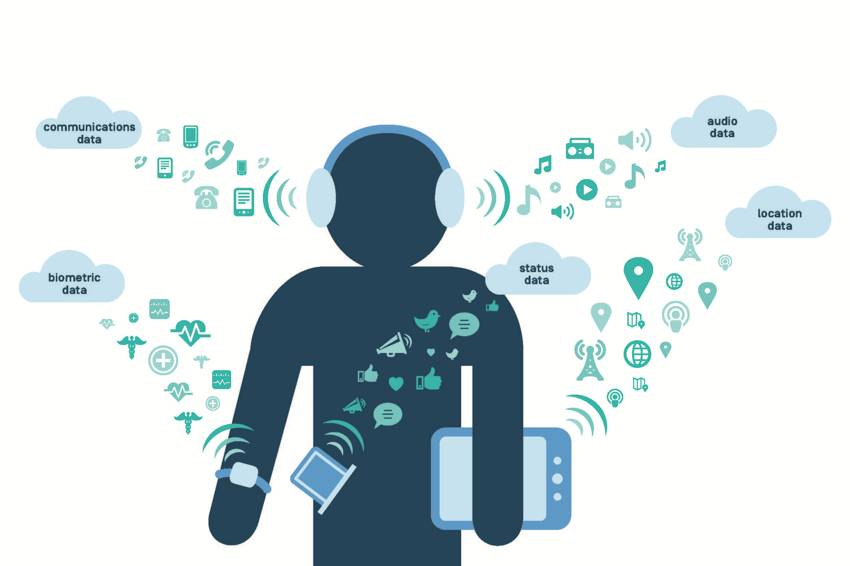
Emerging Technologies
Artificial Intelligence: Used to sort and categorize large data sets, but can suffer from bias, transparency, or ethical challenges
Internet of Things: Dramatically expanded
data sets pose risks of data breach,
exploitation, and user harm
Notes:
Emerging technologies pose a whole host of new privacy and security challenges for both governments and private companies.
For example, the intelligence community is using artificial intelligence to help manage the exponential increase of data they are collecting. Computer analytics are used to read and understand the data, in order to free up humans for more specific tasks. Using AI, intelligence agencies are auditing routine functions that analysts, curators, collectors have manually done in the past. The National Geospatial-Intelligence Agency is using AI to sort large quantities of image data, helping the Agency to pull out specific targets like such as enemy safehouses and airfields. As in other types of data, this frees up humans who used to do this type of analysis manually to do more complex tasks that cannot be performed by a machine.
However, with the rising use of AI there is also a potential for unintended consequences with issues of privacy, transparency, safety, control, and bias. Artificial intelligence can exhibit dataset bias, association bias, interaction bias, automation bias, and confirmation bias. These can enter the system as the result of simple mistakes or oversight in data aggregation techniques, or due to the nature of machine learning algorithms which will perpetuate unknown biases in the data used to train the systems. There are movements to make ethical guides for AI, and it is a best practice for governments and other organizations to stress test their AI models and test for bias. Some of these best practices include making sure there are human analysts included in any AI data analysis to watch for potential bias, to ensure that key decisions are made by humans, and to balance the need for innovation with the obligation to benefit and safeguard society.
The Internet of Things provides a dramatically larger body of data for use by third-parties, with 27.1 billion networked devices expected to be in use by 2021. Not only are connected home appliances and cars gathering troves of personal data, but technology that users carry in their pockets is now collecting biometric data, location data, images, audio, communications data, all sorts of user information that was, until-now, not easily available to companies and governments. Now these massive datasets provide opportunities for exploitation by nefarious actors, as well as general privacy violations through poor privacy and security practices. Much of this information is highly personal, and many users do not understand the potential consequences of their use of IoT devices.

Slide 19
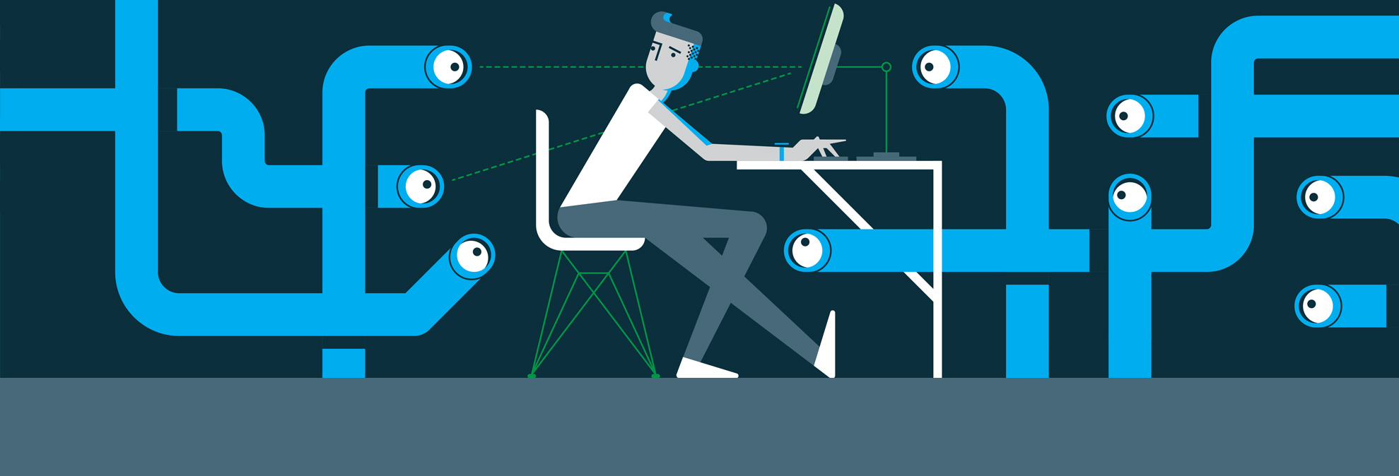
Conclusion
Notes:
In conclusion, as technologies develop and adapt, and as data becomes increasingly integral to the operations of these technologies, and society at large, threats to our privacy and security from both government agencies and companies are rapidly growing. As users, and members of civil society we need to be cognizant about how our data is being managed and used, and how we hold these actors accountable in their management of our data. Image link: https://www.google.com/search?q=privacy&rlz=1C1GCEU_enUS822US823&source=lnms&tbm=isch&sa=X&ved=0ahUKEwjcvqeuoePeAhVKqlkKHeFvCF8Q_AUIDygC&biw=1366&bih=657#imgrc=LdWhF14DBInXSM:

