Slide 1
Freedom of Expression in the Digital Age
DRL Business and Human Rights
February 2019
Open Technology Institute
Ranking Digital Rights
Notes:
Hi everyone, thank you for joining us today. This is Spandana Singh from New America and today we will be conducting a webinar which provides an introduction to freedom of expression in the digital age.

Slide 2
Freedom of Expression in the Digital Age
Article 19 of the Universal Declaration of Human Rights (UDHR) and the International Covenant on Civil and Political Rights (ICCPR): “Everyone has the right to freedom of opinion and expression; this right includes freedom to hold opinions without interference and to seek, receive and impart information and ideas through any media and regardless of frontiers.”
European Convention on Human Rights, American Convention on Human Rights, African Charter on Human and Peoples’ Rights
Notes:
The rise of the digital age, in particular the growth and large scale adoption of platforms that enable users to create and disseminate their own content has significantly increased global information flows and democratized and enhanced freedom of expression online. Freedom of expression can broadly be defined as an individual’s right to say, write and produce content on almost anything they’d like without restrictions from the government.
On an international level, freedom of expression is enshrined in Article 19 of the Universal Declaration of Human Rights (UDHR) as well as the international Covenant on Civil and Political Rights (ICCPR). According to the UDHR: “everyone has the right to freedom of opinion and expression; this right includes freedom to hold opinions without interference and to seek, receive and impart information and ideas through any media and regardless of frontiers.” The ICCPR states something similar, including that the right to free expression includes the “freedom to seek, receive and impart information and ideas of all kinds, regardless of frontiers, either orally, in writing or in print, in the form of art, or through any other media of his choice”. The freedom of expression is also a major component of regional conventions and charts including the European Convention for the Protection of Human Rights and Fundamental Freedoms, the American Convention on Human Rights and the African Charter on Human and Peoples’ Rights (Banjul Charter) which are also applicable to free expression online. In the United States, the freedom of expression and freedom of speech are protected under the First Amendment. Although free expression is generally agreed upon as a legal right, it is a derogable right, and as a rest it may be subject to safeguards which do not protect certain forms of speech.

Slide 3
GNI Principles
“Participating companies will respect and work to protect the freedom of expression of their users by seeking to avoid or minimize the impact of government restrictions on freedom of expression, including restrictions on the information available to users and the opportunities for users to create and communicate ideas and information,regardless of frontiers or media of communication”
Notes:
The principle of freedom expression is also outlined in the GNI Principles

Slide 4
Freedom of Expression in the Digital Age
User-generated content hosting platforms are becoming gatekeepers of online speech
U.S. companies apply a First Amendment perspective on speech issues in the United States and comply with local laws globally where applicable
Companies develop their own standards for acceptable content which can be stricter than speech-related laws
Notes:
As technology platforms such as Facebook, Twitter and Google have been adopted across the globe, they have gained more influence and power, and have assumed the role of digital public squares, as well as de facto gatekeepers of online speech. And just as threats to speech offline have grown, so have threats to online speech, raising significant concerns about censorship and limits to free expression online. Most American technology companies apply a First Amendment perspective in the United States, but comply with other countries’ laws when applicable. However, depending on local laws in varying countries, this may require taking specific steps in certain countries. For example, in Germany it is illegal to deny the Holocaust and as a result platforms that host user-generated content must treat such speech as illegal in the context of that country. Many companies attempt to limit such takedowns to the applicable country through such techniques as geoblocking. In addition, many companies develop their own standards and regulations around permissible speech on their platforms. These rules may restrict certain categories of speech beyond what would or could be prohibited by law in particular countries. For example, Facebook prohibits nudity, violence, bullying and harassment even though some speech in these categories would be protected by the First Amendment if the government sought to prohibit it. Companies have a commitment to comply with speech-related laws around the world, and as private actors have the right to develop their own standards for permissible content on their services. However, the overbroad censorship of speech is a significant human rights concern and threat to free expression that needs to be assessed carefully, and companies need to be held accountable in their management of online speech.

Slide 5
Content Regulation
The process companies employ to review and potentially to remove, restrict or regulate content or accounts that have been identified or flagged as violating a particular law or a company’s content policies or Terms of Service.
Companies typically deploy a combination of trained human content moderators and algorithmic moderating systems.
Notes:
To enforce legal rules and companies’ own terms of service, companies will review content to determine whether or not to remove it from their platforms. Content moderation can be defined as the process companies employ to review and potentially to remove, restrict or regulate content that has been identified or flagged as violating a particular law or a company’s content policies or terms of Service. Content moderation can also result in the suspension or closure of the accounts of users who violate these regulations. Companies deploy an array of processes to remove or restrict content and accounts. There are two common categories of approaches to content moderation. The first is the use of human moderators. Human moderators include company employees and contractors who are trained and familiar with a company’s policies and the laws they need to comply with. Users and trusted organizations such as NGOs familiar with a particular community or issue can also flag violating content. The second approach is the use of algorithms or artificial intelligence to remove content. However, AI tools are unable to judge context and can result in mistaken takedowns and overbroad censorship. As a result, most companies utilize a combination of these approaches to remove content, as human review can mitigate these AI mistakes.

Slide 6
Legal Requests for Content Regulation
Examples of content that can be restricted or removed:
Copyright infringing content
Trademark infringing content
Illegal content in a specific country or region
Notes:
Examples of content that is commonly removed by platforms for violating laws are content that infringe on copyright or trademark. In addition, as mentioned before, companies typically also remove content based on local regulations and laws. For example, in the EU, major platforms are required to remove terror content or face significant fines. There are similar movements to institute legislation to restrict fake news around the world. In cases where the content is only illegal in one particular jurisdiction, and is not illegal in other areas, such as content that violates Blasphemy laws in Pakistan or Holocaust denial laws in Germany, companies typically restrict content in a particular geographic location, through a process known as geo-blocking, rather than removing the content altogether. This prevents the content from being viewed using geographic specific IP addresses, but permits users globally to see it. Depending on the type of content, companies can receive requests to remove content from governments, users, companies etc.

Slide 7
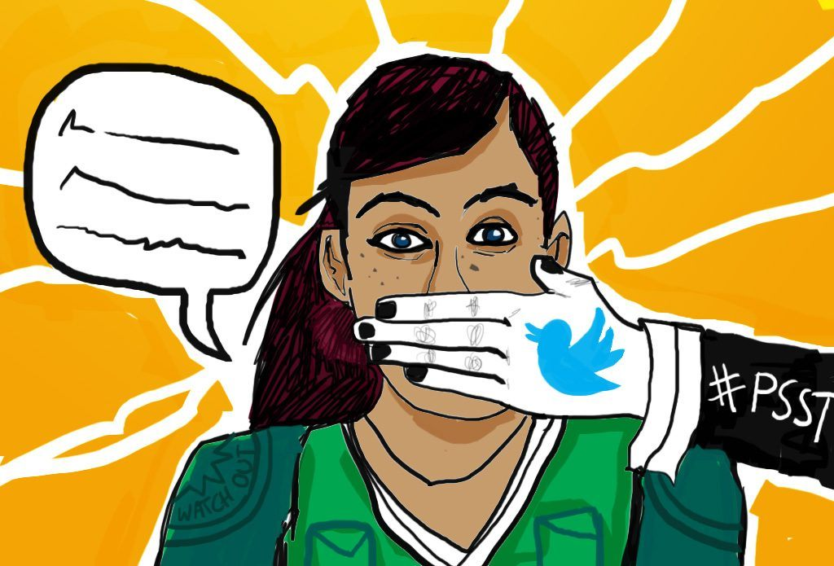
Competing Pressures
Companies face competing pressures to remove content in order to make platforms safer and to protect free expression.
Notes:
Companies are increasingly facing pressure to remove content, including hate speech and terror content in order to make their platforms safer. However, they also have a commitment to protect free expression. These tensions regularly come to head in cases like when minority communities push platforms to take down hate speech or abusive content but platforms in trying to comply with them are also attempting to uphold and not impinge on these communities’ and other communities’ free expression.
Image links: https://businessesgrow.com/2018/01/31/why-you-should-worry-about-europes-new-hate-speech-laws/

Slide 8
Terms of Service
Defining standards of acceptability for content on a platform
Restricts speech beyond what frameworks/laws do
Concerns about overbroad censorship and infringing on free expression
Push for greater transparency around content standards and guidelines
Notes:
As noted previously, companies can also remove content on their platforms based on their own content policies, which define standards of acceptability on their platforms. Typically, these policies restrict speech far beyond what speech related laws do. For example, in the United States, companies’ Terms of Service can restrict speech that the First Amendment cannot legally restrict. The expansion and development of more comprehensive Terms of Service speech restrictions raise several free expression concerns. Company content policies are continuously evolving, mostly in response to emerging forms of controversial speech. Today, for example, we are seeing more and more companies take stances and institute policies in response to hate speech, terror content, graphic violence and fake news. Because these removals do not occur on the basis of legal frameworks, there is often significant controversy around these policies, and overbroad and strict policies are often criticized for curbing free expression and limiting free speech. As a result, companies have faced greater pressure to provide transparency around their content policies and content moderation processes.

Slide 9
Terms of Service Based Removals
Facebook’s Dangerous Goods & Individuals Policy: In an effort to prevent and disrupt real-world harm, we do not allow any organizations or individuals that are engaged in the following to have a presence on Facebook:
Terrorist activity
Organized hate
Mass or serial murder
Human trafficking
Organized violence or criminal activity
We also remove content that expresses support or praise for groups, leaders, or individuals involved in these activities.
Notes:
Here is an example of how Facebook has responded to these calls. In May, they released a detailed set of their Community Standards which outline what content is and isn’t permissible on their platform, and how Facebook moderators typically think about these situations. Their “Dangerous Individuals and Organizations” section outlines that they do not allow any organizations or individuals that are engaged in the following activities to have a presence on Facebook: terrorist activity, organized hate, mass or serial murder, human trafficking and organized violence or criminal activity. They also remove content that expresses support or praise for these groups and their leaders and members.

Slide 10
Stages of Moderation
1. Before content is published
2. After content has been flagged for moderation
3. Active assessment of content on the platform
Notes:
Companies can remove content at three stages: 1) before it is published, 2) after it has been flagged for moderation and 3) actively assessing content on the platform for removal. There are significant free expression concerns when companies attempt to remove content before it is published as this typically signals that they are attempting to act as speech gatekeepers and curb expression. One of the only categories of content that is internationally recognized as illegal and therefore can be acceptably moderated in the pre-publication stage is child pornography and child sexual abuse images. This content is identified online by expert organizations and using the algorithmic PhotoDNA technology is converted into digital hashes. These hashes can be used to identify copies of such child pornography content on platforms and remove them after they have been uploaded, or when they are still in the upload process. The pre publication takedown of this content in this case is permissible because the content is universally considered to be illegal, and is easily identified as fitting this category. However, given that other forms of content, even terror content and fake news lie within a grey zone of acceptability and permissibility, pre-publication takedowns are considered a major free expression concern. Pre- publication takedown technology has also been applied to copyrighted content. Companies can receive flags to moderate content from a range of actors including governments and users. Many companies like YouTube have Trusted Flaggers programs in which organizations and individuals who have a high accuracy rate of flags for particular types of content, such as content that violates a company’s graphic violence or hate speech policies, are permitted to flag content to moderators in bulk, and this content receives priority review. Some governments in the EU have also set up Internet Referral Units to flag terror content to companies to remove. Companies can also actively assess content on their platforms using trained algorithmic models in order to identify and review content that violates laws (especially when there are fines and legal consequences involved) and their own content policies. However, this technology has not yet been perfected and as a result companies are always pushed to incorporate human reviewers in order to ensure content that is permissible on the platform is not mistakenly being removed. We will talk more about the limits of AI in content moderation later on in this webinar.

Slide 11
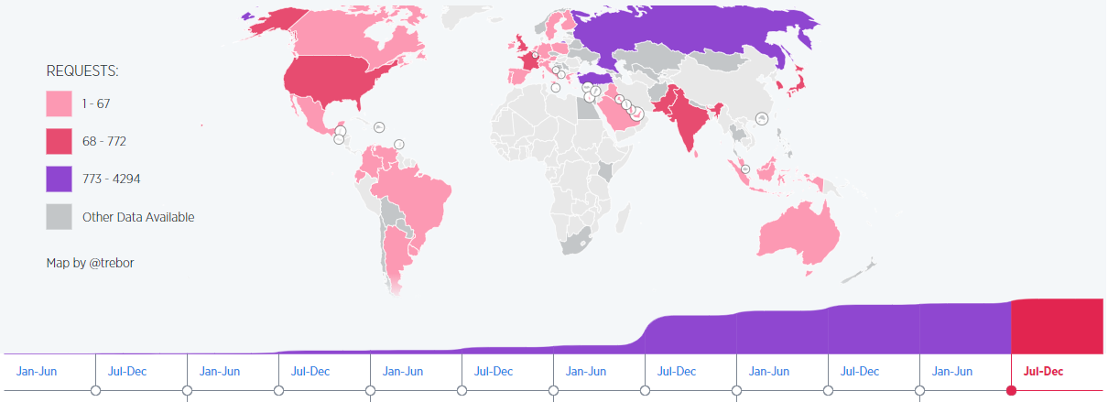
The Need for Transparency
Notes:
Companies are receiving an increasing number of requests to moderate and remove content, as demonstrated by this map image from Twitter’s latest transparency report. This poses significant concerns regarding free expression safeguards, especially when there is little transparency around the policies and practices companies use to guide their moderation decisions, the scope of requests for moderation companies are receiving and the volume of content being removed. As a result, companies have come under pressure to disclose data related to their content removals in their transparency reports.

Slide 12
The Need for Transparency
Notes:
This is a snapshot from Google’s latest transparency report on content takedowns, which also highlights the range of categories of content that are being targeted, and how they have become increasingly prominent in the discussion on content moderation.
OTI recently released a Transparency Toolkit which surveyed international and domestic technology and telecommunications companies and found that 35 prominent companies were reporting on content removals in their transparency reports. However, there was little standardization in how and what companies were reporting, and little granular information was provided, particularly related to Terms of Service based removals and the use automation. If you’d like to take a closer look at the report, we have included it in the Supplementary Materials section.

Slide 13
Best Practice Models for Free Expression
Santa Clara Principles on Transparency and Accountability in Content Moderation
Transparency Reporting Toolkit for Content Takedowns
Ranking Digital Rights’ Corporate Accountability Index
Electronic Frontier Foundation’s Who’s Got Your Back
Notes:
Currently, there are a number of resources that offer best practices for promoting and protecting free expression online. These include the Santa Clara Principles on Transparency and Accountability in Content Moderation, which were launched in May 2018 and outline minimum standards tech platforms must meet in order to provide adequate transparency and accountability around their efforts to take down user generated content or suspend accounts that violate their rules in order to ensure meaningful due process and that the enforcement of their content guidelines is fair, unbiased and respectful of users’ free expression. The Principles urge companies to disclose further data around numbers, notice and appeals. OTI also recently released a Transparency Toolkit which surveyed international and domestic technology and telecommunications companies and found that 35 prominent companies were reporting on content removals in their transparency reports. However, there was little standardization in how and what companies were reporting, and little granular information was provided, particularly related to Terms of Service based removals and the use automation. The Toolkit also offers a set of best practices for reporting on content takedowns. Furthermore, Ranking Digital Rights’ Corporate Accountability Index has a Freedom of Expression category which seeks evidence that companies demonstrate a strong public commitment to transparency not only in terms of how they respond to government and others’ demands, but also how they determine, communicate, and enforce private rules and commercial practices that affect users’ freedom of expression. The Electronic Frontier Foundation also recently released a new edition of its Who’s Got Your Back, which focuses on censorship free expression for the first time. If you’d like to take a closer look at these resources, we have included them in the Supplementary Materials section as well as other related resources from organizations such as the ACLU, BSR and the United Nations.

Slide 14
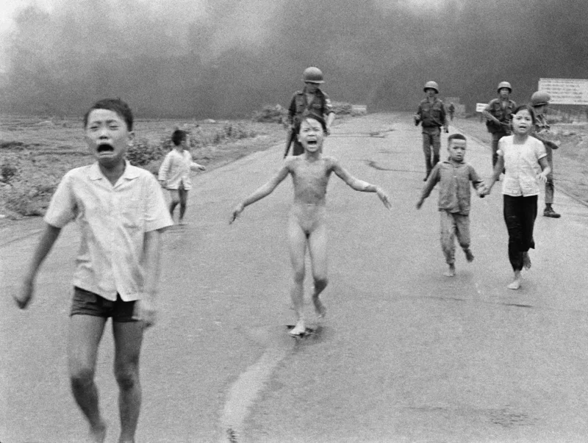
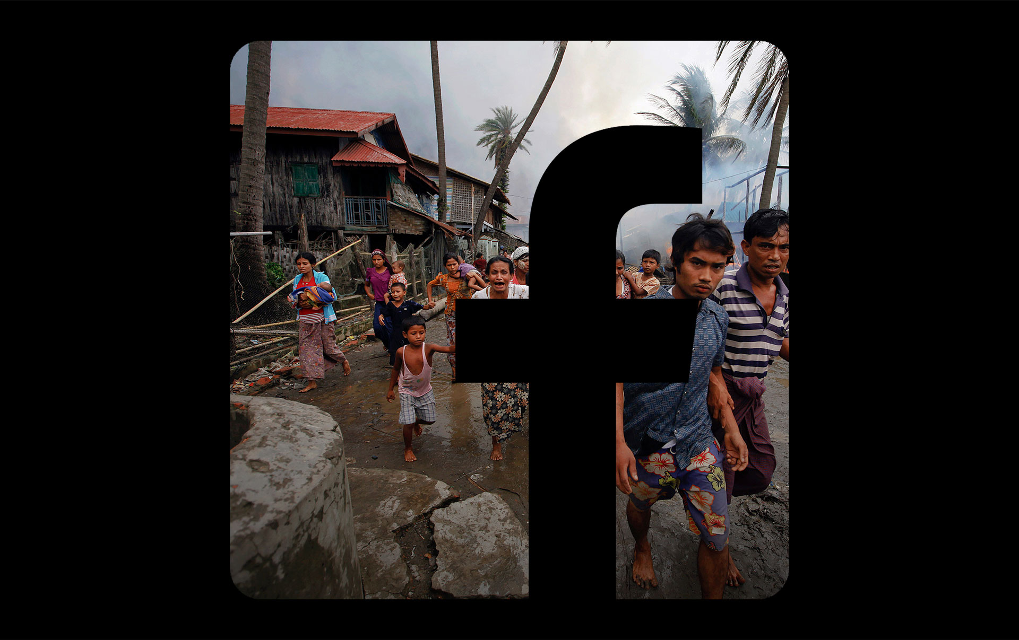
Emerging Technologies and Free Expression
Notes:
As emerging technologies develop they are increasingly being applied to the management of online free expression. Artificial intelligence is the best example of this. As we previously discussed, many platforms deploy AI systems in order to identify and regulate content at scale. This occurs at various stages of moderation including pre-publication moderation and during active assessment of content on the platform. AI systems vary in their ability to identify violating content. For example, some models are better trained and more accurate when identifying child sexual abuse materials on the platform. However, the models are not as reliable when identifying instances of hate speech, for example. In addition, AI tools have resulted in some contentious takedowns. For example, some images such as the famous Vietnam War image of the little girl which carry historical value and weight have been removed by models for violating the nudity policy. In addition, human rights groups who repost images of terrorist atrocities have had their content taken down for violating the policy on terror content, despite their intent being the opposite. This happened for example in Myanmar, where Rohingya activists had their content removed and accounts shut down. As a result, companies are continuously pushed to consistently involve human moderators in all content decision making practices as these human moderators can add cultural context and understanding and prevent such mistakes and such instances of curtailed free expression, from taking place.
Links: http://fortune.com/2016/09/09/facebook-napalm-photo-vietnam-war/
https://www.reuters.com/investigates/special-report/myanmar-facebook-hate/

Slide 15
Conclusion
Notes:
In conclusion, as platforms centered on user-generated content have proliferated and been adopted across the globe, they have become essential to global public conversations. However, in an attempt to ensure their platforms remain safe, major technology companies have developed regulations around permissible content. These often infringe on the right to free expression, however, and as a result companies have been pressed for greater transparency on these decision making processes, especially as automated systems are further deployed. These platforms are in effect privately managing our speech, and this accountability is vital.
Image link: https://www.swissinfo.ch/eng/business/free-speech-or-hate-speech-_the-legal-difficulties-of-online-expression-in-switzerland/43603342
http://www.globaleducates.com/blog/online-censorship-in-india/

