Slide 1
Business and Human Rights in the Digital Environment
Module 1: Introduction to business and human rights (BHR) in the digital environment
Global Partners Digital
Notes:
Introduction and Objective:
Hi there! Thank you for joining us today. We are xx and xx from Global Partners Digital and today we will be looking at the field of business and human rights both broadly, and specifically in the digital environment.
Our hope is that by the end of this module, everyone will have a solid understanding of the core concepts, terminology and principles in the field of business and human rights, as well as their particular application to the digital environment.

Slide 2
Agenda
1. Recap from webinars 2. Main developments in the BHR field 3. Application of the BHR framework to the digital environment 4. Key current issues - Mapping
Photo by Daniel Chen on Unsplash
Notes:
2. Agenda:
I’m just going to quickly explain the structure of this module. It comprises three parts.
In the first section, we will briefly recap the webinars with a true or false exercise that will guide you through some of the most important issues examined and – hopefully – learnt during the webinars.
In the second section, we will take a detailed look at the historical developments at the UN when it comes to business and human rights, and key actors.
In the third section, will look at the key issues on business and human rights when it comes to the digital environment and particularly some of the developments that have occurred in the last few years in the field.
At the end, we will do a very brief exercise to get a better sense of which are the most relevant issues in your national context.

Slide 3
I. Recap from Webinars
True or False Go to menti.com - code: 12 80 53
Notes:
3. Recap from webinars (True or False):
So let’s start by reviewing some of the topics addressed during the two first webinars!
We will do so through a true or false exercise using Mentimeter.

Slide 4
1. States and businesses have the same duties and responsibilities with regard to human rights.
Photo by Joshua Earle on Unsplash
Notes:
Statement: States and businesses have the same duties and responsibilities with regard to human rights.

Slide 5
1. States and businesses have the same duties and responsibilities with regard to human rights.
False Under the UN Guiding Principles states have a duty to protect and businesses have a responsibility to respect human rights.
Photo by Joshua Earle on Unsplash
Notes:
False: States have a duty to protect, respect and fulfil human rights. These are established duties under international human rights law. Businesses do not have direct legal obligations under international human rights law. However, businesses do have a responsibility to respect human rights. This is a global norm of expected conduct outlined in the UN Guiding Principles.
Additional material: what are the sources of international human rights law?
The foundation of modern international human rights law is a document called the Universal Declaration of Human Rights (UDHR) which was adopted by the UN General Assembly in 1948. This was the first ever internationally agreed document setting out the fundamental human rights of all people. The UDHR is not a treaty and so is not binding on states as a matter of international law. However, a number of international human rights treaties developed since the UDHR (for example, the International Covenant on Civil and Political Rights (ICCPR), adopted in 1966) are binding on those states which have ratified them. In addition, many regional organisations have adopted their own human rights treaties, such as the European Convention on Human Rights, the American Declaration of the Rights and Duties of Man, and the African Charter on Human and People’s Rights.

Slide 6
2. The UN Guiding Principles don't require states to regulate the extraterritorial activities of businesses that are domiciled in their territory and/or jurisdiction
Photo by LYCS LYCS on Unsplash
Notes:
Statement: The UN Guiding Principles don't require states to regulate the extraterritorial activities of businesses that are domiciled in their territory and/or jurisdiction.

Slide 7
2. The UN Guiding Principles don't require states to regulate the extraterritorial activities of businesses that are domiciled in their territory and/or jurisdiction
True: The UN Guiding Principles take the position that states are not generally required to regulate the extraterritorial activities of businesses domiciled in their territory and/or jurisdiction.
Photo by LYCS LYCS on Unsplash
Notes:
7. True: The UN Guiding Principles take the position that states are not generally required to regulate the extraterritorial activities of businesses domiciled in their territory and/or jurisdiction. However, it is also recognised that that states are not generally prohibited from doing so, providing that there is a recognised jurisdictional basis. The UN Guiding Principles recognise that there may be strong policy reasons for states to be clear about the expectations of businesses abroad.
Additional material:
What is extraterritoriality?
The applicability or exercise of state laws outside its territory.
What is corporate domicile?
Corporate domicile is a place where a company's principal affairs of business are maintained.
What is jurisdiction?
The territory or sphere of activity over which the legal authority of a court or other institution extends.

Slide 8
3. The corporate responsibility to respect human rights is a legal duty under international human rights law that obliges businesses to implement human rights due diligence.
Photo by Samantha Sophia on Unsplash
Notes:
Statement: The corporate responsibility to respect is a legal duty under international human rights law that obliges businesses to implement human rights due diligence.

Slide 9
3. The corporate responsibility to respect human rights is a legal duty under international human rights law that obliges businesses to implement human rights due diligence.
False: The corporate responsibility to respect requires businesses to avoid infringing on human rights and to address any adverse human rights impacts with which they are involved. Businesses are not required to take steps to ensure the fulfilment of human rights; this is a state duty.
Photo by Samantha Sophia on Unsplash
Notes:
9. False:
The corporate responsibility to respect requires businesses to avoid infringing on human rights and to address any adverse human rights impacts with which they are involved. Businesses are not required to take steps to ensure the fulfilment of human rights; this is a state duty. Businesses may choose to take steps to contribute to the fulfilment of human rights on a voluntary basis, but they are not required to do so as part of the corporate responsibility to respect.

Slide 10
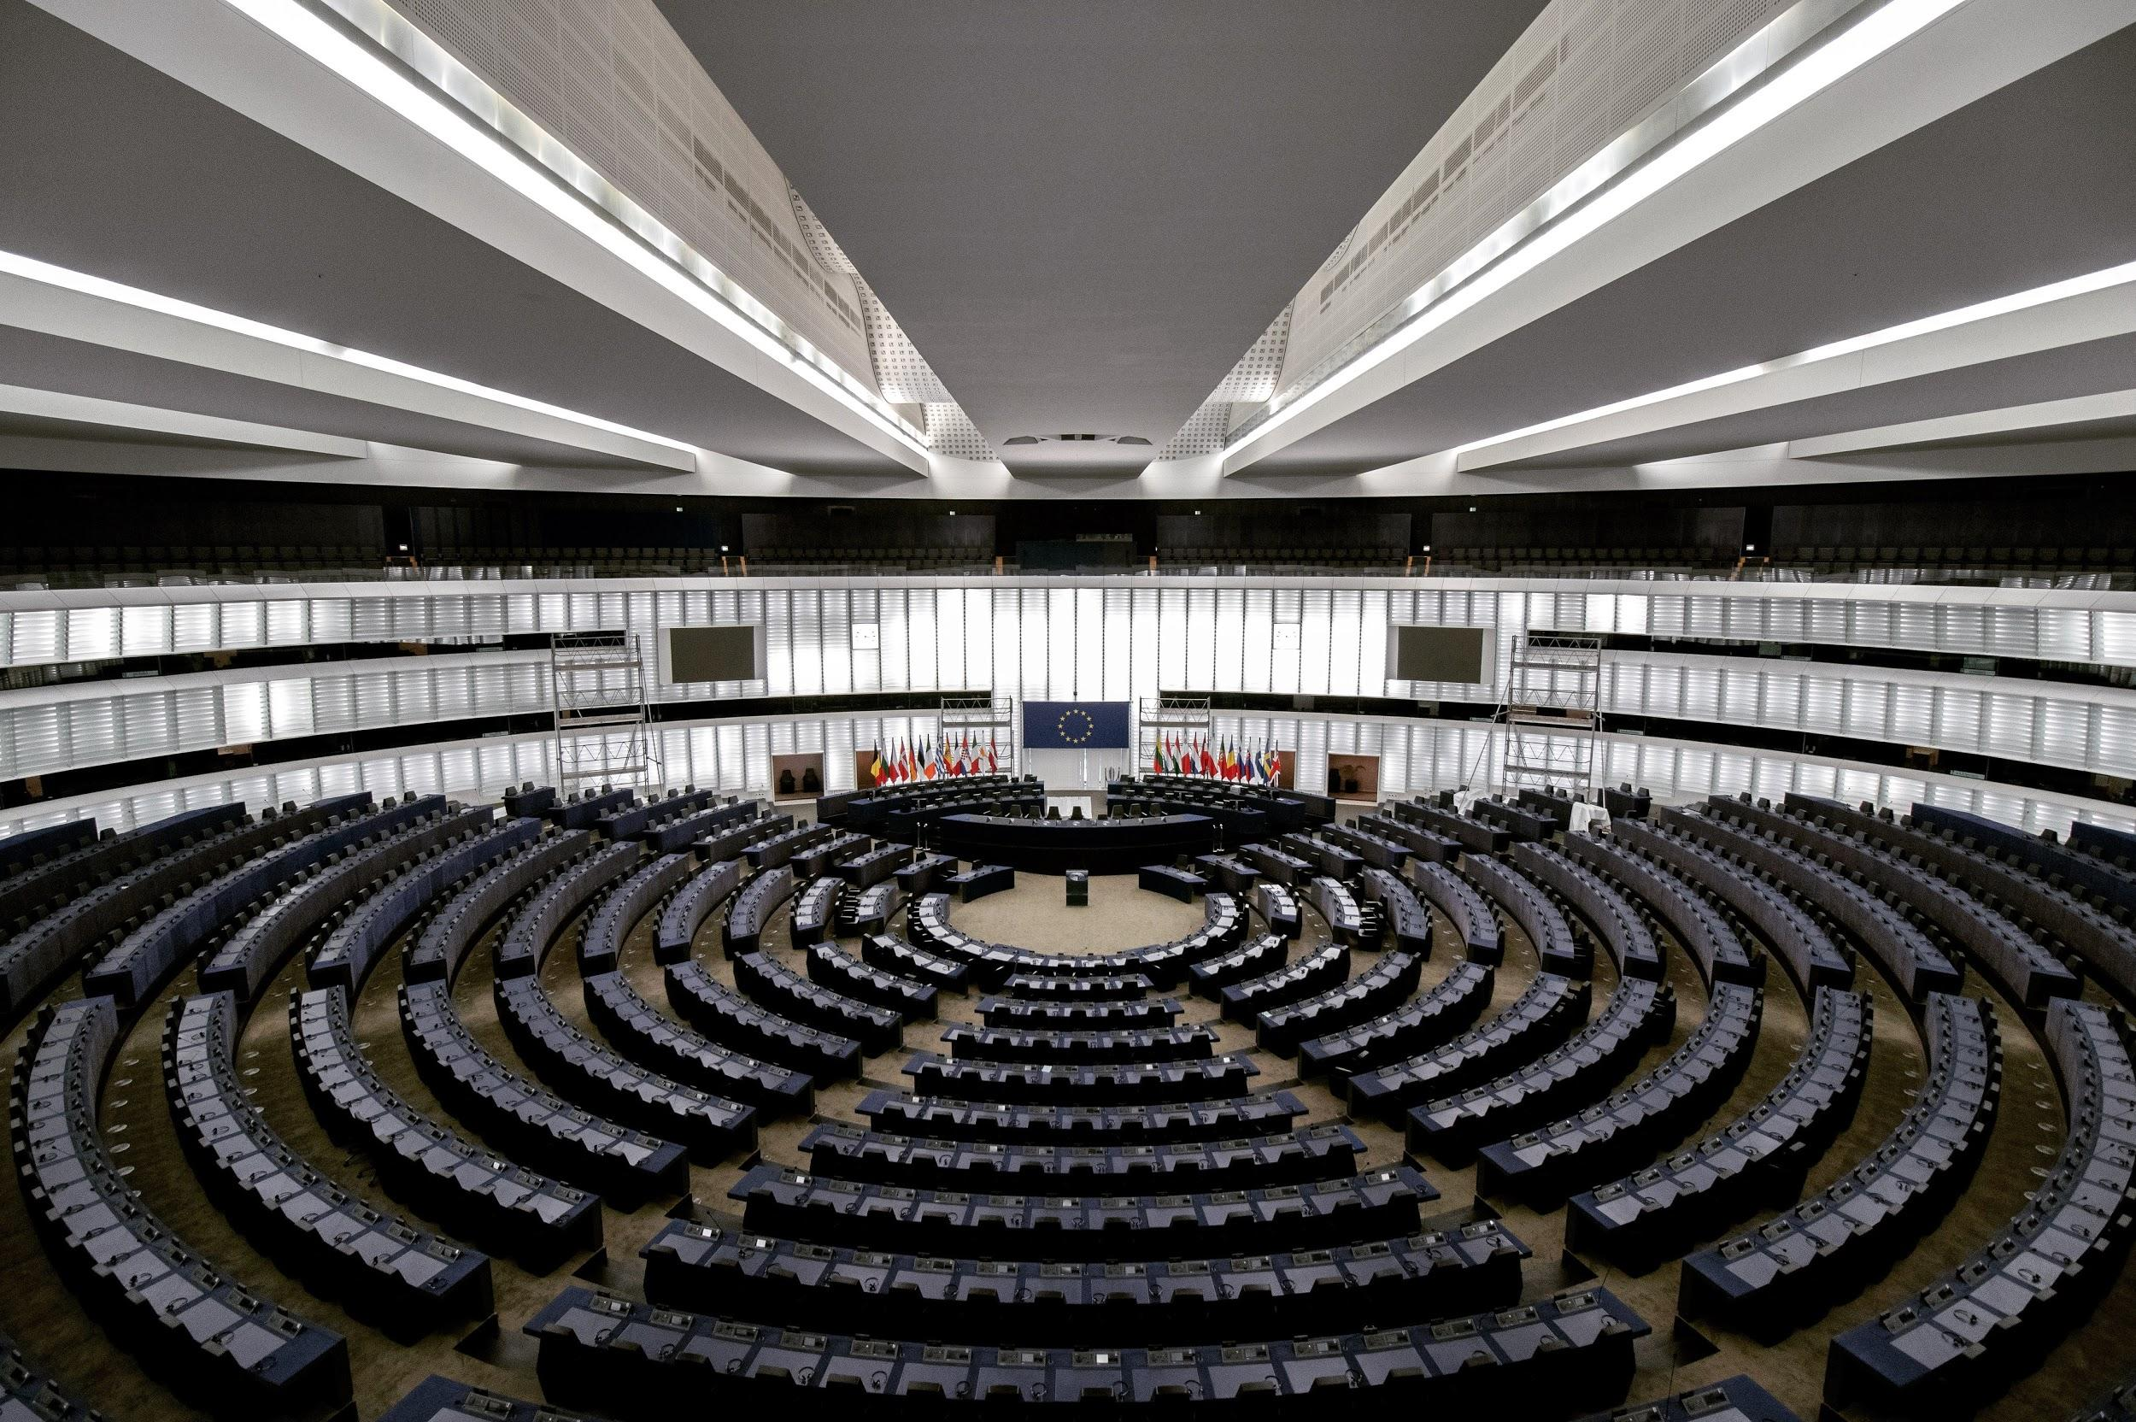
4. The UN Guiding Principles consider judicial and non-judicial grievance mechanisms to be of equal importance.
Photo by Frederic Köberl on Unsplash
Notes:
Statement: The UN Guiding Principles consider judicial and non-judicial grievance mechanisms to be of equal importance.

Slide 11
4. The UN Guiding Principles consider judicial and non-judicial grievance mechanisms to be of equal importance.
False: The UN Guiding Principles state clearly that effective judicial mechanisms must sit at the core of ensuring access to effective remedy for business-related human rights abuses, with non-judicial mechanisms playing a complementary and supporting role.
Photo by Frederic Köberl on Unsplash
Notes:
False:
The UN Guiding Principles state clearly that effective judicial mechanisms must sit at the core of ensuring access to effective remedy for business-related human rights abuses, with non-judicial mechanisms playing a complementary and supporting role.

Slide 12
II. Business and Human Rights: Main Developments, Debates and Actors
Notes:
Historically, it was argued by some that human rights standards were only applicable to states and not the private sector. Some companies claimed that their sole obligation was to respect national laws, even where those laws failed to meet international human rights standards.
Although the primary duty to protect human rights remains with states, companies are now considered to have a responsibility to respect human rights in their operations.
But how did recognition of such a responsibility develop? We will now look at a brief history of the main developments in the field of business and human rights.

Slide 13
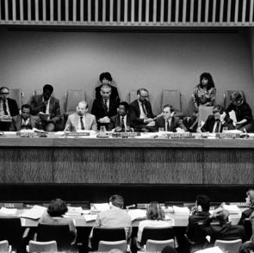
Commission on Transnational Corporations
Mandate:
Research the impacts of transnational business activity and develop draft normative frameworks for transnational business activities.
Main developments: 1986: Draft Code of Conduct on Transnational Corporations. 1983 and 1990: Debates on the Code of Conduct.
1994: Processes dismantled.
Commission Session 1988
Photo of the Commission session, 06 April 1988 United Nations, New York.
Notes:
The UN’s involvement in the question of the relationship between private enterprise and human rights began in the 1970s, with the establishment of the UN Commission on Transnational Corporations and the UN Centre for Transnational Corporations (UNCTC).
This was a response to public frustration with the inadequacy of a purely state-centric approach to human rights accountability.
These bodies’ mandate were:
researching the impacts of transnational business activity,
strengthening the ability of host countries to negotiate terms with these enterprises, and
developing draft normative frameworks for transnational business activities.
Additional material:
What is a normative framework?
A normative framework on international law refers to both binding international law as well as non-legally binding best practices and principles.
1986: The work of the Commission led to a draft Code of Conduct on Transnational Corporations,
The Code of Conduct was debated in a series of special sessions between 1983 and 1990.
Due to significant opposition to the Code, particularly by host states of transnational corporations based in the Global North, it was abandoned in 1994, and the UNCTC was dismantled.
Additional Material: What did the Code of Conduct say?
The Code of Conduct was never adopted but attempted to provide either mandatory requirements or voluntary guidelines for transnational corporations (TNCs) to follow, by encouraging contribution to the development goals and objectives of the countries in which they operated. The Code also attempted to facilitate co-operation with and among States on issues relating to TNCs; and to alleviate difficulties derived from the international character of such corporations and the resulting diversity of laws and cultures.

Slide 14
Global Compact
2000: UN Global Compact. The Global Compact established ten non-binding principles to guide businesses in the development of socially and environmentally sustainable practices. Good reception by companies. Criticisms: Non-binding nature of the principles.
Notes:
Under the leadership of Kofi Annan, the UN embarked on a new effort to address issues with regard to the corporate sector, leading to the eventual development of the UN Global Compact in 2000.
The Global Compact established ten non-binding principles to guide businesses in the development of socially and environmentally sustainable practices.
Many human rights advocates opposed the voluntary nature of the Global Compact, arguing that binding regulation was necessary to stem harmful corporate activity. The Global Compact, however, was relatively well received by the business community, and a significant number of companies joined the voluntary initiative.

Slide 15
UN Draft Norms
Early 2000s aim develop a set of Norms on the Responsibilities of Transnational Corporations and Other Business Enterprises with Regard to Human Rights (UN Draft Norms). First UN attempt to identify human rights legal standards that would apply to corporations. The UN Commission on Human Rights resolution refused to grant the norms legal status.
UN Draft Norms
Notes:
In light of the critiques of voluntary initiatives in dealing with corporate accountability for human rights violations, the UN Sub-Commission on the Promotion and ﻿Protection of Human Rights began in the early 2000s to develop a set of Norms on the Responsibilities of Transnational Corporations and Other Business Enterprises with Regard to Human Rights (UN Draft Norms).
As the product of an expert group, the UN Draft Norms did not have a directly binding effect, but they represented the first UN attempt to identify legal human rights standards that would apply to corporations.
The UN Draft Norms were scuttled through a UN Commission on Human Rights resolution, but it refused to grant the norms legal status and mandated the Sub-Commission to abstain from performing monitoring functions with respect to the Norms.
Additional material: What was the Sub-Commission on the Promotion and Protection of Human Rights?
The United Nations Sub-Commission on the Promotion and Protection of Human Rights was the main subsidiary body of the former Commission on Human Rights. It was established in 1947 with 12 members. Originally the 'Sub Commission on Prevention of Discrimination and Protection of Minorities', it was renamed in 1999.
Under General Assembly resolution 60/251 of 15 March 2006 which established the Human Rights Council, all mandates, mechanisms, functions and responsibilities of the Commission on Human Rights, including the Sub-Commission on the Promotion and Protection of Human Rights, were assumed, as of 19 June 2006, by the Human Rights Council.
The Sub-Commission on the Promotion and Protection of Human Rights was replaced by the Human Rights Council Advisory Committee that has been established to function as a thinktank for the Council and work at its direction.

Slide 16
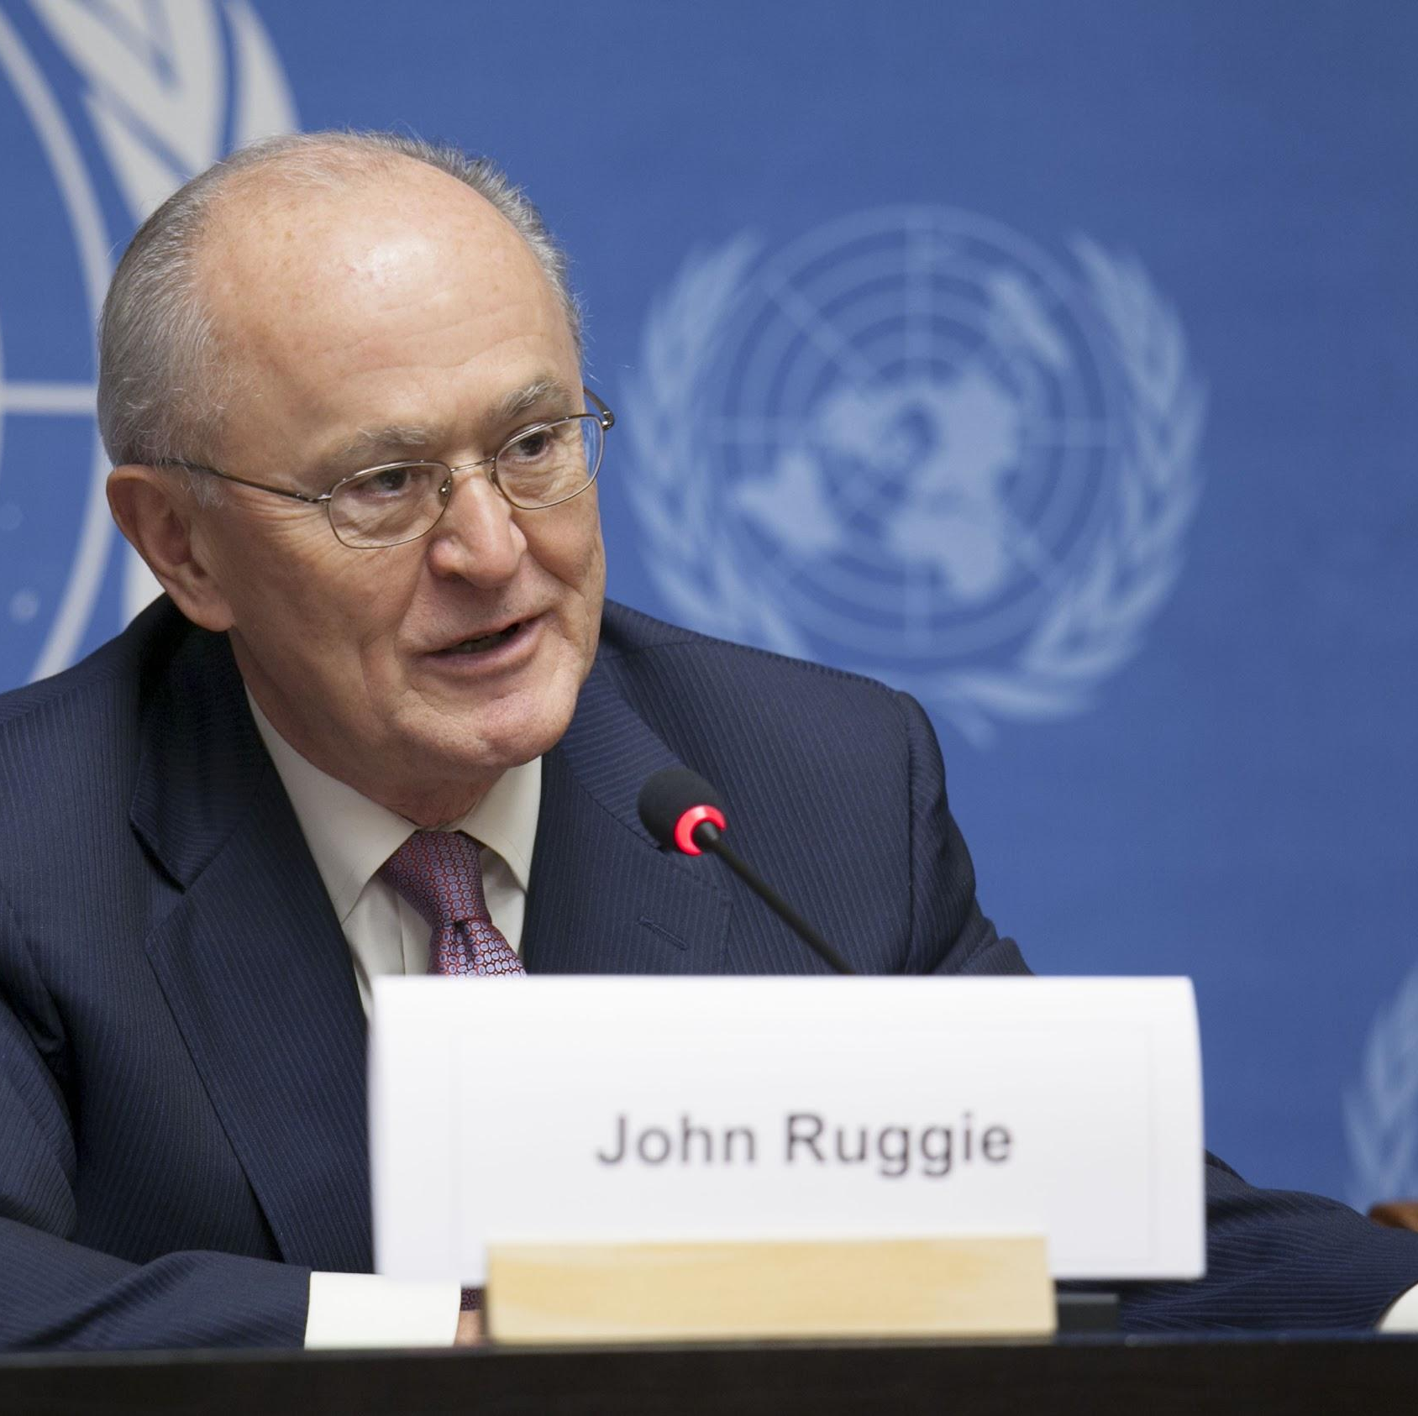
Special Representative on Business and Human Rights
2005: UN Human Rights Council appointed John Ruggie as Special Representative on Business and Human Rights. Limited mandate: identification and clarification of standards of corporate accountability with respect to human rights and the identification of state and corporate best practices.
Notes:
In light of the failure of the Norms, the Commission on Human Rights requested the UN Secretary-General to appoint a special representative on the subject.
In 2005, Kofi Annan appointed John G. Ruggie – who had formerly worked for Annan as chief adviser for strategic planning, and had been involved in the development of the Global Compact – as Special Representative on Business and Human Rights ﻿(SRSG).
﻿The initial mandate of the Special Representative was relatively limited in scope, and focused largely on the identification and clarification of standards of corporate accountability with respect to human rights and the identification of state and corporate best practices.
Unlike other UN special procedures, the SRSG’s mandate did not include country visits or the examination of specific situations of human rights issues related to business.

Slide 17
Special Representative on Business and Human Rights
First three years: protect, respect and remedy framework. Consultations with governments, businesses, and civil society groups. Extension of the mandate to operationalise the protect, respect and remedy framework.
Notes:
Ruggie culminated his first three-year mandate with the development of the Protect, Respect, and Remedy Framework, which set out a state duty to protect against human rights abuses, a corporate responsibility to respect human rights, and victims’ need for greater access to judicial and non-judicial remedies.
﻿The Special Representative developed the framework, in part, through consultations with governments, businesses, and civil society organisations over the course of his mandate.
The mandate was extended for another three years, and expanded with the idea that the Special Representative would “operationalise” the Protect, Respect, Remedy Framework through concrete guidelines for both states and businesses.
John Ruggie used the extension of his mandate to develop what are now known as the UN Guiding Principles on Business and Human Rights.
They are a set of non-binding standards based on the PRR Framework that the UN Human Rights Council endorsed in 2011.
While civil society had partially welcomed the PRR Framework, as it dealt directly with some of the issues human rights advocates had previously highlighted, the UNGPs became the subject of significant debate.

Slide 18
Business and Human Rights (UN)
UN Commission on Transnational Corporations and UN Centre for Transnational Corporations (UNCTC)
The draft was finally abandoned and the UNCTC was dismantled
John Ruggie appointed as Special Representative on Business and Human Rights
1983-1990s
2000
2011
1970s
1994
2005
Discussion of the draft Code of Conduct on Transnational Corporations
UN Global Compact (10 Principles) &
Norms on the Responsibilities of Transnational Corporations and Other Business Enterprises with Regard to Human Rights (UN Draft Norms)
UN Guiding Principles on Business and Human Rights & Working Group on Business and Human Rights
Notes:
Before discussing the UN Guiding Principles on Business and Human Rights, it may be good to recap the main developments in the business and human rights field so far.
Since 1970, the UN have tried to develop standards of human rights which apply to the activities of businesses.
Most of these developments have been criticised either by governments, companies or civil society.
The latest developments are the UN Guiding Principles on Business and Human Rights.

Slide 19
UN Guiding Principles on BHR
PROTECT
State duty to protect against human rights abuses by third actors, including businesses
Policies, laws & regulations
.
RESPECT
Companies’ responsibility to respect human rights. Apply to all HR, all sectors and all sizes.
HRIAs, due diligence & grievance
REMEDIES
Access to remedy in case of a human rights violation secured by state and non-state actors
Judicial & non-judicial mechanisms
Icons from SlidesCarnival
Notes:
The UNGPs rest on three pillars:
The state duty to protect against human rights abuses by third parties, including business, through appropriate policies, regulation, and adjudication;
﻿An independent corporate responsibility to respect human rights, which means that business enterprises should act with due diligence to avoid infringing on the rights of others and to address adverse impacts with which they are involved;
Greater access by victims to effective remedy, judicial and nonjudicial.
﻿
Through the workshop we will go into more detail about each of these pillars. At this point it is important to understand that:
The UNGPs are comprised of thirty one principles, each with commentary elaborating its meaning and implications for law, policy, and practice.
They encompass all internationally recognised rights, and apply to all states and all business enterprises.
They do not, by themselves, create new legally binding obligations for business but derive their normative force through the recognition of social expectations by states and other key actors, including business itself. Elements of them have, though, already been incorporated into binding regulations and national laws.

Slide 20
Main criticisms:
1. Voluntary nature 2. Lack of implementation 3. Impunity
Photo by Isaiah Rustad on Unsplash
Notes:
At this point, it might be useful also to consider the main critiques to the UN Guiding Principles on Business and Human Rights.
Voluntary: The voluntary nature of the UNGPs has been a lightning rod of criticism for many of the civil society organisations and NGOs that have been demanding and pushing for a binding treaty process.
Lack of implementation: Civil society organisations and some states allege a lack of implementation of existing norms and express the fear that the Guiding Principles enable impunity, or at least do little to change the current state of implementation of human rights norms.
﻿Impunity: Communities’ interventions on the international stage regularly remark on impunity, lack of access to justice and the implementation gap between state obligations under international norms and the realities on the ground. ﻿A simplified version of the assumptions is that binding instruments are part of hard law and carry legal consequences for their breach, while non-binding instruments are ’soft law’ and they do not.

Slide 21
Main developments so far:
23 NAPs
.
Almost 400 companies aligned their policies to UNGPs
Non-judicial grievance mechanisms
Icons from SlidesCarnival
Notes:
As will be further developed throughout the workshop, there have been important developments that build from the UNGPs, for example:
21 states have developed National Action Plans on Business and Human Rights and other 21 are in the process of creating one.
Approximately 400 leading companies have aligned their policies and practices with Principle 16 of the UNGPs which states that ‘As the basis for embedding their responsibility to respect human rights, business enterprises should express their commitment to meet this responsibility through a statement of policy’.
There are some initiatives that create special remedies mechanisms such as:
OECD ﻿Guidelines for Multinational Enterprises were made consistent with the UNGPs through National Contact Points
International Finance Corporation
Additional Material: Binding Treaty
﻿In the middle of these developments, in September 2013, Ecuador proposed that the UN Human Rights Council establish an intergovernmental working group to negotiate a binding instrument, and some 600 NGOs formed a “treaty alliance” to support it.
﻿Ecuador called for the establishment of an open-ended intergovernmental working group within the Human Rights Council, “the mandate of which shall be to elaborate an international legally binding instrument to regulate, in international human rights law, the activities of transnational corporations and other business enterprises.”
﻿In addition to Ecuador, the resolution was cosponsored by Bolivia, Cuba, South Africa, and Venezuela. The vote in the Council was twenty in favour, fourteen against, with thirteen abstentions. A majority of African members voted for it, as did China, India, and Russia. Apart than the sponsors, all other Latin American countries, abstained.
The European Union and the United States voted against the resolution, which they thought counter-productive and polarising; both stated that they would not participate in the treaty negotiating process. Japan and South Korea also voted against it.
The question at this point is if this latest attempt to impose binding international law obligations on transnational corporations will repeat the same historical problems that we have already observed or if it will add something new to the discussions.
﻿
Additional material: Debate Binding Treaty - Main considerations
There are a series of questions that can help to frame the discussions on the binding treaty.
Do you think is the right geo-political moment to discuss a binding treaty? The discussion acknowledges the fact that there’s a fragmentation of global governance regimes, and the likelihood that this trend will continue to mark international regulatory fields, including business and human rights. This is reinforced by ﻿the diversity of legal subjects, and the blurring lines of geopolitical interest between countries in the Global North and emerging powers in the Global South.
Is it necessary to have a hard law approach to business and human rights? In reality, ﻿the distance between soft and hard law is much less clear than the analytical distinction would suggest, as courts, governments, rights-holders, corporations and civil society organisations invoke soft and hard regulations oftentimes interchangeably. ﻿To cite just one recent illustration within the BHR field, in November 2015, the Inter-American Court of Human Rights drew on the UNGPs in the Kaliña and Lokono Peoples v. Suriname judgment.
﻿Should the treaty discussion build from UNGPs or not? Any ongoing efforts to negotiate a binding treaty should be non-regressive vis-a-vis existing international human rights norms (which include not only the ones recognised by the UNGPs, but all the core human rights treaties).
Does a binding treaty help to fight against impunity? ﻿There is some evidence suggesting that the binding nature of a human rights instrument does not necessarily increase the likelihood of implementation. There is evidence that suggests that alternative, however. ﻿Christopher Fariss, found a positive correlation between ratification and improved human rights conditions.
Additional material: What’s the difference between hard and soft Law?
The term soft law is used to denote agreements, principles and declarations that are not legally binding, but which may be persuasive. Soft law instruments are predominantly found in the international sphere. UN General Assembly resolutions are an example of soft law. Hard law refers generally - but not necessarily - to legal obligations that are binding on the parties involved.
Additional material: What does non-regression means?
The principle of non-regression is an international law principle known by human rights specialists requiring that norms which have already been adopted by states should not be revised, if this implies going backwards on the subject of standards of protection of collective and individual rights.

Slide 22
Business and Human Rights (UN)
NAPs Denmark & Finland Binding Treaty: Creation of the intergovernmental working group on transnational corporations and other business enterprises with respect to human rights
EU Commission call on governments to adopt National Action Plans
NAPs Switzerland, Italy, Norway and USA
2013
2015
2017
2011
2014
2016
NAPs UK & Netherlands
NAPs Lithuania, Sweden, Norway & Colombia
NAPs France, Poland, Spain, Belgium, Chile, Czech Republic & Ireland
Notes:
Historically, some argued that human rights standards were only applicable to states and not the private sector. Some companies claimed that their sole obligation was to respect national laws, even where those laws failed to meet international human rights standards.
The UN’s involvement in the question of the relationship between private enterprise and human rights began in the 1970s, with the establishment of the UN Commission on Transnational Corporations and the UN Centre for Transnational Corporations (UNCTC).
John Ruggie used the extension of his mandate to develop what are now known as the UN Guiding Principles on Business and Human Rights. They are a set of non-binding standards based on the PRR Framework that the UN Human Rights Council endorsed in 2011.
From then on, a series of developments have occurred in the BHR field.

Slide 23
International Actors
Human Rights Council
Working Group on Business and Human Rights
Open-ended intergovernmental working group on transnational corporations and other business enterprises with respect to human rights
Other special mechanisms
Civil society organisations
Businesses
Global Alliance for Human Rights Institutions
Photo by Jason Leung on Unsplash
Notes:
UN Human Rights Council (UNHRC): The United Nations Human Rights Council is a United Nations body whose mission is to promote and protect human rights around the world. The UNHRC has 47 members elected for staggered three-year terms on a regional group basis.
UN Working Group on Business and Human Rights: A five-person expert group, one from each of the geographic regions recognised within the UN, whose job it was to promote the UNGPs and facilitate their implementation.
Open-ended intergovernmental working group on transnational corporations and other business enterprises with respect to human rights: This working group has a mandate "to elaborate an international legally binding instrument on transnational corporations and other business enterprises with respect to human rights."
Other special mechanisms: Other working groups and Special Rapporteurs have also worked on issues related to business and human rights, such as the Special Rapporteur on Freedom of Expression, and the Special Rapporteur on the Rights of Indigenous Peoples.
Civil society organisations: While the limitations on formal consultations are given only to those organisations with ECOSOC consultative status, the working group has done some efforts to include informal consultations with NGOs, among others.
Businesses: Informally businesses have been part of the discussions. Formally they have been represented by the International Chamber of Commerce as well as the International Organisation of Employers, both of which have ECOSOC consultative status.
Global Alliance for Human Rights Institutions: A global network of national human rights institutions (NHRIs) that coordinates the relationship between NHRIs and the United Nations human rights system.

Slide 24
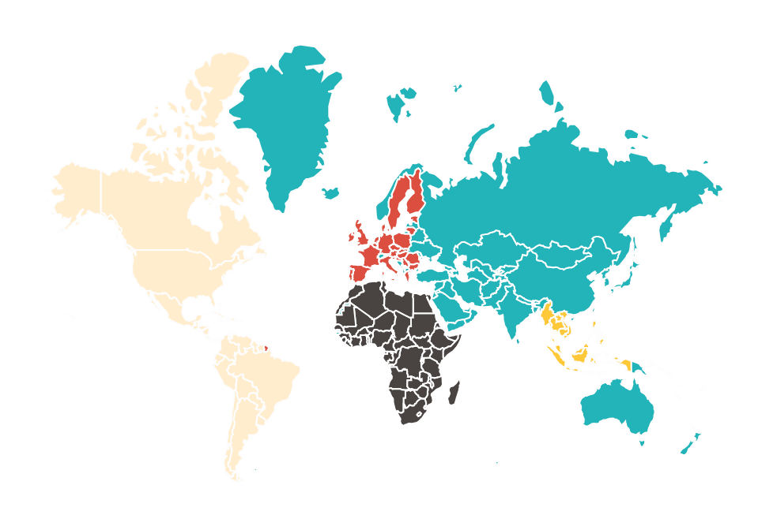
Regional Actors
European Union
OAS
ASEAN
African Union
Notes:
European Union: For example has called on all members to develop National Action Plans (p.14)
ASEAN: The Intergovernmental Commission on Human Rights is drawing on the UNGPs in its own work
﻿African Union: Has developed a draft policy framework on business and human rights that builds from UNGPs (see here)
﻿OAS: The General Assembly of the Organization of American States has formally endorsed the UNGPs (see here)

Slide 25
National Actors
Government
Ministries, judiciary, parliaments, regulatory bodies and NHRIs
Policies, Laws & Regulations
.
Businesses
Investors and companies
HRIAs, Due diligence & Grievance
Civil Society
NGOs, CSOs, universities, think tanks, independent researchers, among others
Judicial & Non-judicial mechanisms
Notes:
State: Including relevant ministries, judiciary, parliaments, regulatory bodies and NHRIs
Companies: Including investors and companies itself.
Civil Society Organisations: This include among others NGOs, CSOs, universities, think tanks, independent researchers, among others.

Slide 26
Exercise - 3 steps
Civil Society
Government
.
Businesses
Define Key actors
International and national
Brief Power Analysis
Using cartesian plane: x = your position
Y = importance of the actor
Engagement with actors
Which actors? When? How?
Notes:
During the workshop, we will have some modules that will be more practical and that will help you to create a national strategy in terms of business and human rights.
At this point and with the information that you already have, it’ll be good if you could take 15 minutes to think in pairs about the actors that you have worked with and those that may be useful to work with in this regard.

Slide 27
Exercise - Identify key actors
Government
.
Businesses
Civil Society

Slide 28
(y) Importance / Power
-
(x) Your Position
-
Notes:
Key concept slide
Get other icons from end of deck

Slide 29
(y) Importance / Power
Very important for your objective. They can act as veto players
Require a high degree of strategic engagement
Potential or actual partners
Important for your objective
Don’t require much strategic engagement / but coordination!
-
(x) Your Position
May be less important for your objective now
Maintain information about their actions
Potential or actual partners
Important for your objective
May require more strategic engagement for them to gain importance
-
Notes:
Key concept slide
Get other icons from end of deck

Slide 30
III. Business and Human Rights in the Digital Environment
Notes:
For the last 10 years or so, privacy and free expression have been key issues when it comes to business and human rights in the digital environment. This section builds from these priority issues, acknowledging the developments experienced in the field of business and human rights when it comes to the digital environment.

Slide 31
10+ years of development
World Summit on the Information Society
Global Network Initiative
UNHRC resolution on the internet
Surveillance and increasing report from companies
Free expression, misinformation and political elections
2006
2011
2013
2015
2017
2003
2008
2012
2014
2016
Internet Governance Forum
Arab Spring
UNGPs
Snowden
Big data, Internet of Things and data breaches
Misinformation and new HRs
Notes:
In this section we will take a look at some of the key developments when it comes to BHR in the digital environment.
This mapping aims to show which have been some of the key issues that have occurred in the last 10 years or so.
More than going through historical developments, this exercise is a brief photograph of key developments in the field that can help you to identify the key priority issues in your own country and start thinking about potential engagement in those issues.

Slide 32
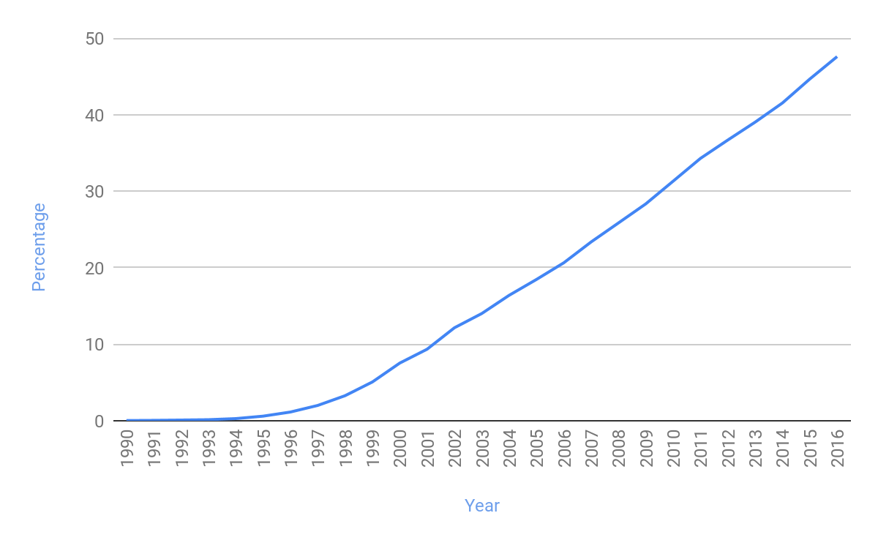
Initial Developments
2003: World Summit on the Information Society
2006: Internet Governance Forum 2008: Global Network Initiative
2011: UNGPs
Individuals using the Internet (% of population)
Own creation based on WB data
Notes:
As the graphic shows, there has been an explosive growth in the usage of internet around the world. With such a growth issues of privacy and free expression attracted the attention of many governments, civil society organisations and companies. And a number of multi-stakeholder efforts appeared to address these challenges:
The World Summit on the Information Society (WSIS) was a two-phase United Nations-sponsored summit on information, communication and, in broad terms, the information society that took place in 2003 in Geneva and in 2005 in Tunis. One of its chief aims was to bridge the global digital divide separating rich countries from poor countries by spreading access to the Internet in the developing world. The conferences established 17 May as World Information Society Day. The WSIS+10 Process marked the ten-year milestone since the 2005 Summit. In 2015, the stocktaking process culminated with a High-Level meeting of the UN General Assembly on 15–16 December in New York
The Internet Governance Forum, established in 2006 to support the United Nations Secretary-General in carrying out the mandate from the World Summit on the Information Society (WSIS), was one of the first multi-stakeholder spaces for policy dialogue in this area. The mandate of the IGF was broad: working on issues such as to accelerate the availability and affordability of the internet in the developing world to addressing valid security measures and those established by governments to collect data for control and suppression.
As a reaction to these issues, an important multi-stakeholder effort to tackle such challenge was the Global Network Initiative. The GNI was set up in 2008 by a group of companies, civil society organisations (including human rights and press freedom groups), investors and academics. The Initiative has sought to shape a collaborative approach to protect and advance freedom of expression and privacy in the ICT and Telecommunications sector.

Slide 33
2011 Surveillance, Privacy and Arab Spring:
During the Arab Spring, the internet and mobile technology was used to mobilise, organise, and campaign for political change. Companies created innovative tools Others colluded with security forces
Photo by Kym Ellis on Unsplash
Notes:
During the Arab Spring, the internet and mobile technology was used to mobilise, organise, and campaign for political change.
Some information technology companies developed innovative tools to support dissidents, bloggers, and writers, such as encrypted technologies and ways to bypass restrictions by devising alternative routes.
But other companies colluded with security forces by providing governments with surveillance technology to track down dissidents. Others have unquestioningly accepted government orders to restrict communication, divulged the identity of users, leading to their arrest.
The 2018 Freedom of the Net report observed initial signs of politically motivated internet controls.
The United Nations reacted to these developments. The Special Rapporteur for Freedom of Expression, Frank La Rue, declared access to the internet as a human right, and some governments have stepped in, such as Sweden, the Netherlands, and the United States, and made defence of freedom of expression in cyberspace a priority.

Slide 34
2012 Government restrictions
Freedom on the Net: 19 of the 47 countries examined, passed new laws or directives that either restrict online speech, violate user privacy, or punish individuals who post content deemed objectionable or undesirable UN UNHRC resolution: The promotion, protection and enjoyment of human rights on the Internet
Photo by arvin febry on Unsplash
Notes:
New laws and directives started to disproportionately enhance surveillance or started to restrict user anonymity. Freedom of the Net identified that new laws started to restrict free speech. In fact, 19 of the 47 countries examined passed new laws or directives that either restrict online speech, violate user privacy, or punish individuals who post content deemed objectionable or undesirable.
In 2012, the phrase "deep packet inspection" became to be used more frequently, particularly with regard to the UK government's proposed web surveillance plans.
The same year, the UN Human Rights Council endorsed a broad approach to human rights and the internet through a resolution affirming “the same rights that people have offline must also be protected online”.

Slide 35
2013 Mass data gathering and transparency reports
Snowden revelations during 2013 of mass data gathering practices by a number of intelligence agencies called into question the commitment of some governments to ensuring protection of privacy rights In response, more ICT companies joined the handful that pioneered the practice of releasing ‘transparency reports’.
Photo by Markus Spiske on Unsplash
Notes:
Revelations made by Edward Snowden during 2013 of mass data gathering practices by a number of intelligence agencies called into question the commitment of some governments to ensuring protection of the right to privacy, and highlighted the potential chilling effect on freedom of expression and freedom of association.
According to Freedom of the Net forms of internet control such as blocking and filtering, blocking social media and throttling or shutting down services by governments became more common.
More ICT companies joined the handful that pioneered the practice of releasing transparency reports, which publish the number of government requests or judicial orders to take down or block content under local laws or obtain access to and monitor user data that the company has received and complied with. US companies petitioned the US government to allow all such requests, including those authorised by secret court orders, to be aggregated in transparency reports. Some companies explored new ways to respond, such as making efforts to strengthen encryption to prevent unauthorised access to user data. One of the reason companies sought permission to publish more statistics was that they felt the real numbers (how many customers affected by government demands) were not as bad as what the public thought based on Snowden disclosures.
Additional material: Once again, United Nations reacted to these developments. A UN General Assembly resolution to strengthen the right to privacy in the digital age, co-sponsored by Germany and Brazil, received widespread support and the UN Special Rapporteur on Counter-Terrorism launched an investigation on some of these issues.

Slide 36
2014 Mass surveillance and Encryption
Countries rapidly adopted new laws that legitimise existing repression and effectively criminalise online dissent.
According to Freedom on the Net, this year also saw increased government pressure on independent news websites ICT companies implicated in mass surveillance took steps to restore user trust, mainly through encryption.
Photo by Markus Spiske on Unsplash
Notes:
Concerns continued to rise during 2014 over mass surveillance practices of government intelligence agencies. In a departure from the past, when most governments preferred a behind-the-scenes approach to internet control, countries rapidly adopted new laws that legitimize existing repression and effectively criminalize online dissent. According to Freedom of the Net, this year also saw increased government pressure on independent news websites, which had previously been among the few uninhibited sources of information in many countries, in addition to more people detained or prosecuted for their digital activities than ever before.
The human rights community has been vocal in opposing the bulk collection of data as an unjustified infringement on the right to privacy with significant adverse impacts on other rights, including freedom of expression, assembly, information, and political participation.
Additional materials:
A 2014 report by the UN Office of High Commissioner for Human Rights on The Right to Privacy in the Digital Age stated that mass surveillance is “emerging as a dangerous habit rather than an exceptional measure” and that practices in many States reveal “a lack of adequate national legislation and/or enforcement, weak procedural safeguards, and ineffective oversight.” Ben Emmerson, the UN Special Rapporteur on the promotion and protection of human rights while countering terrorism, stated in his report: “The adoption of mass surveillance technology undoubtedly impinges on the very essence of that right [to privacy].”
At the UN level, a new General Assembly resolution stated that the legal framework of surveillance must be clear and publicly accessible; considers the interception of metadata to be a highly intrusive act; and calls for access to remedy for individuals whose right to privacy has been violated because of surveillance. The resolution also encourages the UN Human Rights Council to consider appointing a UN Special Rapporteur on the Right to Privacy.

Slide 37
2015 Big Data, Internet of Things and relation between ICT and other businesses
In 2015 the terms “big data”, where large datasets are analysed to provide insights into a particular topic, and “internet of things”, where an increasing number of devices and appliances are connected to the Internet, started to have an increasing importance when related to privacy and other rights.
The main questions had to do with how to ensure effective privacy safeguards on the collection, storage, use and sharing of personal data.
Photo by ev on Unsplash
Notes:
This was another year of regression for internet freedom. In this year, content removals increased, arrests and intimidation escalated, surveillance laws and technologies multiplied and governments undermined encryption, anonymity.
Also, this is the first year of Ranking Digital Rights Corporate Accountability Index. It showed that “there were no winners”, as even companies in the lead are falling short and arguing that companies needed to improve their commitments to, and disclosures of, policies and practices that affect users’ freedom of expression and privacy.
In 2015 the terms “big data”, where large datasets are analysed to provide insights into a particular topic, and “Internet of things”, where an increasing number of devices and appliances are connected to the Internet, started to have an increasing importance when related to privacy and other rights.
The main questions had to do with how to ensure effective privacy safeguards on the collection, storage, use and sharing of personal data. Innovations massified in 2015, like “wearable" technology, which record and store health data, and facial recognition, that makes identification instant, raised new challenges for the ICT sector.
Additional material:
The Institute for Human Rights and Business argued in this year that in the future, all companies will effectively become ICT companies due to the reliance on technology to deliver services, such as automobiles, energy and even the oil and gas sector and cities around the world are already making use of big data to manage traffic, energy, and the day-to-day business of government.
Data, even if anonymised, can identify individuals and reveal many personal details when combined with other datasets. Data can now also be stored indefinitely. Therefore, information collected for one purpose could be put to an unknown secondary use in the future, making it impossible for users to give informed consent. The more data companies collect the more others will want access to it, raising hard questions on how to secure personal information from theft or attacks. This was confirmed by high profile cases of data breaches in 2015, including TalkTalk, Ashley Madison and Experian.

Slide 38
2016 Free expression in social media and big data in political elections
By 2016, the growing range of social media companies were now crucial intermediaries for public conversations, and were still often the first source of news for many people.
Political parties and movements for example were using big data to analyse information and individual choices to sharpen and tailor political messages to influence electoral outcomes, as seen in 2016 in the UK’s Brexit referendum and the US presidential election.
Photo by William Iven on Unsplash
Notes:
Internet freedom around the world declined in 2016 for the sixth consecutive year and governments increasingly went after messaging apps like WhatsApp and Telegram, which can spread information quickly and securely. Also, online manipulation and disinformation tactics played an important role in elections in at least 18 countries.
The dissemination of hate speech targeting women and minorities is an area of particular concern for many governments and civil society groups. Women have been targeted with misogynist abuse and hate speech, and a few prominent women have stepped away from some popular social networking sites.
An issue uniting all media companies – traditional and social – is that of advertising. Precedents started to become an issue around the world such as withdrawing advertising from a local newspaper for publishing the names of lesbian and gay individuals (which exposed them to possible persecution or violence), or withdrawing promotions for alarmist and hateful content about refugees and migrants. But such pressure can work both ways, and public advocacy campaigns can represent all ideologies, including those unconcerned about or hostile to human rights.
Also, access to big data – vast amounts of information accessible easily and quickly and the technology that enables the dissemination of the data rapidly – has significantly enhanced the ability of the state to monitor and control behaviour. Political parties and movements for example are using big data to analyse information and individual choices to sharpen and tailor political messages to influence electoral outcomes, as seen in 2016 in the UK’s Brexit referendum and the US presidential election.

Slide 39
2017 Propaganda and misinformation
Propaganda, surveillance, and clamping down on access to information have all occurred in the past. The difference now is that big data and technology relying on algorithms allow companies and governments to process vast amounts of data efficiently and quickly, and to make nuanced conclusions and judgments which have lasting impacts on human rights and society.
Photo by rawpixel on Unsplash
Notes:
Disinformation tactics contributed to a seventh consecutive year of overall decline in internet freedom, as did a rise in disruptions to mobile internet service and increases in physical and technical attacks on human rights defenders and independent media.
Propaganda, surveillance, and clamping down on access to information have all occurred in the past. The difference now is that big data and technology relying on algorithms allow companies and governments to process vast amounts of data efficiently and quickly, and to make nuanced conclusions and judgments which have lasting impacts on human rights and society. There are some that have offered guidance for policymakers, but the scale of the problem is not understood fully, which makes remedial measures inadequate and elusive.
Companies started to examine the potential adverse impacts of their innovations and use of big data so that they do not undermine human rights. Technological progress offers advantages provided it is harnessed properly, but it can pose grave risks to privacy, security, and safety, as well as influence public opinion.

Slide 40
Other Issues
Consent and Big Data
In the context of big data, some have argued that consent is no longer a meaningful concept.
Gig Economy
These tools have made many business processes more efficient and reduced costs. They also pose fundamental challenges to the nature of work.
Automation
Companies increasingly automated their processes as a replacement for workers.
Notes:
Apart from free expression and privacy, these last years can be seen as a those were the digital environment started to massively impact on other human rights, as an example:
Informed Consent and Big Data
The principle of "free, prior and informed consent" is an important procedural concept that has long existed in relation to the land rights and cultures of indigenous peoples. The concept, with which the extractive sector is familiar, has since been extended to other communities facing similar pressure, and is coming into focus in sectors such as pharmaceuticals, for example in the context of clinical trials, or ICTs, such as the endless consent boxes we all tick when online.
In the context of big data, some have argued that consent is no longer a meaningful concept. But to surrender consent to the inevitable march of algorithms risks surrendering to a world of implicit and explicit discrimination. Social media opens users to new forms of bullying and abuse based on their gender, ethnicity or sexual orientation. For example, search algorithms can generate radically different results for the same search terms for young men and women depending on the whether the adjective "black" is added.
By 2020, there will be 352,000,000,000,000,000,000,000 bytes (or 352 zettabytes) of data in the world. In 2009, the entire World Wide Web was estimated to be about 0.5 zettabytes of information. It is estimated that if all the speech ever spoken in human history were digitalised, this would be about 42 zettabytes.
Within the next three years, over 70% of these zettabytes will be in the hands of private companies, increasingly managed and exchanged between machines, with little human intervention. It is beholden on all companies, not just those in the ICT sector, to engage society in a discussion about what this data is for and how it might be used. Otherwise people will have been assumed to have given corporations and governments permissions to do what they wish with their data, eroding privacy rights further.
Gig Economy
2016 saw an increasing use of apps to secure services. These tools of the gig economy have made many business processes more efficient and reduced costs. This trend also poses fundamental challenges to the nature of work. Some companies started moving from hiring permanent staff to temporary workers or offering “zero hour contracts”. This granted workers flexibility – but also made them more vulnerable. Too often these workers do not have the protection of unions, and nor are they considered employees by companies using their services, which in some countries means they may be less likely to access important benefits such as health insurance.
Technological advances are often value-neutral, and the impact of the gig economy can cut both ways for women. Many women want greater flexibility once they have had children, and some assert the gig economy grants them more options. But the evidence is mixed. While outwardly such work arrangements look more attractive for women, economists are divided over its longer term impact on women staying in the workforce. This has economic implications given that women continue to earn less than men. Often, this flexibility comes at a price – lower-end jobs. Concerns over safety and high start-up costs also prevent women from seeking out certain jobs within the gig economy, such as drivers.
The challenge for governments became increasingly difficult as they sought to upholding human rights while encouraging technological changes that can benefit industries and services. In 2016, for example a British tribunal ruling held that drivers who sign up with Uber are its employees. As the dispute shows, there is still work to do to find consensus on how to benefit from technological advances and protect rights within the gig economy.
Automation:
From airline check-in terminals, to sophisticated manufacturing machinery, and robotics in mining, companies started to increasingly use automating their processes to replace workers.
One consequence of automation is rising unemployment in industrialised economies. This year saw developments on the idea of a world without work. More manufacturing and service companies were replacing workers with machines – in particular, jobs requiring simple, repeatable tasks and relatively lower skills. Job losses started to widespread from developing economies and emerging powers like India and China.
Studies shown that automation also made working lives more complicated for women, and the gender impacts could be severe. Women workers will be particularly at risk of job loss, as sectors where women have found it easier to get jobs – bank tellers, cash register operators, sorters at supermarkets, and light manufacturing – are particularly vulnerable to the rise of robotics and automation.

Slide 41
10+ years of development
World Summit on the Information Society
Global Network Initiative
UNHRC resolution on the internet
Surveillance and increasing report from companies
Free expression, misinformation and political elections
2006
2011
2013
2015
2017
2003
2008
2012
2014
2016
Internet Governance Forum
Arab Spring
UNGPs
Snowden
Big data, Internet of Things and data breaches
Misinformation and new HRs
Notes:
Through the last 10 years we have seen key development in the creation of multistakeholder organisations such as the GNI and the IGF. We have also observed how the UN has made efforts to catalogue internet access as a human right and specific developments in the area of privacy and free expression.
During the last 3 or 4 years, we have observed how new issues have been dominating the debate. Big data, automation, algorithmic decisionmaking and misinformation dominate some of the debates around business and human rights when it comes to the digital environment.

Slide 42
10+ years of development
· Data protection · Government requests for user data · Freedom of expression online · Government requests for content removals · Corporate assistance in surveillance · Discrimination · Propaganda-misinformation (“fake news”)
· Filtering and blocking · Internet shutdowns · Intermediary liability · Informed consent and big data · Gig economy and automation
Notes:
Through this historical review, we have highlighted a number of business and human rights issues in the digital environment:
Data protection
Government requests for user data
Freedom of expression online
Government requests for content removals
Corporate assistance in surveillance
Discrimination
Propaganda and misinformation (“fake news”)
Filtering and blocking
Internet shutdowns
Intermediary liability
Informed consent and big data
Gig economy and automation

Slide 43
10+ years of development
Of the issues outlined, which do you think is most relevant in your national context? Are there any business and human rights issues that are not mentioned that you would add as priorities for your national context?
Notes:
Of the issues outlined, which do you think is most relevant in your national context?
Are there any business and human rights issues that are not mentioned that you would add as priorities for your national context?

Slide 44
Thank you!
Designed by Kendall Lake and New America’s Open Technology Institute (2018)

