Slide 1
Business and Human Rights in the Digital Environment
Module 2: Privacy and free expression in the digital age
New America’s Open Technology Institute
Ranking Digital Rights
Notes:
Hi everyone, thank you for joining us today. We are Spandi Singh, Laura Reed and Andi Wilson Thompson from New America and today we will be conducting a workshop on privacy and free expression in the digital age.

Slide 2
Agenda
Privacy in the Digital Age
Break
Free Expression in the Digital Age
Notes:
As part of our agenda today we are going to cover the two key priority issues we discussed during the webinars -- namely, privacy and free expression, in more depth. We’ll begin by discussing privacy, take a short break, and then move on to free expression. Our goal here is to provide you with a comprehensive overview and understanding of these concepts, and highlight areas and ways in which you can engage with companies and governments on these issues going forward.

Slide 3
Agenda
Privacy in the Digital Age
Principles and Frameworks
Data Protection
Governments Requests for User Information
Transparency Reporting
Emerging Technologies
Best Practice Models
Notes:
As part of our discussion on privacy, we will go over principles and frameworks relevant to privacy and then briefly discuss topics such as data protection, government requests for user information, transparency reporting, the impact of emerging technologies on privacy and relevant best practice models for protecting and upholding privacy online.

Slide 4
Privacy in the Digital Age
Privacy: The right to be free from unwarranted intrusion and to keep certain matters from public view.
Security: Governing how your information is collected, used, shared and managed, and having protections that uphold these decisions.
Article 17 of the International Covenant on Civil and Political Rights (ICCPR) recognizes the right to privacy
Notes:
As we covered in the webinar on privacy, as technology has developed it has opened up a number of opportunities for individual expression and coordination including for human rights activists and defenders. However, it has also made individuals susceptible to surveillance and vulnerabilities which threaten their privacy and security.
Privacy is recognized in international frameworks such as the ICCPR and security, particularly data security has also emerged as a key global concern.
Other international accords and agreements also discuss the right to privacy. These include the OECD’s set of “Core Privacy Principles,” the Council of Europe’s “Convention for the Protection of Individuals with regard to Automatic Processing of Personal Data,” APEC’s “Privacy Framework” and the EU General Data Protection Regulation (GDPR). These international treaties and agreements generally outline the obligations for governments regarding human rights, whereas frameworks such as the UN Guiding Principles provide guidance for how companies should integrate respect for human rights.

Slide 5
GNI Principles
“Participating companies will employ protections with respect to personal information in all countries where they operate in order to work to protect the privacy rights of users.” “Participating companies will respect and work to protect the privacy rights of users when confronted with government demands, laws or regulations that compromise privacy in a manner inconsistent with internationally recognized laws and standards.”
Notes:
The GNI Principles also emphasize the need for privacy, calling for companies to employ protections that respect the personal information and privacy rights of their users, particularly when confronted with government demands that aim to unjustly compromise privacy.

Slide 6
COMPANIES
GOVERNMENTS
Credit: Shutterstock
Notes:
In addition, as we highlighted in the webinar, when we think about privacy in the digital era, we need to distinguish between privacy from companies and privacy from governments. As we discussed, the risks of an intrusion into your privacy and the legal frameworks that apply to both of these contexts are very different. In addition, there are divergences in viewpoints on privacy among different countries. In the United States, dating back to the country’s founding, people are inherently more suspicious of the government. On the other hand, until recently, Americans have not had an innate distrust of companies, and perhaps for that reason, have focused less on consumer privacy laws. In the EU and Australia, however, the opposite is true, and there has generally been stronger regulation on privacy from companies.
Images: Shutterstock

Slide 7
Privacy from Government
UDHR, ICCPR, and other international frameworks and instruments have recognized privacy as a fundamental human right.
Infringements or curtailments of the right to privacy, such as government surveillance, must be prescribed by law, necessary to achieve a legitimate aim, and proportionate to the aim pursued.
Laws permitting government surveillance and collection of personal information vary from country to country.
Notes:
In addition, as we highlighted in the webinar, the laws governing surveillance vary from country to country, and involve different safeguards to ensure government surveillance does not unduly infringe on individual privacy. Governments also collect vast quantities of personal data on their citizens for other purposes and so the four categories of safeguards we’ve discussed -- collection, use, retention, and data security -- are also applicable to government collection of personal information.

Slide 8
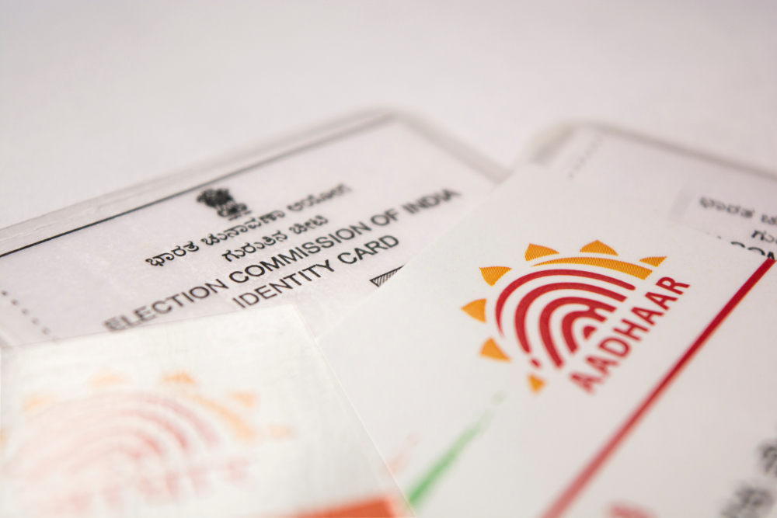
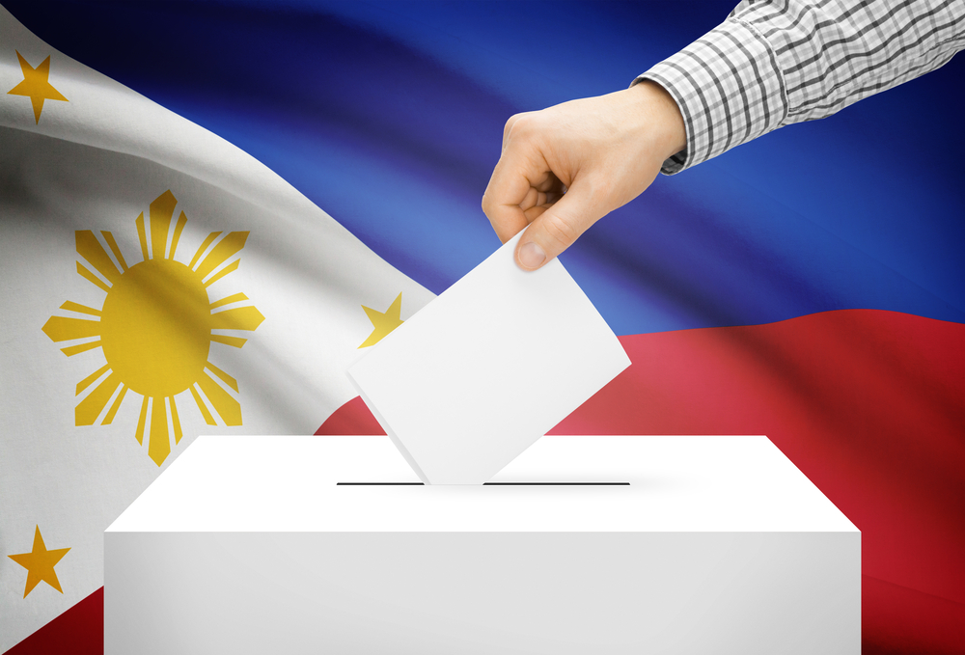
Credit: lakshmiprasada S / Shutterstock
Notes:
Threats to individual privacy and security are only growing, as we have seen with major data breaches and scandals occuring in the technology industry over the past few years. A large amount of attention is focused on how these breaches and hacks impact major US technology platforms, given the scale of global user data they hold. But there have also been a number of large data breaches on an international scale, but on the corporate and government levels. One of the most globally discussed data breaches is related to the Aadhaar system, which is India’s national identification system and is the largest biometric database in the world. In 2015 and 2016, vulnerabilities were discovered which enabled anyone to download the private information of individuals in the database. In 2016 an investigation found that you could buy the information of over 1 billion Indians from this database for less than 6 pounds online. Also in 2016, hackers under the group Anonymous Philippines hacked into the website of the Philippine Commission on Elections, defaced it and called for tighter security measures on vote counting machines. A second hacker group shortly after posted a link to what it claimed to be the entire database of the Commission on Elections. This is considered the biggest private data leak in the history of the country, and it left millions of registered voters at risk.

Slide 9
Credit: solomon7/Shutterstock
Notes:
On the corporate side of things, we discussed the Cambridge Analytica scandal, in which political data firm Cambridge Analytica gained access to the private information of over 50 million Facebook users during the webinars. Other notable examples include a hack of LinkedIn in 2012, which was originally thought to have impacted 6.5 million usernames. In 2016, however, the group which orchestrated the hack revealed they had acquired the email and passwords of over 117 million LinkedIn users and were going to be selling them. Also in 2016, personal information belonging to approximately 57 million Uber customers and drivers, including drivers’ license numbers. was stolen by hackers. But, the company kept the breach hidden for a year, and the company paid 100,000 to the hackers to cover the breach up. These events seriously jeopardized the personal information and digital security of these platforms’ users. And in many of these cases, the companies failed to disclose the breaches to the users, therefore leaving them, and their sensitive personal data vulnerable to manipulation and misuse for even longer. As was outlined in previous sessions, under the UN Guiding Principles, companies have a responsibility to protect human rights, and the decision to not disclose the breaches demonstrates a failure to safeguard the fundamental human right to privacy.

Slide 10
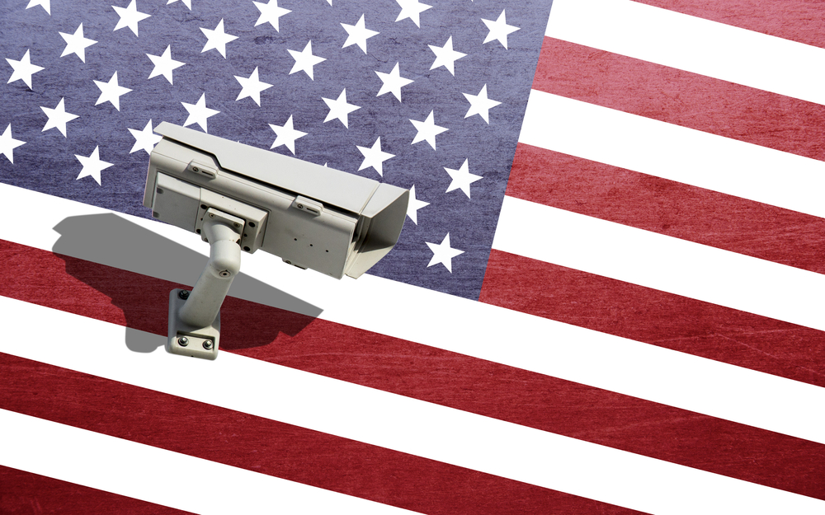
Credit: Shutterstock
Notes:
Privacy intrusions can also occur at the hands of the government in other ways. For example, governments can institute robust surveillance programs which collect vast amounts of data on individuals and monitor their movements. Governments sometimes use surveillance and data collection to prosecute political enemies, opposition members, dissenters and so on. In addition, governments collect vast quantities of personal data on their citizens for other purposes, ranging from financial information collected for tax purposes to personnel information on government employees, to sensitive health information. The collection of such vast quantities of information poses risks of data breaches or that information may be misused. An example of a program that poses privacy risks is Section 702 of the Foreign Intelligence Surveillance Act in the US, which authorizes the U.S. government to target foreigners located abroad to collect foreign intelligence information. The Act is controversial however, because the definition of “foreign intelligence” is broad, and because it permits the warrantless collection of substantial quantities of Americans’ communications, whenever Americans communicate with foreign targets. Another example is the Social Credit System the Chinese government is developing. By 2020, the system aims to provide each Chinese citizen with a credit score that is based on data collected by both private and public entities regarding their economic and social reputation. This is also intended to be applied to businesses. Thus far, citizens with low social credit scores have been banned from booking air and train travel and were placed on travel blacklists. It is also predicted that the score will be used to bar children from certain schools. A positive social score on the other hand can provide greater access to loans and jobs. Governments around the world are also increasingly adopting surveillance technologies such as facial recognition technology. The government of Zimbabwe, for example, recently formed a strategic partnership with Chinese AI startup CloudWalk Technologies to import facial recognition software into the country that will initially be applied in law enforcement and security settings, but with the intention of augmenting this for broader public use. This has been particularly concerning given Zimbabwe’s troubling human rights record in the past. With the Aadhaar program in India, there have also been concerns that by mandating that citizens get an Aadhaar card and link all of their personal information, including telephone service, internet service, bank accounts and so on to the system, it is creating a mass surveillance program that enables the government to monitor and keep track of every citizen. In addition, collecting large volumes of personal information increases the risks of data breaches and poses risks that databases will be targeted by hackers. Government databases like Aadhaar have been targeted by hackers, such as occurred in the United States with the repeated breaches of the Office of Personnel Management (OPM) databases, reported to the public in 2015, and attacks on the Aadhaar database itself.

Slide 11
Credit: MariaX/Sean Wandzilak/Shutterstock
Notes:
In addition, aside from data breaches which leave user data vulnerable, companies can also intrude on the privacy of users through vast data collection. This has been seen, for example, with the emergence of targeted ads. One particularly striking case was with US department store Target. Target assigns every customer a Guest ID number which is tied to their credit card, name or email address and this stores a history of everything they’ve bought and any demographic information Target has on them or has bought from other sources. Using this data Target was able to identify when women are pregnant, based on their buying habits, and send them targeted ads for items. An investigation found that this could occur before the women or their families know they’re pregnant.
Smartphone makers like Google have also come under fire for their pervasive location tracking features which enable them to see everywhere you’ve gone, often even when your phone is switched off.

Slide 12
Your Experiences
Credit: Shutterstock
Notes:
Are there any government or company examples in your own regions or countries that apply to this? Does your government follow a particular stream when approaching privacy from governments or companies?

Slide 13
DATA PROTECTION
Credit: Shutterstock
Notes:
This section will discuss issues of data protection and identify several critical best practices, as well as highlighting the risks of failing to implement best practices.
The importance of data protection increases as the amount of data created and stored continues to grow at unprecedented rates. When working with companies to advocate for stronger data protection practices, it is useful to provide best practices and to tie those practices to both user privacy AND economic or other benefits to companies.
For example, data exploitation or breach, whether conducted by nefarious actors or by some accident or malfunction, can have devastating consequences not only for users but also for the organization responsible for that data. Companies face major public relations repercussions, with loss of business or professional reputation as actors that respect and can provide security for their customers. At the same time, strong data protection practices can be a valuable selling-point for companies marketing to enterprise or consumer customers. Companies that provide strong encryption and other security features can set themselves apart from competitors in the field and could be more attractive to customers who are becoming ever more concerned about cybersecurity threats for themselves and their organizations.

Slide 14
PRIVACY SAFEGUARDS
FIPPS:
Collection Limitation
Data Quality
Purpose Specification
Use Limitation
Security Safeguards
Openness
Individual Participation
Accountability
Notes:
There are a variety of safeguards that governments and businesses can implement to reduce the risks of privacy intrusions. One framework for protecting privacy is the Fair Information Practice Principles (FIPPs), which provides a set of best practices used by many different actors as guidance on implementing processes for information security and privacy. The preliminary version of the Principles was developed by the US Department of Health, Education and Welfare in 1973, which the OECD built on to create the OECD Guidelines on the Protection of Privacy and Transborder Flows of Personal Data - issued in 1980.
The first OECD edition of the guidelines was issued before many of the current privacy challenges that we face today, but versions of the FIPPs have been adopted by many governments and international organizations as part of their general frameworks for privacy protection. The US Federal Trade Commission has recommended their use by companies, as well as the government of Canada, the Council of Europe, the European Union, and others.
There are various formulations of the FIPPs, but the OECD formulation, which has been widely adopted, includes the following principles:
Collection Limitation
Data Quality
Purpose Specification
Use Limitation
Security Safeguards
Openness
Individual Participation
Accountability

Slide 15
DATA COLLECTION
Credit: Shutterstock

Slide 16
Best Practices
Only collect information needed to use the product or service
Allow users to control what of their information is collected
Disclose the type(s) of information that are being collected
Inform users when and how information is being collected
Notes:
It is crucial that any company or organization (this can include governments) that collects information about its users is encouraged to follow clear data collection best practices. This is necessary to protect users privacy, but also to minimize what data could be lost in a data breach. Transparency around data collection can increase user trust in a product or service, and provide necessary education for them to use the tools wisely.
Many organizations collect far more information than they actually need. Data is valuable to organizations for purposes of research, advertising, and implementation of new features, but much of the information collected isn’t necessary for the product or service to function. For example, when downloading certain applications to a smartphone they may ask for access to various types of personal information like a contacts list or camera roll. They may also ask for access to sensors like a microphone and camera. However, many of these applications won’t require this supplementary information in order to function. To protect user privacy, companies should practice data minimization and limit the information they collect. Although a company may find access to your contacts list valuable so they can encourage you to engage with other contacts using the same app, that information isn’t necessary and can pose significant privacy and security risks.
Organizations should allow users to control the data that is being collected about them, and disclose this information to users. In the example we just mentioned, the application asked the user whether it could access certain personal information on that smart phone. It is a data collection best practice to allow users to opt in or out of providing access to that information, rather than collecting it without user notification or permission.
Using tools like lights, sounds, or pop-ups to inform users when or how their information is being collected is a good best practice for organizations. This is especially relevant for physical devices, where features like cameras often have a light that turns on when they begin collecting video, notifying users that the camera has been engaged. Because there are so many cases of cameras, audio recorders, or other sensors being harnessed to collect information on their users, clear notifications as to when those features are in use are useful in protecting user security and privacy as well as providing transparency around data collection practices.

Slide 17
just
25%
of respondents believe most companies handle their sensitive personal data responsibly.
PriceWaterhouseCoopers
Notes:
Just 25% of respondents believe most companies handle their sensitive personal data responsibly. Even fewer—only 15%—think companies will use that data to improve their lives.

Slide 18
DATA RETENTION
Credit: Shutterstock

Slide 19
Best Practices
Disclosure of different information retention timelines
Retain minimal information and delete it as soon as possible
Deleted all information when users terminate an account or stop using a device
Notes:
Encouraging companies to adhere to data retention best practices is a way to protect users from misuse or breach of their personal information. It is important that they disclose to users the timeline for deletion of different types of data like messages, photos, recordings, or accounts. Knowing these timelines can help users decide what type of information they want to use with the product or service, and allow them to better understand the risks posed by retention of that data. The more user data retained, the higher risks posed by data collection and storage, such as data breaches and other unauthorized access.
Companies should also retain minimal user information, reducing the privacy and security risks that come with large-scale data collection and storage, such as data breaches and other unauthorized access. The effects of a data breach such as those affecting the credit rating company Equifax or the US Government agency OPM can be very harmful, and the more data companies have on their users, the higher the likelihood that they will be a target and that a breach would have catastrophic consequences.
People now tend to have many different types of devices, accounts, and applications, which are not always consistently used or maintained. It is a best practice that, after a certain timeline, after warning inactive users, organizations close inactive accounts and delete user information. This puts that data at less of a risk for breach, and helps preserve security and privacy of users by giving fewer actors access to “abandoned” information they are no longer using.
Some countries or international agreements have guidelines or legal requirements surrounding data retention. For example, the GDPR states personal data shall be kept for no longer than is necessary for the purposes for which it is being processed. There are some circumstances where personal data may be stored for longer periods (e.g. archiving purposes in the public interest, scientific or historical research purposes). In other cases courts have struck down data retention legislation. After the “Digital Rights Ireland” case ruling before the European Court of Justice, both the Netherlands and Belgium had their data retention laws struck down as in violation of the right to respect for private life and the right to protection of personal data, in contravention of the Charter of Fundamental Rights of the European Union.

Slide 20
3.3b⁺
data records compromised in the first half of 2018
Gemalto
Notes:
According to Gemalto’s Data Breach Index, in the first half of 2018 there were $3.35 billion data records compromised through breaches. That’s $18.5 million each day.

Slide 21
DATA SECURITY
Credit: Shutterstock

Slide 22
Best Practices
Encryption
Vulnerability management
Authentication/passwords
Known exploit resistance
Patching
Breach notification
Mitigation policies
Notes:
Data security practices are extremely important for all products and services that collect information about their consumers. With the amount of personal data that many companies gain through the use of their products there is an obligation to take steps to protect that data from accidental leaks or data breaches. There are a variety of best practice tools that can be used to protect users’ security and privacy, as well as reducing financial and reputational risk to the company or organization.
Encrypting data in transit and at rest can prevent breaches and information theft
Having a program to encourage disclosure and manage hard and software vulnerabilities allows organizations to benefit from independent security researchers to help them reduce vulnerabilities in their product
Secure authentication practices, like not using default passwords, requiring passphrases of a certain length and complexity, enabling multi factor authentication, and notifying users when account security settings have changed can help reduce chances of breach
Testing products or systems against known exploits helps reduce chances of a serious vulnerability in the system
Regular patching, ideally with automatic updates, ensures that users benefit from the most secure version of the software
Having a transparent process for notifying users whose information has been breached increases user trust in the organization
Implementing mitigation processes in case of a data breach helps increase user trust and prevent further security breaches

Slide 23
87%
of consumers will take their business to a competitor if they don’t trust a company to handle their personal data responsibly.
PriceWaterhouseCoopers
Notes:
Consumers are increasingly worried about how private companies use their personal data, resulting in a lack of trust in the businesses handling their personal data. With a decline in consumer trust comes a decline in consumer sales. According to a PWC survey, 87% of consumers say they will take their business elsewhere if they don’t trust a company is handling their data responsibly.

Slide 24
DATA USE
Credit: Shutterstock
Credit: Shutterstock

Slide 25
Best Practices
Clearly disclose all ways information will be used
Do not use information in any way that the user has not consented to
Disclose what user information is shared and with whom and provide opportunities for consumers to opt out where possible
There is a debate in the U.S. about whether these are sufficiently protective or should be revised or expanded
Notes:
Once a product or service has collected information about its users, ranging from biographical data like names and dates of birth to biometric data like heartbeat, and blood glucose, there are certain best practices it should follow with how it uses that data.
Whether it is sending you “Happy Birthday” messages, or optimizing features to your needs, or sending you targeted information, companies or organizations sometimes use your own data in ways you do not consent to, or do not understand that you have already consented to. For example, personal data about my clicks on certain pop-ups, communications with friends, or age and gender, can be used to sell a user things specific to their assumed preferences. Companies make money by selling their users’ data to advertisers who then benefit from that data to target them in order to better sell products. Organizations should disclose the ways that they may use information that they collect from users so that they can make more informed choices about how they use that product or service. It is also a best practice that organizations give users the ability to opt in or out of certain types of data use, like targeted advertising, and not use data in ways that the users have not consented to. This is good for protecting user security and privacy, as well as maintaining user trust and confidence in a service.
As the U.S. is debating its own privacy regime, a vibrant discussion is occurring about whether the above best practices are sufficiently protective. The GDPR’s notice and consent model only goes so far, and there may be options for increasing those protections by either adapting the current regime or adopting new practices altogether. For example, adopting best practices concerning data portability, rectification, and data access, would expand user rights beyond those covered by the GDPR and could serve as a model for other countries to adopt. In addition, companies should incorporate safeguards for civil rights because data collection practices and algorithmic decision making can lead to discriminatory treatment.

Slide 26
$57m
France’s data privacy watchdog fined Google, claiming they did not adequately explain to users how it handled personal data, and obtain permission for personalized ads.
Notes:
In January 2019 France’s data privacy watchdog hit Google with a 50 million euro or $57 millon fine, claiming that the U.S. search giant did not adequately explain to users how it handled their personal data, and did not properly obtain their permission for personalized ads. The penalty is the largest so far under the European Union-wide “General Data Protection Regulation,” which came into effect last year. While the fine is relatively small for Google, legal analysts say it could mark the beginning of a raft of regulatory actions that will define how GDPR is interpreted. Under the law, EU regulators can fine companies up to 4 percent of their global annual revenue, or 20 million euros, whichever is larger.

Slide 27
Government Requests for User Data
Google Transparency Report: Requests for User Information, July 2009- June 2018
Notes:
As we covered in the webinar briefly, the Snowden disclosures highlighted the scope and extent of US government surveillance and how this can involve the government seeking user data directly from internet companies. Intelligence and law enforcement agencies have long sought data directly from companies, and as internet and telecommunications companies collect and store more data, the number of requests for this data from these agencies has increased. As a result, it has now become common investigatory practice for these entities to request data from the services that a target may have used. If a company or organization collects and stores data, the likelihood of receiving such a legal request is high. This above image is from Google’s transparency report on requests for user data and you can see the numbers have climbed. As a result, it is vital that these companies prepare for such requests and that users hold these companies accountable when managing their data. Source: Google Transparency Report: Requests for User Information, July 2009-June 2018, https://transparencyreport.google.com/user-data/overview?hl=en

Slide 28
Your Experiences
Credit: Shutterstock
Credit: Shutterstock
Notes:
Have you seen similar trends in government requests for user data in in your regions or countries? What’s driven them? How have companies generally responded? What role does transparency reporting play?

Slide 29
Relevant Frameworks/Mechanisms
Subpoenas
Search Warrants
Foreign Intelligence Surveillance Act Requests (FISA)
National Security Letters
MLATs
CLOUD Act
E-Evidence (EU)
UK Investigatory Powers Act
Indian Information Technology
Notes:
Here are some domestic and international instruments that governments can use to justify and make requests for user data. For each one, the issuing authority and standard vary depending on the jurisdiction and what kind of information they are seeking. Companies frequently receive data demands from the governments of their own countries, relying on the domestic law of that country, and issued in various forms such as subpoenas or court orders.
An MLAT or Mutual Legal Assistance Treaty is an agreement between two or more countries which enables governments to seek information that is held by companies in another country in connection with their investigation and prosecution of criminal cases. For example, various governments may want to seek gmail information that is held by Google in the United States. However, with the growth of the internet and expansion of electronic communications, MLATs have become cumbersome and time-consuming processes, and as a result many countries have sought to develop new legal frameworks to bypass the MLAT process. Last year the United States enacted the CLOUD Act, which enables the U.S. to enter into bilateral agreements with other countries that meet certain human rights standards, and once such as agreement is in place, the countries can send demands for electronic communications data directly to tech companies in the other country. The EU is considering a similar legal structure under its E-Evidence proposal. What are some frameworks and mechanisms that apply in your countries and regions?

Slide 30
BEST PRACTICE
Establish clear policies for processing and responding to legal and government requests
Credit: Shutterstock
Notes:
There are a number of best practices companies can implement and users can push for in order to ensure the process of engaging with and responding to legal requests for user data is transparent and respectful of human rights. The first best practice is to develop clear policies for processing and responding to government requests.

Slide 31
Government Requests for User Data
Establish a process for tracking requests and their status
Review and classify requests for accuracy and validity
Respond to requests using a previously established playbook
Create clear guidelines for providing user notice
Ensure data is kept secure
Challenging requests where necessary and appropriate
Provide public overview of policies and procedures
Notes:
This is a critical but challenging process and must involve consultations with legal counsel. Only a lawyer can help a company identify lawful requests and develop effective compliance mechanisms. Based on our conversations with companies, we have identified a few broad considerations for ensuring procedures and policies are transparent and efficient and that companies are pushing back on requests that are not appropriate. More detailed information about each of these processes is available in your supplementary materials handouts.

Slide 32
BEST PRACTICE
Issue regular and consistent transparency reports which highlight the scope and volume of government requests received.
Credit: Shutterstock
Notes:
The second best practice for responding to legal requests for user data is for companies to publish regular and consistent transparency reports which provide quantitative and qualitative information on the scope and volume of government requests for user information they have received.

Slide 33
Benefits of Transparency Reports
Benefits to the Public:
Raise awareness about scale and scope of government requests
Educate lawmakers
Advocate for policy change
Benefits to Companies:
Signal company values
Ease customers’ fears about privacy intrusions
Improve company morale
Notes:
Transparency reporting is an extremely valuable practice that helps the public hold companies accountable to safeguard user data and enables companies to communicate with their users and lawmakers about privacy and security. In addition, transparency reporting has a number of added benefits such as signaling company values, educating lawmakers and easing customers’ privacy concerns. Although the amount of data the government is seeking has risen markedly, these request impact a very low percent of users. This is why tech companies pressed governments to let them provide more information about the extent of government demands. OTI has published comprehensive toolkits and guides for companies which outline best practices for creating and expanding transparency reports, which we have summarized in the handouts. In addition, Ranking Digital Rights’ Corporate Accountability Index also includes a segment on transparency reporting about privacy.

Slide 34
EMERGING TECHNOLOGIES
Credit: Shutterstock
Notes:
Emerging technologies pose a whole host of new privacy and security challenges.

Slide 35
“Anything that could give rise to smarter-than-human intelligence, in the form of Artificial Intelligence...wins hands down beyond contest as doing the most to change the world. Nothing else is even in the same league.”
ELIEZER YUDKOWSKY
ARTIFICIAL INTELLIGENCE
Credit: Shutterstock
Notes:
For example, the intelligence community is using artificial intelligence to help manage the exponential increase of data they are collecting. Computer analytics are used to read and understand the data, in order to free up humans for more specific tasks. Using AI, intelligence agencies are auditing routine functions that analysts, curators, collectors have manually done in the past. The US National Geospatial-Intelligence Agency is using AI to sort large quantities of image data, helping the Agency to pull out specific targets like such as enemy safehouses and airfields. As in other types of data, this frees up humans who used to do this type of analysis manually to do more complex tasks that cannot be performed by a machine.
However, with the rising use of AI there is also a potential for unintended consequences with issues of privacy, transparency, safety, control, and bias. Artificial intelligence can exhibit dataset bias, association bias, interaction bias, automation bias, and confirmation bias. These can enter the system as the result of simple mistakes or oversight in data aggregation techniques or due to the nature of machine learning algorithms which will perpetuate unknown biases in the data used to train the systems. There are movements to make ethical guides for AI, and it is a best practice for governments and other organizations to stress test their AI models and test for bias. Some of these best practices include making sure there are human analysts included in any AI data analysis to watch for potential bias, and to balance the need for innovation with the obligation to benefit and safeguard society.

Slide 36
"The Internet will disappear. There will be so many IP addresses, so many devices, sensors, things that you are wearing, things that you are interacting with, that you won't even sense it … Imagine you walk into a room, and the room
is dynamic.
ERIC SCHMIDT
INTERNET
OF
THINGS
Credit: Shutterstock
Notes:
There are three major concerns that arise out of expanded data collection through the Internet of Things that can be addressed by the implementation of best practices for privacy and security. First, these massive datasets provide opportunities for exploitation by nefarious actors, as well as general privacy violations through poor privacy and security best practices. When information about users’ very private lives is being collected on such a massive scale it is a significant target for hackers and cybercriminals. There was a 600% increase in attacks against IoT devices from 2016-2017, and implementing security measures like encryption, strong authentication practices, and testing software against known vulnerabilities are best practices that can help protect these massive troves of user data against hackers.
Second, there is the potential for misuse of this data to benefit the companies that collect it, in ways that are not beneficial or comprehensible to the users of those devices. Companies can use data for targeted advertising, or they could sell data to other companies for profit. Consumers don’t necessarily understand the implications of giving manufacturers and developers all of this private user data, and so best practices like terms of service and privacy policies can help protect consumers and allow them to make informed choices.
Third, the devices themselves can be harnessed to commit harmful acts. When surveillance cameras, routers, internet doorbells, thermostats, and other infrastructure sensors are IoT-enabled, there is potential for these devices to be harnessed in DDOS attacks or even exploited to make them malfunction in ways that could hurt their users. Security best practices like encryption, authentication, and patching are best practices that can help protect users.

Slide 37
GETTING INTERNET COMPANIES TO DO THE RIGHT THING
Credit: Shutterstock
Notes:
So now that we’ve gone over how internet companies are gatekeepers of our privacy and security, it’s important to discuss how we as internet freedom actors and civil society members can push these companies to do the right thing and protect our fundamental human rights. New America published a report on this a few years back, called “Getting Internet Companies to do the Right Thing” which outlines trends we’ve seen over the past decade in how companies have changed their privacy and security practices and what has led them to make these changes. The report focuses on companies adopting transit encryption by default, offering two factor authentication, and issuing transparency reports. We’re going to go over the key lessons from this report that can be useful in the work you do.

Slide 38
An Initial Big Crisis
Using Transit Encryption by Default | Offering Two-Factor Authentication | Issuing Transparency Reports
Major Chinese hacking campaign | Major Chinese hacking campaign | Controversy over how US internet companies were engaging in China and growing Chinese government demands to these companies
Notes:
The first finding is that companies began implementing these changes in response to an initial, big crisis that highlighted the need for these changes. In the case of 2FA and transit encryption, these deployments were prompted by a major Chinese hacking campaign, whereas transparency reports were first issued in response to controversy around US companies engaging with China and the lack of transparency around Chinese-issued government demands to these companies. You can therefore be on the lookout for major crises such as these and using them to your advantage to push for stronger protections.

Slide 39
2. A First Mover
Using Transit Encryption by Default | Offering Two-Factor Authentication | Issuing Transparency Reports
Google | Google | Google
Notes:
The second finding was that each practice needed a major company to take the first trailblazing step to demonstrate that it can be done and to ignite the competitive fire between companies. In the three companies outlined in the report, Google, in its role as the biggest and most scrutinized player in the online services environment, was the first mover. The takeaway for advocates from this has been that pressuring Google to be the first mover, or a similar large player in your online ecosystem, is worthwhile when you’re trying to enact positive change or pressure competitors to adopt similar change.

Slide 40
3. Another Big Crisis (Or Little Ones)
Using Transit Encryption by Default | Offering Two-Factor Authentication | Issuing Transparency Reports
Snowden disclosures and the international crisis of consumer confidence that his disclosures spurred | Celebrity iCloud photo hacks, the hacking of Barack Obama’s Twitter account etc. | Snowden disclosures and the international crisis of consumer confidence that his disclosures spurred
Notes:
In many of these cases, a second crisis further stoked the fire and pushed for change. For both transit encryption and transparency reporting, this second crisis was the Snowden disclosures. In the case of 2FA, there wasn’t one huge additional crisis, but rather smaller high-profile events including celebrity iCloud photo hacks, the hacking of President Barack Obama’s Twitter account and so on.

Slide 41
4. Prioritization by Privacy Advocates
Using Transit Encryption by Default | Offering Two-Factor Authentication | Issuing Transparency Reports
The Electronic Frontier Foundation and activists | The Electronic Frontier Foundation and activists | The Electronic Frontier Foundation and activists
Notes:
In each of these cases, privacy advocates spent years pressuring companies to adopt these practices. Consistent and sustained pressure from a range of privacy advocates over time needs to present. Advocates will have to pick their battles carefully, and prioritize the ones they’ve picked for up to a decade if you want to take a new practice from zero to widespread adoption.

Slide 42
5. Standards for Companies to Meet
Using Transit Encryption by Default | Offering Two-Factor Authentication | Issuing Transparency Reports
Development of technical standards by organizations such as the Internet Engineering Task Force | Development of technical standards by organizations such as the Internet Engineering Task Force | Resources pushing for standardization of transparency report such as the Transparency Reporting Toolkit
Notes:
Standards for Companies to Meet. In the case of transit encryption and 2FA, the early development of technical standards by bodies such as the Internet Engineering Task Force was critical to pushing for widespread adoption. For transparency reporting, the lack of standardization in reporting arguably hindered the speed and usefulness of its adoption, which is why creating resources like the Transparency Reporting Toolkit was prioritized by a range of stakeholders.

Slide 43
Other Factors
6. Sweetener
7. Scorecards to Promote Competition
8. Policymakers Using their Bully Pulpits
9. Technical Interventions
Notes:
The other factors that spurred change were that: 6) A Sweetener: In some cases rather than just being spurred by crisis or criticism, companies need to see a positive reason why adopting the practice will further the goals. For transparency reporting, this was that these reports are a strong platform through which to advocate for updates to the US’s outdated law enforcement surveillance laws. 7) Companies love getting gold stars as these are positive publicity for their efforts. So it incentivizes them to do better so their rankings on rankings like EFF’s Who Has Your Back scorecard and RDR’s Corporate Accountability Index are good and seen as improving.
8) Getting a group of policymakers to champion these issues and push for them publicly and consistently. 9) In many of these case studies the release of new technologies demonstrated the need for one of the three practices, or it helped drive adoption of the three practices. For example, the ethically dubious release of the easy-to-use Firesheep hacking tool made a huge splash by demonstrating how simple it was to hijack accounts on a wide range of popular services because they weren’t using transit encryption, while EFF’s HTTPS Everywhere plugin made it easier for users to get the benefits of encryption.

Slide 44
Your Experiences
Credit: Shutterstock
Notes:
What are the challenges you face when working with companies and pushing them to do the right thing? Have you used any of these best practices?

Slide 45
Sample Models
The Digital Standard
Transparency Reporting Toolkit
Ranking Digital Rights’ Corporate Accountability Index
EFF’s Who Has Your Back?
Credit: Shutterstock
Notes:
There are a number of best practice frameworks and models that we can look to when attempting to assess and safeguard privacy and security online. These are also summarized in the handouts.

Slide 46
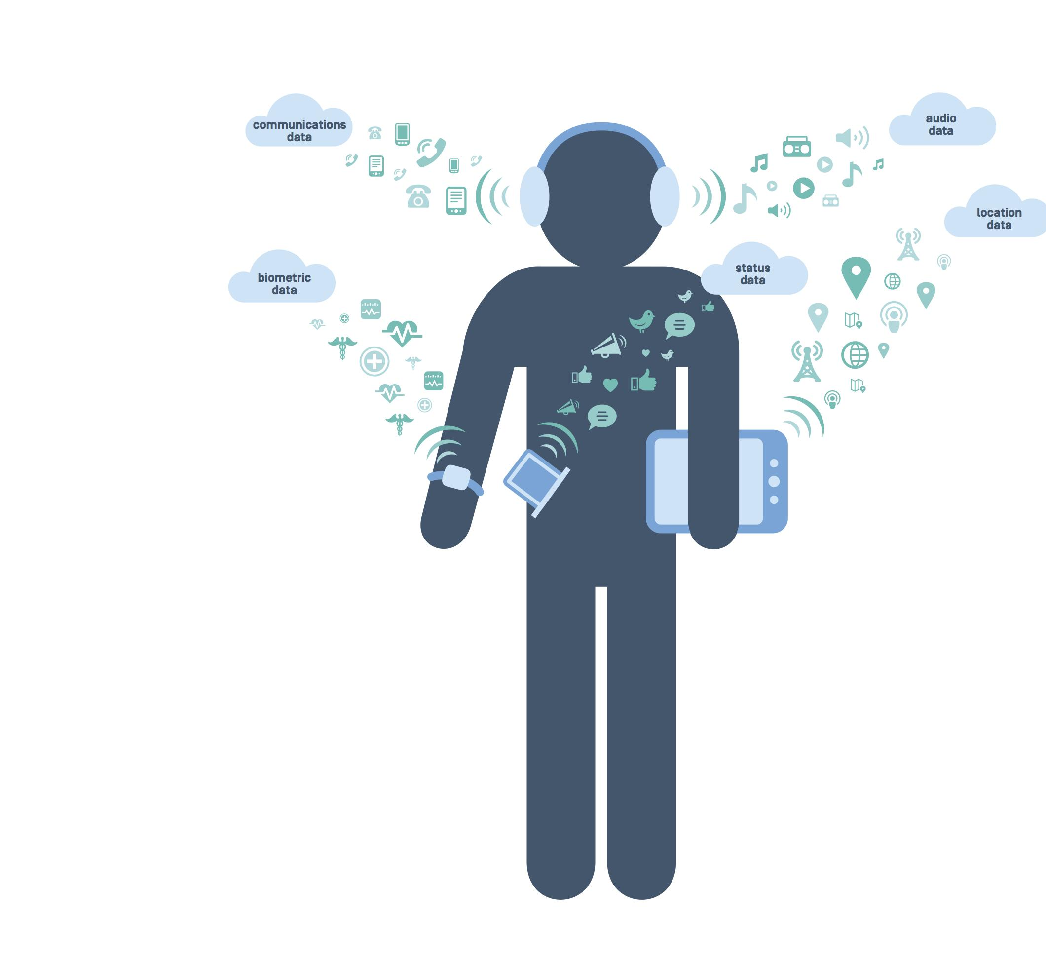
Digital Standard
A methodology for evaluating the privacy and security impacts of a given piece of connected software or hardware.
Specifically targeted at Internet of Things consumer products
Notes:
The Digital Standard is an open source, collaborative methodology that was developed by Ranking Digital Rights, Disconnect, the Cyber Independent Testing Lab, Aspiration, and the ratings magazine Consumer Reports. So far Consumer Reports has used the Standard to evaluate Smart TVs and Payment Applications. The goal is to create a consumer-facing, publicly available evaluation of the types of products that consumers might purchase. In the past, Consumer Reports would have evaluated a television for image quality, sound, etc. but its most recent publication also tested the security and privacy features of the connected products it was evaluating.
It has four guiding principles:
Electronics and software-based products should be secure
Consumer information should be kept private
Ownership rights of consumers should be maintained
Products should be designed to combat harassment and help protect freedom of expression
Although Consumer Reports has deep experience doing product evaluations and ratings, the Standard was built so that anyone can use its methodology. Companies, civil society organizations, or academic institutions could all use the tests to evaluate consumer products based on their specific interests and area of work.

Slide 47
BREAK
Credit: Shutterstock

Slide 48
Agenda
Free Expression in the Digital Age
Principles and Frameworks
Content Regulation
Transparency Reporting
Emerging Technologies
Best Practice Models
Notes:
We will now begin the second half of this workshop on key priority issues, which is focused on free expression online. In this segment we will go over principles and frameworks relevant to free expression and then briefly discuss topics such as content regulation, transparency reporting, the impact of emerging technologies on free expression and relevant best practice models for protecting and upholding free expression online.

Slide 49
Principles on Free Expression
Article 19 of the Universal Declaration of Human Rights
Article 19 of the International Covenant on Civil and Political Rights
European Convention on Human Rights
American Convention on Human Rights
African Charter on Human and Peoples’ Rights (Banjul Charter)
Notes:
As we discussed in the webinar on free expression, there are a number of international frameworks which recognize the right to free speech and free expression. The two most commonly referenced ones are the UDHR and the ICCPR, both of which recognize that “everyone has the right to freedom of opinion and expression; this right includes freedom to hold opinions without interference and to seek, receive and impart information and ideas through any media and regardless of frontiers.”
There are also a number of other more regionally focused international instruments that recognize these fundamental rights.
Although free expression is generally agreed upon as a legal right, it is a derogable right, and as a result, it may be restricted or limited in certain ways.

Slide 50
GNI Principles
“Participating companies will respect and work to protect the freedom of expression of their users by seeking to avoid or minimize the impact of government restrictions on freedom of expression, including restrictions on the information available to users and the opportunities for users to create and communicate ideas and information,regardless of frontiers or media of communication.”
Notes:
Companies that participate in GNI agree to abide by the principle of freedom expression as outlined in the GNI Principles.

Slide 51
COMPANIES
GOVERNMENTS
Credit: Shutterstock
Notes:
Like privacy, free expression online interfaces with governments and companies differently. In the United States, for example, governments generally cannot restrict speech due to the First Amendment, but since companies are private entities, they are more free to impose limits. This is why companies are able to engage in content regulation practices and establish their own Terms of Service and content standards. Images: Shutterstock

Slide 52
Free Expression: Companies
DIGITAL PUBLIC SQUARE
Platforms that host user-generated content provide space for users to exercise their free expression rights and to reach others.
CONTENT REGULATION
Platforms are becoming gatekeepers of online speech.
CONTENT STANDARDS
Companies develop their own standards for acceptable content which can be stricter than speech-related laws.
Notes:
As technology platforms such as Facebook, Twitter and Google have been adopted across the globe, they have gained more influence and power, and have assumed the role of digital public squares, as well as de facto gatekeepers of online speech. And just as threats to speech offline have grown, so have threats to online speech, raising significant concerns about censorship and limits to free expression online. Most American technology companies apply a First Amendment perspective in the United States, but comply with other countries’ laws when applicable. However, depending on local laws in varying countries, they may adjust their policies. For example, in Germany it is illegal to deny the Holocaust and as a result platforms that host user-generated content must treat such speech as illegal in the context of that country. In addition, companies develop their own standards and regulations around permissible speech on their platforms. These rules may restrict certain categories of speech beyond what would or could be prohibited by law in particular countries. For example, Facebook prohibits nudity, violence, bullying and harassment, even though some speech in these categories would be protected by the First Amendment if the government sought to prohibit it. Companies both have a commitment to comply with speech-related laws around the world, and as private actors, have the right to develop their own standards for permissible content on their services within the bounds of these laws. However, the overbroad censorship of speech is a significant human rights concern and threat to free expression that needs to be assessed carefully, and companies need to be held accountable in their management of online speech. Companies also grapple with competing pressures when managing free expression. Companies are increasingly facing pressure to remove content, including hate speech and terror content in order to make their platforms safer. However, they also have a commitment to protect free expression. These tensions regularly come to a head in cases like when minority communities push platforms to take down hate speech or abusive content, but platforms, in trying to comply with them are also attempting to uphold and not impinge on these communities’ and other communities’ free expression.

Slide 53
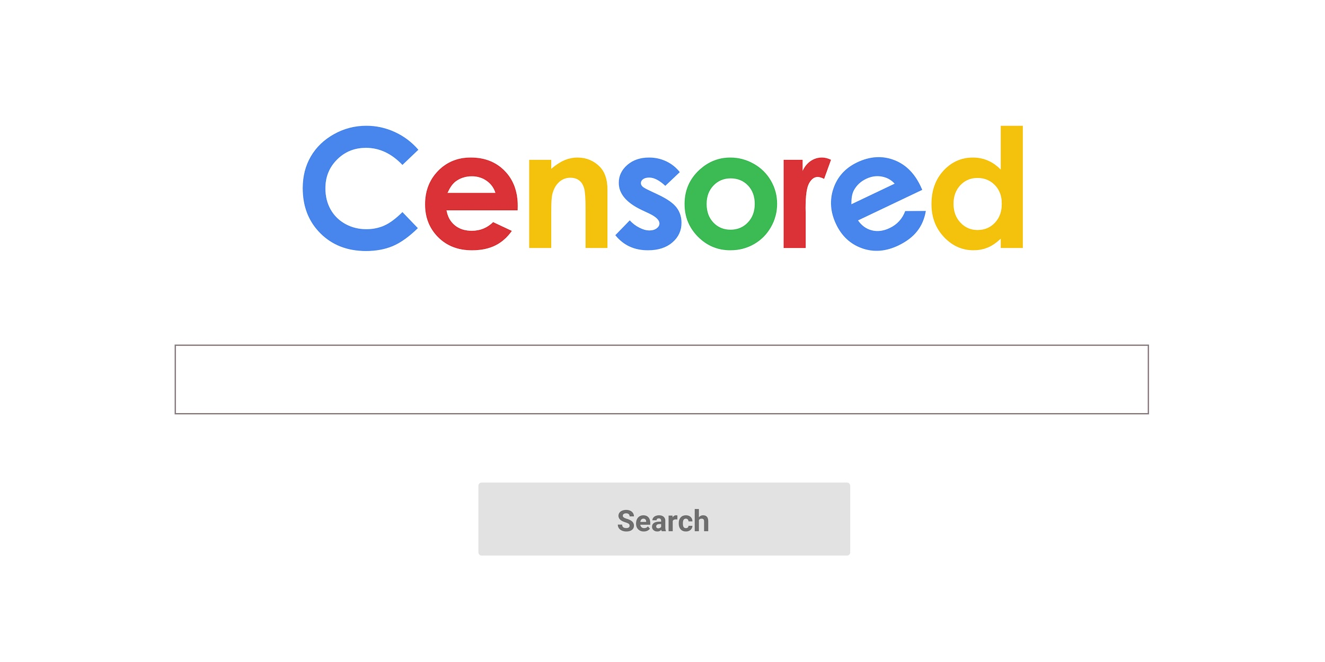
Credit: Shutterstock
Notes:
Challenges to free expression are growing around the world, both from companies and governments. Some recent examples of controversies around free expression are - The passage of the Network Enforcement Act or NetzDG law in Germany, which mandates that social media companies of a particular size must remove “obviously illegal speech” such as terror content that is flagged to them within 24 hours or face massive fines.
- The recent reports alleging that Google is attempting to launch a censored search engine under the name Project Dragonfly in China
- The spread of disinformation on Facebook in Myanmar to stoke ethnic and religious tensions and conflict
- The spread of fake news stories via WhatsApp in India that has resulted in mob violence and the deaths of dozens of people - A string of cybersecurity and fake news bills in countries like Malaysia, Kenya and Egypt

Slide 54
Your Experiences
Credit: Shutterstock
Notes:
Are there any government or company examples in your own regions or countries that apply to this?

Slide 55
Free Expression Safeguards
Governments:
Ensure laws restricting certain types of speech are compatible with international human rights norms.
Companies:
Create rules that are compatible with freedom of expression norms, and are clear to your users.
Conduct due diligence on requests received through government or private processes to restrict content, accounts, or access.
Notes:
In order to safeguard free expression, governments should ensure that any laws they pass that restrict speech are compatible and in line with international human rights norms. Additionally, companies should ensure their speech standards are compatible with free expression norms and are clearly communicated to users. Further, they should conduct due diligence on requests received through government or private processes to restrict speech, in order to ensure these processes and requests are just, fair and not resulting on overbroad censorship.

Slide 56
CONTENT REGULATION
The process companies employ to review and potentially to remove, restrict or regulate content or accounts that have been identified or flagged as violating a particular law or a company’s content policies or Terms of Service.
Notes:
During the webinar we briefly touched upon how major internet platforms like the Facebooks, Twitters and Google’s of the world have evolved into platforms for, and private arbiters and gatekeepers of our personal speech online. Right now we’re going to take a deeper dive into the different ways in which our speech is being impacted and influenced, and then look at how we can effectively engage companies and policymakers on these issues.
So as a reminder, content regulation can be defined as the process companies employ to review and potentially to remove, restrict or regulate content that has been identified or flagged as violating a particular law or a company’s content policies or terms of Service. Content moderation can also result in the suspension or closure of the accounts of users who violate these regulations.
Just as companies use their Privacy Policies to outline how data is managed and governed on their platforms, they use Terms of Service to define standards and norms of acceptability on their platforms, including for speech. In this context, Terms of Service are also commonly referred to as Community Guidelines, Community Standards, and so on. The latter two are particularly used by platforms that engage in a large amount of content regulation and they may also choose to break out their content policies separately. Here are a couple of examples of these guidelines issued by major platforms.

Slide 57
Facebook Community Standards
Policy Rationale: We prohibit people from promoting or publicizing violent crime, theft, and/or fraud because we do not want to condone this activity and because there is a risk of copycat behavior. We also do not allow people to depict criminal activity or admit to crimes they or their associates have committed. We do, however, allow people to debate or advocate for the legality of criminal activities, as well as address them in a rhetorical or satirical way.
Facebook Community Standards: Violence and Criminal Behavior.
Notes:
In May 2018, Facebook released a detailed edition of their Community Standards which outline standards of acceptability for content on the platform. The Standards also include a policy rationale and a clear list of what not to post. Here is an example of what they share for their policy on promoting or publicizing crime. https://www.facebook.com/communitystandards/promoting_publicizing_crime

Slide 58
Facebook Community Standards
Acts of physical harm committed against people
Acts of physical harm committed against animals except in cases of hunting, fishing, religious sacrifice, or food preparation/processing
Poaching or selling endangered species or their parts
Staged animal vs. animal fights
Theft
Vandalism or property damage
Fraud
Trafficking
Sexual violence or sexual exploitation, including sexual assault
Facebook Community Standards: Violence and Criminal Behavior.
Notes:
They also outline that you should not post content that depicts, admits, or promotes the following criminal acts committed by you or your associates.
https://www.facebook.com/communitystandards/promoting_publicizing_crime

Slide 59
Twitter Rules
Requirements for parody, newsfeed, commentary, and fan accounts:
Bio: The bio should clearly indicate that the user is not affiliated with the subject of the account, including, for example, by incorporating a word such as (but not limited to) "parody," "fake," "fan," or "commentary,” and be done so in a way that would be understood by the intended audience.
Account name: The account name (note: this is separate from the username, or @handle) should not be the exact name as the subject of the account without some other distinguishing word, such as (but not limited to) "not," "fake," or "fan," and be done so in a way that would be understood by the intended audience.
Twitter Rules: Parody, newsfeed, commentary, and fan account policy (the “policy”).
Notes:
Similarly here is an example from Twitter’s rules, which highlights the requirements that parody, newsfeed, commentary and fan accounts have to meet in order to not be moderated.
https://help.twitter.com/en/rules-and-policies/parody-account-policy

Slide 60
LOCATION SPECIFIC ILLEGAL CONTENT
Credit: Shutterstock
Notes:
Some of the most commonly targeted categories of content for removal online are:
Content that is illegal in a particular region or country. As we discussed in the webinar, this content is often not removed from the platform altogether, rather it is restricted or geo blocked so that it cannot be viewed by users in the country where it is illegal. Some examples of this are in Germany it is illegal to deny the Holocaust, in Thailand it is illegal to insult royalty, including online, in Turkey it is illegal to insult Turkishness and as a result many people who insult Turkey’s founding father Kemal Ataturk are often punished. A few years ago YouTube was banned from the country for failing to remove content that insulted Ataturk.
Typically this content is removed as a result of legal requests by governments or others who flag the content as illegal, or companies must proactively identify such content, depending on the country.

Slide 61
Government Removal Requests Trends
Twitter Transparency Report: Removal Requests, January 2018 - June 2018
Notes:
And generally we’re seeing more and more government requests to remove content, especially as of late. This is a visualization demonstrating how these requests have become especially prevalent beginning in the second half of 2015 for Twitter.

Slide 62
INTELLECTUAL PROPERTY INFRINGING CONTENT
Credit: Shutterstock
Notes:
Companies often also receive requests from users, other companies and at times governments to remove content that infringes on intellectual property. This includes copyright and trademark infringing content, and at times patent and counterfeit related claims, although the latter two are not as frequent. Most American companies process copyright claims as per the Digital Millennium Copyright Act, unless there is a local copyright law in a particular country that is applicable. The same goes for trademark.

Slide 63
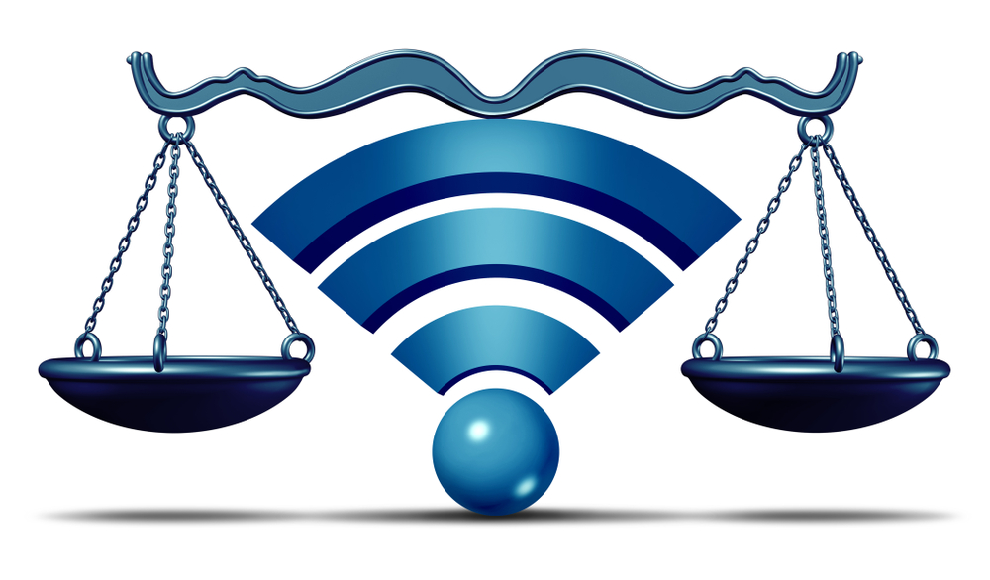
MISUSING IP TAKEDOWN REQUESTS
Credit: Shutterstock
Credit: Shutterstock
Notes:
Copyright and trademark requests are generally thought of as the most straightforward types of requests, but nuance and context is needed for any form of request that is submitted to companies, and it’s important to be cognizant of how these policies can impact your free expression. For example, there have been some cases where intellectual property related takedown request procedures have been misused by governments in an attempt to quell dissent and silence activists and opposition members. This happened in Ecuador in 2015, when the government allegedly hired a Spanish law firm to submit DMCA takedown notices to companies like Google, Twitter and Vimeo on behalf of state officials targeting critical documentaries, tweets, and search results that included images of those officials, alleging copyright infringement. Because removal of this category of content was generally thought of straightforward, many of these requests were processed but some of the content was restored after the posters filed counter-notices. This is just an example of how these procedures can be abused, and therefore if you are a content creator online, and find that you’re having your free expression challenged in such a manner, you need to be aware of the appeal mechanisms that are available to you.

Slide 64
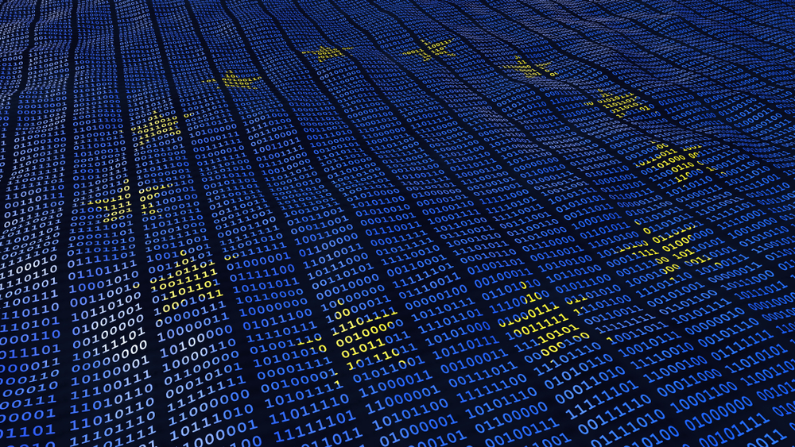
THE RIGHT TO BE FORGOTTEN
Credit: Shutterstock
Notes:
In May 2014, the Court of Justice of the European Union ruled that citizens of the EU could request search engines to delist search results tied to their names if the information in the result was “inadequate, irrelevant or excessive in relation to the purpose of processing.” This right to erasure was also included in the EU’s General Data Protection Regulation which came into effect in May 2018. A similar Right to Erasure law came into effect in Russia in January 2016. Right now the law is only applied to search engines, and as a result only search engines such as Google and Microsoft’s Bing receive these requests. However, these takedowns subsequently impact content on other platforms that appear in the search engine results.

Slide 65
“Everyone should have free access to relevant and neutral information of public concern; delisting and removing such content from the internet harms our collective ability to remember history and understand the world.”
-THE WIKIMEDIA FOUNDATION
Notes:
There has been some pushback against the Right to be Forgotten and the concept of the Right to Erasure, and some companies, such as the Wikimedia Foundation, propose that there is a Right to Remember, and everyone should have free access to relevant and neutral information of public concern. This side of the debate generally argues that by delisting content you’re damaging the collective ability to remember history and understand the world.

Slide 66
COMMUNITY GUIDELINES RELATED CONTENT
Credit: Shutterstock
Notes:
As mentioned before, the Community Guidelines of a platform define standards of acceptability for content and often touch on issues including graphic violence, nudity, terror content, hate speech, bullying, harassment and so on. There is still a large amount of ambiguity around how companies moderate content based on their guidelines, and what their guidelines even are. This is why companies like Facebook have taken steps to releasing detailed versions of their guidelines, in order to promote greater transparency around their practices and their thinking on policy implementations. Still, there is a lot of room to grow and expand this, especially across the industry.

Slide 67
Stages of Moderation
BEFORE CONTENT IS PUBLISHED
AFTER CONTENT HAS BEEN FLAGGED
ACTIVE ASSESSMENT OF CONTENT
Notes:
As we previously discussed, there are three stages during which content can be moderated -- before content is published, after content has been flagged and through an active assessment of content being posted on platforms.

Slide 68
Terms of Service Removal Trends
Google Transparency Report: YouTube Community Guidelines Enforcement Report, July 2018 - September 2018
Notes:
Right now only Facebook, Twitter and Google issue comprehensive transparency reports that cover ToS removal requests for multiple content categories. But they do demonstrate some interesting trends. This is from Google’s latest report, which shows that automated flagging of content that violates terms of service is by far the most common method for identifying content that is removed.

Slide 69
Terms of Service Removal Trends
Google Transparency Report: YouTube Community Guidelines Enforcement Report, July 2018 - September 2018
Notes:
This pie chart from Google’s report highlights the videos that were flagged using automated flagging mechanisms, segmented by those which were removed before any views and after any views. The majority of this content is proactively being removed before it is viewed.

Slide 70
Terms of Service Removal Trends
Facebook Transparency Report: Community Standards Enforcement, July 2018 - September 2018
Notes:
Facebook’s report provides a similar slice of data, which is prevalence, or how much of the content for each content category was actually viewed on Facebook by users before it was removed, because according to their logic, if it wasn’t viewed, it had no impact. This is an example of the prevalence metric for graphic violence. https://transparency.facebook.com/community-standards-enforcement

Slide 71
Terms of Service Removal Trends
Google Transparency Report: YouTube Community Guidelines Enforcement Report, July 2018 - September 2018
Notes:
And I think this is also a particularly useful chart for understanding the breakdown of content that is removed under ToS on Google. The other categories in this section are harmful dangerous content, child abuse and terror promoting content. Facebook doesn’t provide a comparative break down like this right now but they do report separately on categories such as graphic violence, adult nudity and sexual activity and fake accounts.

Slide 72
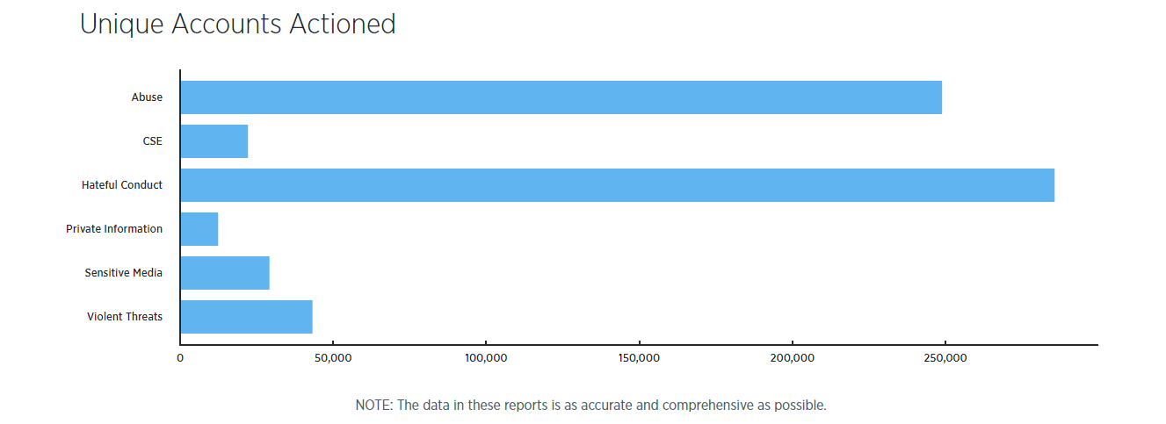
Terms of Service Removal Trends
Twitter Transparency Report: Twitter Rule Enforcement, January 2018 - June 2018.
Notes:
Twitter also provides similar information, but only for accounts that were reported and accounts that were subsequently acted or actioned on.
Also there are other forms of emerging transparency report on issues such as DNS intermediary blocking, but we’ve yet to see much movement on that front yet.
https://transparency.twitter.com/en/twitter-rules-enforcement.html

Slide 73
NETWORK SHUTDOWNS AND DISRUPTIONS
Credit: Shutterstock
Notes:
Another area that impacts content and free expression that some platforms report on is network shutdowns and disruptions. These can be government mandated or government instituted disruptions of entire systems. Recent reports have shown how network shutdowns are becoming increasingly prevalent around the world, but sometimes companies are barred from reporting on these instances by law.

Slide 74
Network Shutdown Trends
AccessNow: #KeepItOn Campaign, 2018
Notes:
Access Now runs a great resource as part of their #KeepItOn campaign which is a Shutdown Tracker Optimization Program which aims to develop a list of internet shutdowns and provide information on the scope, magnitude and context of these events.

Slide 75
Network Shutdown Trends
AccessNow: #KeepItOn Campaign, 2018
Notes:
Their findings have found that governments generally use shutdowns to silence political opposition from their citizens and they are increasingly used as a tool of repression and to curb free expression. https://www.accessnow.org/keepiton/

Slide 76
Network Shutdown Trends
AccessNow: #KeepItOn Campaign, 2018
Notes:
And as you can see here there is a concentration of these events in Asia and Africa. Threats to free expression through network disruptions and shutdowns can also be instituted by telecommunications companies. However, these companies typical face greater restrictions and so they can’t always disclose information on shutdowns they had to institute.

Slide 77
Your Experiences
Credit: Shutterstock
Notes:
Have you seen similar trends in your regions or countries? What’s driven them? How have companies generally responded?

Slide 78
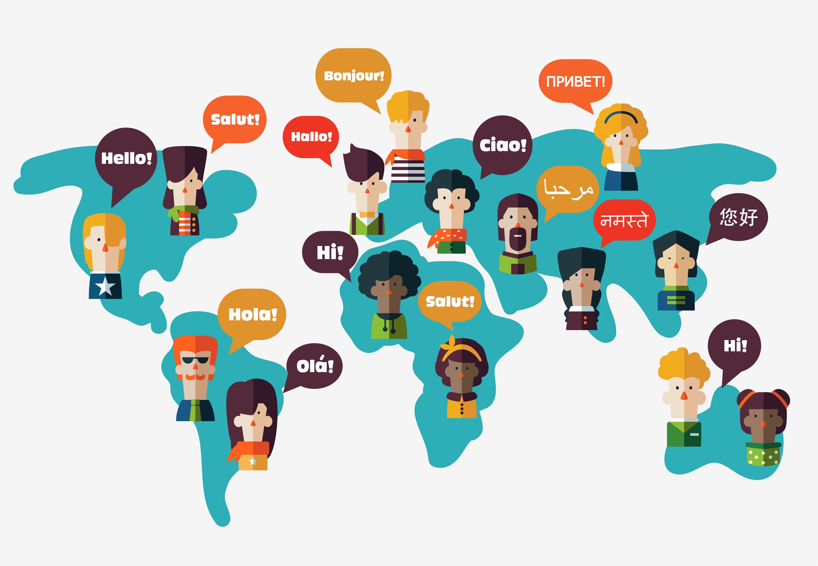
ISSUES RELATED TO CONTENT MODERATION
Credit: Shutterstock
Notes:
Content moderation has become an increasingly common and called for practice for technology companies. Facebook has over 7,500 content moderators, Google similarly have 1000s of moderators on their payroll. There are a number of issues surrounding the profession and practice of content moderation however. One is that content moderators require cultural and linguistic context in order to effectively moderate content. What may be harmful in one country or situation may not be harmful in another. For example, in Myanmar recently, Facebook was used to spread immense amounts of hate speech against Rohingya refugees and other Muslims in the country. In early 2015, there were only 2 moderators at Facebook who could speak Burmese, and as a result this low capacity translated into low reaction to this content. Since the outbreak of this issue online, Zuckerberg has committed to hiring dozens more Burmese speaking moderators. There have also been calls for moderators to receive greater bias training to prevent them from making biased decisions.
In addition, many of these moderators are outsourced employees and there are significant concerns regarding fair wages and labor practices. This is especially a concern considering that these moderators have to regularly engage with really harmful and abusive content online and this can take a toll on their mental health. A recent film called the Cleaners documents this and calls on companies to provide better services to these employees. Finally, there is a general lack of transparency around the guidelines that these moderators use. Facebook released a detailed version of their Community Standards because of pressures for greater transparency, but the standards most companies employ are still opaque which prevents the public from understanding the procedures used for these platforms.

Slide 79
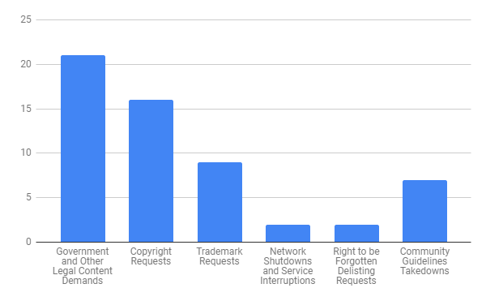
Transparency Reporting
New America’s Open Technology Institute’s Transparency Reporting Toolkit: Content Takedown Reporting, October 2018
Notes:
As we’ve seen, companies remove content across a number of content categories. This significantly impacts free expression and free speech online. In the fall we released a Transparency Reporting Toolkit that surveyed how domestic and international internet and telecommunications companies were reporting on these content removals in their transparency reports, and you can see in this chart, which summarizes our survey of US companies, that there is a general tendency to report on government request and copyright requests, but there is less reporting for the other forms of content removals.

Slide 80
Key Factors
1. A big crisis
2. A major company to take the first step
3. Prioritization by Advocates
4. Standards and Scorecards
Notes:
1. A major crisis that highlights the need for this transparency. Some of the case studies we highlighted are good examples of this. 2. A major company to take the first step and push other competitors to similarly adopt this practice. For example, Google released a comprehensive transparency report on its terms of service based takedowns for YouTube and shortly after Facebook followed suit. Now we’re waiting on other companies like Twitter to join in. 3. Prioritization by advocates concerned with free expression. 4. The development of standards and scorecards like New America’s recent Transparency Reporting Toolkit focused on content takedowns, EFF’s first Who Has Your Back focused on censorship, RDR’s Corporate Accountability Index and the Santa Clara Principles.

Slide 81
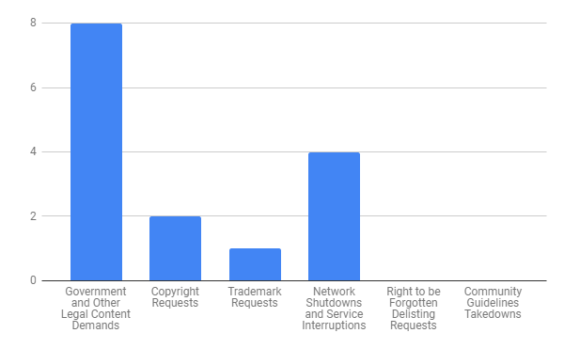
Transparency Reporting
New America’s Open Technology Institute’s Transparency Reporting Toolkit: Content Takedown Reporting, October 2018
Notes:
This is a summary of the findings we had for international companies. As you can see here, there is no reporting whatsoever on Community Guidelines based removals from these companies. For more information on best practices for transparency reporting on content takedowns, take a look at your handouts.

Slide 82
EMERGING TECHNOLOGIES
Credit: Shutterstock
Notes:
As emerging technologies develop they are increasingly being applied to the management of online free expression. Artificial intelligence is the best example of this. As we previously discussed, many platforms deploy AI systems in order to identify and regulate content at scale. This occurs at various stages of moderation including pre-publication moderation and during active assessment of content on the platform. AI systems vary in their ability to identify violating content. For example, some models are better trained and more accurate when identifying child sexual abuse materials on the platform. However, the models are not as reliable when identifying instances of hate speech, for example. In addition, AI tools have resulted in some contentious takedowns. For example, some images such as the famous Vietnam War image of the little girl which carry historical value and weight have been removed by models for violating the nudity policy. In addition, human rights groups who repost images of terrorist atrocities have had their content taken down for violating the policy on terror content, despite their intent being the opposite. This happened for example in Myanmar, where Rohingya activists had their content removed and accounts shut down. As a result, companies are continuously pushed to consistently involve human moderators in all content decision making practices. Although humans can also make errors, human moderators can add cultural context and understanding and help prevent such mistakes and such instances of curtailed free expression, from taking place.

Slide 83
Emerging Technologies
Google Transparency Report: YouTube Community Guidelines Enforcement Report, July 2018 - September 2018
Notes:
Companies have also been pushed for greater transparency around how their automated tools are being deployed in content moderation. In Google’s most recent transparency report on the enforcement of their community standards, for example, they highlight that the majority of content they removed was flagged by automated tools. But they don’t provide breakdowns for what categories of content, like terror content, hate speech etc. these automated flags targeted. One positive step we’ve seen to adding transparency around these efforts is Facebook is currently working on a metric that will highlight how many mistakes they have made during their content regulation process, and how many of those mistakes were corrected using their appeals process.

Slide 84
GETTING INTERNET COMPANIES TO DO THE RIGHT THING
Credit: Shutterstock
Notes:
Similar to how companies adopting practices like transparency reporting on government requests for user data and two factor authentication, now we are seeing more and more companies issue transparency reports on their content takedowns, share their content policies and expand things like appeals processes for takedowns. Some of the best practices we’ve seen in getting these companies to do the right thing when it comes to safeguarding free expression are:

Slide 85
Your Experiences
Credit: Shutterstock
Notes:
What are the challenges you face when working with companies and pushing them to do the right thing? Have you used any of these best practices?

Slide 86
The Santa Clara Principles
Santa Clara Principles on Transparency and Accountability in Content Moderation, 2018
Notes:
In May, OTI and a number of individuals and groups who support free expression launched the Santa Clara Principles on Transparency and Accountability in Content Moderation which call for companies to provide greater transparency around numbers, notices and appeals. These guiding best practices are also summarized in the handouts we have for you and may be good starting points for engaging with companies and demonstrating clear asks around safeguarding free expression. You can also take a look at the best practices for transparency reporting we came up with in our transparency reporting toolkit in the handouts.

Slide 87
You Make the Call
Policy:
We do not permit any organizations or individuals that are engaged in terrorist activity, organized hate, mass or serial murder, human trafficking or organized violence or criminal activity on our platform. We also remove content that expresses support or praise for groups, leaders, or individuals involved in these activities.
Session Structure Credit: Center for Democracy and Technology
Notes:
Now we’re going to try a short interactive exercise that will let you make the call on content moderation issues. We’ve adapted this exercise based on an interactive session developed by the Center for Democracy and Technology. As we know, making content moderation decisions can be challenging at times. There may be some sensitive materials in the following slides, so if you are uncomfortable viewing them, feel free to step out for the next few minutes. For the first example, here is the policy:

Slide 88
You Make the Call
https://bit.ly/2EfaCYo
Image Credit:The Associated Press
Notes:
How would you apply this policy to this tweet? You can use the link on the bottom right to cast your vote.
Images: https://www.cooltools.us/Design-Stamp-Peace-Dove-p/pun-349.htm
https://www.cbsnews.com/news/youtube-videos-syria-war-activists-human-rights-violations-war-crimes/

Slide 89
You Make the Call
Policy:
We restrict the display of nudity or sexual activity because some people on our platform may be sensitive to this type of content. Additionally, we remove sexual imagery to prevent the sharing of non-consensual or underage content. Restrictions on the display of sexual activity also apply to digitally created content unless it is posted for educational, humorous, or satirical purposes.
Notes:
And here is the second policy:

Slide 90
You Make the Call
https://bit.ly/2UgwRBX
Image Credit: Wikipedia
Notes:
How would you apply this policy to this post? You can use the link on the bottom right to cast your vote.
Images: https://en.wikipedia.org/wiki/The_Birth_of_Venus

Slide 91
Questions?
Credit: Shutterstock

Slide 92
Thank you!
Design Template Credit: Kendall Lake and New America’s Open Technology Institute

