Slide 1
Business and Human Rights in the Digital Environment
Module 3: UN Guiding Principles Pillar I: The state duty to protect human rights
Global Network Initiative
Notes:
Created July 2018 by Kendall Lake; draft: https://docs.google.com/presentation/d/1qNXf5NxRTpftuIf9v2etM9fOq5NDI9iT-D-hPudtHRo/edit#slide=id.p1

Slide 2
DRL BHR
Activity 1.1
Global Network Initiative
Notes:
Created July 2018 by Kendall Lake; draft: https://docs.google.com/presentation/d/1qNXf5NxRTpftuIf9v2etM9fOq5NDI9iT-D-hPudtHRo/edit#slide=id.p1

Slide 3
The State Duty to Protect
Nikki Bourassa
Jason Pielemeier
David Sullivan
4 March 2019
Notes:
Title slide

Slide 4
Agenda
Background
Review of UNGP Framework
National Action Plan
ICTs & National Action Plans
Other Related Efforts

Slide 5
Law 101
Domestic Law
International Law
International Human Rights Law
Notes:
Handout: https://docs.google.com/document/d/1Yls0tB-7uW6FzLuhdQUsxxeyuwaqaHD9_EoBALLHE9k/edit
How many of you are trained in the law? If you aren’t, then you are about to be! If you are, well then we can argue about what I’m about to present!
Law, in essence, is the codification of power by the State. For our purposes today, the most important element of law to understand is its “binding and enforceable nature.”
Domestic law is implemented by “sovereign right”, which can be sourced to notions of “divine power”, “royal/hereditary power”, or “democratic legitimacy”. By contrast, international law is generally based either on the concept of “international norms/customs” or “international agreements”. International law informs - and in some instances, where it is incorporated directly, can be synonymous - with domestic law. Meanwhile, domestic law can both implement and inform international law.
International human rights law is a subset of international law focused on the “rights and dignity of individuals” vis-a-vis States. As such, it is one of the areas of international law that is most directly in tension with concepts of sovereignty.

Slide 6
Business and Human Rights is a new area of practice, and is very much still under development.
Notes:
BHR is a relatively new area of human rights practice. But it has roots in older concepts about the roles and responsibilities of the private sector. Early multilateral companies - like the Dutch and British East India Companies - were essentially extensions of the State’s in which they were incorporated, and were thus cloaked with certain state functions and responsibilities.

Slide 7
A-B-C… easy as 1-2-3!
Corporate Philanthropy
CSR --- Corporate Social Responsibility
RBC --- Responsible Business Conduct
BHR --- Business and Human Rights
Notes:
Handout: https://docs.google.com/document/d/1G2tmsdoGc1dq1qYE5ToONj0BuUWo87hfjXOqhGfSWsg/edit
The concept of “corporate philanthropy” articulates an expectation that large, powerful companies should use some of their largesse for public benefit. This typically manifests through charitable activities for workers, local communities, or other stakeholders and/or causes identified as salient for the companies reputation. As such, it is often perceived as “green or blue washing” meant to serve as some sort of compensation for impacts that the company is perceived to be responsible for.
More contemporary concepts like “responsible business conduct” (the terminology used in the OECD Guidelines for Multinational Enterprises) and “business and human rights” focus more on the need for companies to scrutinize and modify their business activities in order to avoid or mitigate negative impacts in the first place.

Slide 8
Key Areas of Contestation
Scope of Obligation
Voluntary Commitments
Auditable Standards
Multistakeholder
Initiatives
Binding
Law
Notes:
Preview how NAPs can address each level of “obligation”; UNGPs vs. binding treaty
Because BHR is grounded in notions of international human rights law, it raises expectations about compliance and enforcement. Early BHR efforts focused on “voluntary” corporate commitments to identify and address human rights impacts. Over time, these have proven insufficient, leading stakeholders to pursue methods for grounding those commitments in shared expectations, and finding ways to objectively evaluate and compare company efforts.
Questions about the relative-value of more-voluntary vs. more-binding initiatives are hotly contested and we’ll discuss some of this further later in the day.

Slide 9
Key Areas of Contestation
Scope of Application
→ Extraterritorial obligations of States?
“Each State Party to the present Covenant undertakes to respect and to ensure to all individuals within its territory and subject to its jurisdiction the rights recognized in the present Convention…”
-ICCPR, Art. 2(1)
Notes:
Extraterritorial obligations of states -- can really dive into details, but will try to keep to the point
Another important area of contestation related to BHR is the question of whose laws apply to which impacts, and thus where and how victims can seek remedy.
Different international treaties have different jurisdictional provisions, but for our purposes the most important treaty is the ICCPR, whose jurisdictional provision is very much contested.

Slide 10
Key Areas of Contestation
Scope of Application
→ Extraterritorial obligations of States?
“Each State Party to the present Covenant undertakes to respect and to ensure to all individuals within its territory and subject to its jurisdiction the rights recognized in the present Convention…”
N A R R O W reading:
Territory and jurisdiction overlap
B R O A D E R reading:
Understanding jurisdiction through “effective control”
Notes:
Explain effective control. [There will also be a one-page handout that expands a bit on this slide]
As you can see here and in the associated hand-out, there are two primary readings of the highlighted clause - one is conjunctive, requiring both control over territory and an assertion of jurisdiction; while the other, disjunctive reading reads territory as one ground for obligations, and opens up the idea of that jurisdiction and thus obligations may also be established outside a State’s borders.
Example of how different theories apply to a particular fact-pattern (NSA surveillance?)

Slide 11
UN Guiding Principles on Business & Human Rights
Notes:
Transition slide

Slide 12
Review: UNGPs
Apply to all States
Apply to all business enterprises -- regardless of size, sector, location, ownership, and structure
Do not create new international law obligations
Do not limit or undermine any legal obligations a State may have undertaken or be subject to under international law with regard to human rights
Should be implemented in a non-discriminatory manner
Notes:
Handout: https://docs.google.com/document/d/1RwxhuZW_rpzenh5eXcTsTeYRLciEQeP_Jx7gGXcDFQ8/edit
States must protect against human rights abuse within their territory and/or jurisdiction by third parties, including business enterprises. This requires taking appropriate steps to prevent, investigate, punish and redress such abuse through effective policies, legislation, regulations and adjudication.
Note: Recall the earlier discuss on interpretations of “territory and/or jurisdiction”.
Example: WG on BHR and ICAR recommend assessment of existing laws as a initial step prior to conducting a NAP. Several govts have taken this step.
2. States should set out clearly the expectation that all business enterprises domiciled in their territory and/or jurisdiction respect human rights throughout their operations.
Note: How can States do this? Clear, available and enforced laws and regulations. But also guidance, encouragement, and engagement
Example: This is what a lot of NAPs have focused on to date – lots of hortatory language.
3. In meeting their duty to protect, States should:
Enforce laws that are aimed at, or have the effect of, requiring business enterprises to respect human rights, and periodically assess the adequacy of such laws and address any gaps;
Note: E.g., consumer protection, environmental protection, criminal/civil liability.
Ensure that other laws and policies governing the creation and ongoing operation of business enterprises, such as corporate law, do not constrain but enable business respect for human rights;
Note: Make sure cost of being a business, and doing business, doesn’t incentivize rights abuses.
Provide effective guidance to business enterprises on how to respect human rights throughout their operations;
Note: Beyond law, this is about proactive assistance.
Encourage, and where appropriate require, business enterprises to communicate how they address their human rights impacts.
Note: Transparency.
4. States should take additional steps to protect against human rights abuses by business enterprises that are owned or controlled by the State, or that receive substantial support and services from State agencies such as export credit agencies and official investment insurance or guarantee agencies, including, where appropriate, by requiring human rights due diligence.
Note: States have special responsibilities for the conduct of state-owned enterprises (SOEs). This principle also addresses state-assistance to private businesses such as export credits, investments, insurance, etc.
Example: Canadian commitment to tie provision of these services to demonstratations of respect for human rights.
5. States should exercise adequate oversight in order to meet their international human rights obligations when they contract with, or legislate for, business enterprises to provide services that may impact upon the enjoyment of human rights.
Note: This primarily has to do with concessions – i.e., mineral extraction, oil & gas operations, hydroelectric facilities, transportation, utilities. The ability to exercise adequate oversight in this regard can also be a condition for external support for projects by International Financial Institutions (IFIs) like the World Bank.
6. States should promote respect for human rights by business enterprises with which they conduct commercial transactions.
Note: This includes ways to use procurement as an incentive for promoting respect for human rights.
Example: US State Department requires companies bidding on large, private security contracts to be certified against human rights standards and members of a multistakeholder, human rights initiative (the ”International Code of Conduct on Private Security Service Providers Association” or ICOCA)

Slide 13
National Action Plans
… or NAPs!
Notes:
Hi everyone, following that quick introduction to international law and review of the UNGPs, we will now move into an in-depth review of National Action Plans, or NAPs – hopefully this section won’t put anyone to sleep!
We’re going to go over the basic elements of and the process related to NAPs, and I will occasionally provide some personal reflections based on my experience in helping to lead the development of the US NAP.

Slide 14
NAPs in Action!
Notes:
NAPs are “State policy strategies outlining the strategic orientation and concrete activities to address a specific policy issue” and have long been used by governments to define and address a wide array of issues, from human trafficking to climate change, to women, peace, and security. These are just a few examples of NAPs developed by different countries to address these types of issues.

Slide 15
NAPs 101
“An evolving policy strategy developed by a State to protect against adverse human rights impacts by business enterprises in conformity with the UN Guiding Principles on Business and Human Rights”
-Guidance on National Action Plans for Business and Human Rights
Notes:
In the business and human rights context, a NAP is defined as a ““An evolving policy strategy developed by a State to protect against adverse human rights impacts by business enterprises in conformity with the UN Guiding Principles on Business and Human Rights”.
This definition comes from the UN Working Group on Business and Human Rights, and much of the substance of this section is drawn from the guidance on NAPs that the working group published in November 2016.

Slide 16
NAPs 101
Notes:
Since you’ve been listening to us talk for awhile now, we thougth we’d spice things up with a short video about NAPs from the Danish Institute for Human Rights (b/c nothing spices up a presentation like a video from the Danish Institute!)

Slide 17
NAPs 101 - Four Essential Criteria
Founded on UN Guiding Principles
Context-specific to address actual and potential adverse human rights impacts
Developed through inclusive and transparent processes
Regularly reviewed and updated
Notes:
The video gave the Danish Institute’s 6 criteria for BHR NAPs, but today we’re going to instead look at the 4 criteria defined by the UNWG.
First, a NAP has to be founded on the UNGPs – meaning that is has to be based on international human rights standards and reflect the Guiding Principles’ emphasis on state obligations and business responsibilities. [The UN Working Group makes two key recommendations to ensure that a NAP is based on the Guiding Principles: 1) States should conduct capacity building on the UNGPs within government; 2) Take UNGPs as guiding instrument (with underlying international instruments) when identifying and deciding on measures to address protection gaps].
Now, in the case of the US experience, we actually decided to frame our NAP around both the UNGPs and the OECD Guidelines on Multinational Enterprises.
Second, NAPs must respond to specific challenges in the national context. In other words, one size will not fit all. Key differences include: host or home government for multinationals, nationally important sectors, etc.
Third, NAPs should be developed transparently and inclusively
Fourth, NAPs need to be regularly reviewed and updated

Slide 18
NAPs 101 - Five Phase Process
Initiation
Assessment and Consultation
Drafting Initial NAP
Implementation
Update
1
2
3
4
5
Notes:
The UNWG sets out a five phase process for creating, implementing, and updating NAPs
Note that there are different views about some elements of the process. The Danish Institute and the International Corporate Accountability Roundtable (coaliton of corporate accountability focused NGOs) stress the need for national baseline assessments for NAPs, but not all governments have employed this practice. Only 6 of 21 NAPs published as of late 2018 conducted baseline assessments.

Slide 19
NAPs 101 - Initiation
Publish Work Plan
Formal Commitment
04
01
03
Collaboration
Format for cross-departmental collaboration and designate leadership
Engagement
Format for engagement with non-governmental stakeholders
02
Notes:
Steps that the UNWG flags as key to initiating a NAP include:
1) Seeking formal commitment from the Government to a NAP
2) Creating a format for cross-departmental collaboration and designate leadership within government
3) Create a format for engagement with non-governmental stakeholders
4) Develop and publish a workplan and allocate adequate resources
Examples: NHRIs and academic institutions have raised awareness, conducted research and laid groundwork for NAPs in Philippines, Ghana, Korea, Malaysia, Morocco, and South Africa
Switzerland and Netherlands – Parliament called on Govt to develop NAP
Spain – workplan published early, updated frequently

Slide 20
NAPs 101 - Assessment and Consultation
Understand adverse impacts
Identify gaps
Consult interested stakeholders
Notes:
Identify main adverse human rights impacts and gaps in government and corporate responses. Need input from stakeholders.
“Adverse impacts” - includes impacts occurring on the State’s territory as well as abroad with the involvement of a company domiciled in the country.
“Identify Gaps” – outline laws, regulations and policies in relation to 3 pillars of the UNGPs and identify protection gaps. Same with business enterprises in country’s territory. (Baseline assessment Template can be useful here)
Consult stakeholders on priorities and concrete actions to include in the NAP. UNWG criteria: 1) severity of human rights impacts 2) leverage of government to make change on the ground.

Slide 21
NAPs 101 - Drafting Initial NAP
Draft NAP
Consult on the draft
Finalize and launch
Notes:
Draft should be consulted on and revised before it is published
Key role for leading government entity – ensure participation, mediate interests, ensure coherence
Structure and content – UNWG guidance includes outline (section 4.1) underlying principles (4.2) and non-exhaustive list of measures to consider on each guiding principle
Consulting on the draft – seek written comments [explain US decision not to do a first draft]
Finalize and launch – key opportunity to raise awareness of BHR issues in the country, and to engage business on their responsibilities
Examples of good practice:
Finland, Spain, Switzerland invited written feedback
India just published a zero draft for consultation
Colombia – public consultations with stakeholders on draft
UK NAP – launched by 2 ministers – cross-ministerial and high level signals of support

Slide 22
NAPs 101 - Implementation
Implement defined actions and continue cross-departmental collaboration
Set up multi-stakeholder monitoring group
Notes:
Easier to implement and monitor if actions in NAP have cleaer objectives, responsibilities and timelines
Multi-stakeholder monitoring group – independent monitoring (e.g. Finland Committee on Corporate Social Responsibility)
Government focal point – respond to requests and concerns from non-govt stakeholders

Slide 23
NAPs 101 - Update
Evaluate impact of previous NAP and identify gaps
Consult stakeholders on actions to address gaps and identify priority areas
Draft updated NAP, consult, finalize, and launch it
Notes:
Include date for evaluation and update in the NAP
Evaluation by independent entity, such as NHRI, and consult with relevant stakeholders
Update assessments of adverse impacts and protection gaps
Inform and consult with stakeholders in preparation for updated NAP
Examples:
UK has published updated NAP
Denmark committed to regular updates in alignment with country action plan on CSR

Slide 24
NAPs 101 - Underlying Principles
Focus on addressing concrete impacts
Use UNGPs to identify how to address adverse impacts
Identify “smart mix” of mandatory and voluntary, international and national measures
Ensure effective protection from gender-specific impacts
Notes:
Central element of NAPs is defining government response to adverse business HR impacts. UNWG recommends incorporating 4 principles when drafting:
Concrete impacts – severity and leverage
Use UNGPs to identify how to address impacts – use operational guidance from the UNGPs, promote human rights due diligence, and refer to principles for all 3 pillars
“Smart mix”- mandatory and voluntary, national and international
Genders sensitivity – gender analysis, disaggregated data, commit to measures to prevent, mitigate, and remediate gender-based impacts

Slide 25
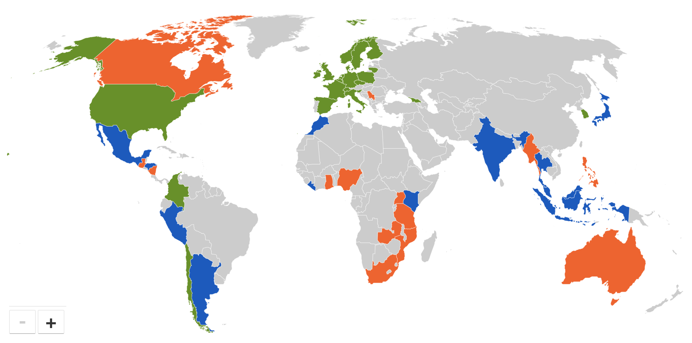
Overview of Current NAPs
Notes:
Transition slide

Slide 26
NAPs 101 - Global Rollout
EU Commission call on governments to adopt National Action Plans
Denmark & Finland develop NAPs; Binding Treaty
Switzerland, Norway, Italy & United States develop NAPs
Slovenia and South Korea develop NAPs
2013
2015
2017
2011
2014
2016
2018
The United Kingdom & the Netherlands develop first NAPs
Lithuania, Sweden, Norway & Colombia develop NAPs
France, Poland, Spain, Belgium, Chile, Czech Republic & Ireland develop NAPs
Notes:
Here is a timeline with an overview of the rollout of BHR NAPs in parallel with other key BHR initiatives since 2011 - as Sebastian mentioned yesterday there have been several new NAPs since then. The 2011 “communication” by the European Commission inviting MSs to conduct BHR NAPs is why so many of the first NAPs published were from EU member states. Since then, other regional and multilateral bodies have encouraged and, in some instances, facilitated the development of NAPS, including the AU, ASEAN, the Council of Europe, and the G7 and G20, and the OAS.

Slide 27
Overview of Current NAPs
Argentina → Developing
Kenya → Developing
Malaysia → Developing
Mexico → Developing
Nigeria → Other non-state initiatives
The Philippines → Other non-state initiatives
Notes:
And here is where we understand the countries that you are working in are on this issue. According to the UN, Argentina, Kenya, Malaysia, and Mexico are all in the process of developing NAPs, while in Nigeria and the Philippines there are efforts underway by either the National Human Rights Institution and/or civil society to begin working on NAPs. But of course, you likely know better than we do whether this is accurate.

Slide 28
NAPs Criticism
Too slow
Not participatory enough
Not enough new commitments
Commitments are not strong enough
Insufficiently clear process for assessment / follow-up
Notes:
(From UNGP background module)
Creation of the intergovernmental working group on transnational corporations
and other business enterprises with respect to human rights

Slide 29
NAPs and the ICT Sector
Notes:
Transition slide

Slide 30
NAPs that Reference ICTs
Notes:
Many first NAPs were European because they had done something similar (plan on CSR) and had already established a process for that
Czech Republic, Finland, France, Lithuania, Luxembourg, Netherlands, Poland, Spain, Sweden, Switzerland, United Kingdom, United States

Slide 31
NAPs that Don’t Reference ICTs
Notes:
Belgium, Chile, Colombia, Denmark, Georgia, Germany, Ireland, Italy, Norway, South Korea

Slide 32
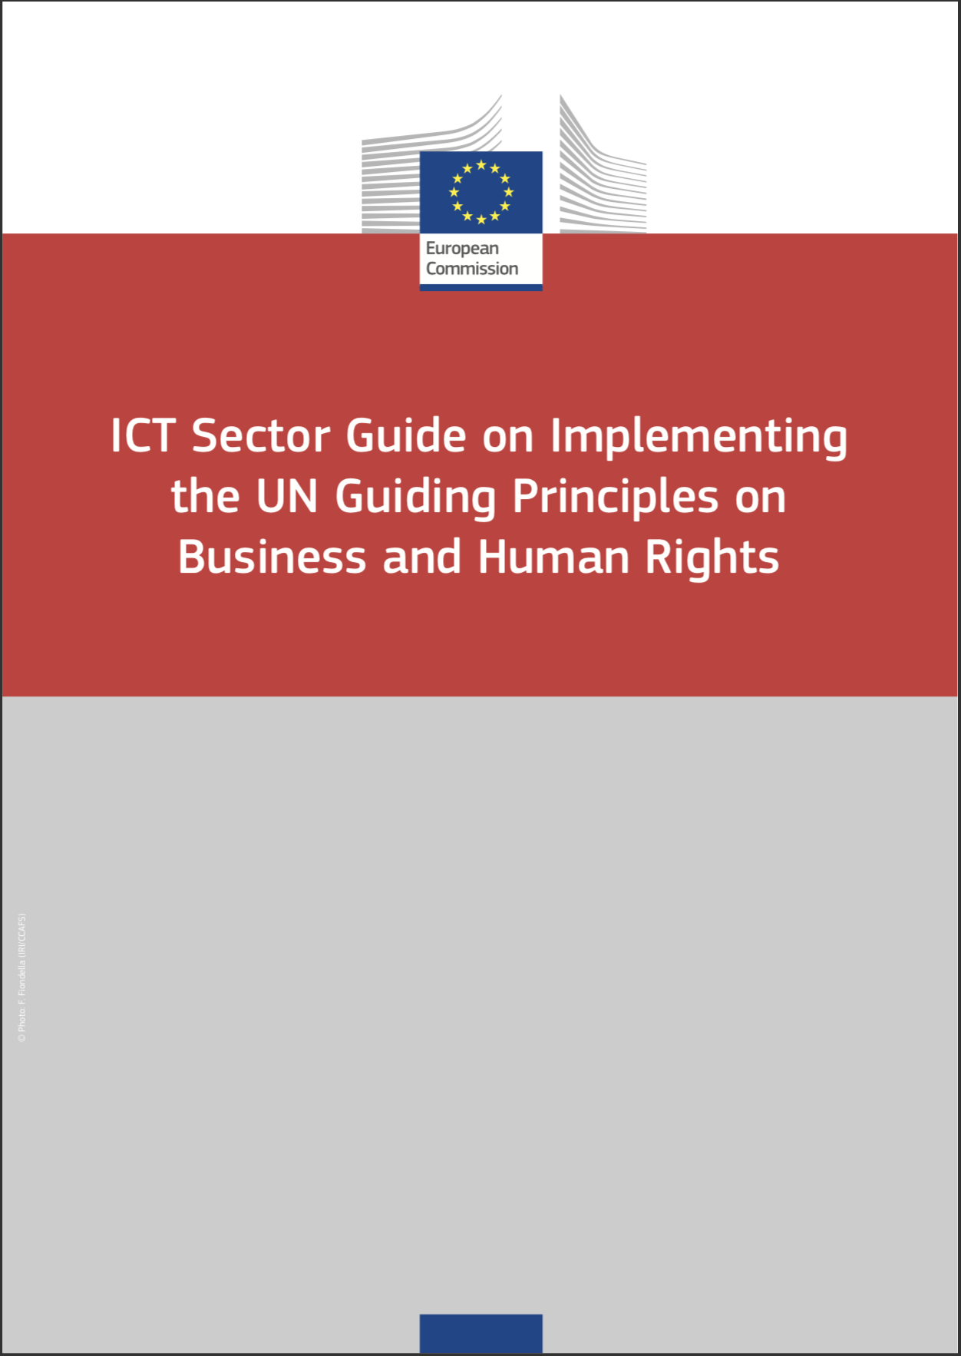
Sector Guidance
Netherlands
Sweden
France
United Kingdom

Slide 33
Finland
“The right to privacy, protection of personal data, and the protection of confidential messages are fundamental human rights.”
Proposes roundtable on privacy with government, companies, and civil society.

Slide 34
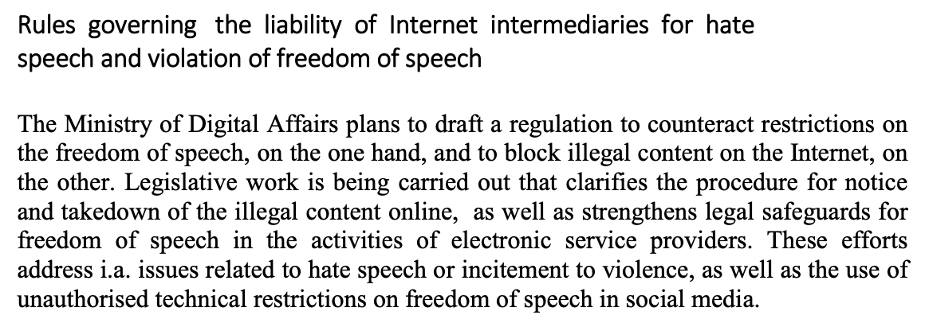
Poland

Slide 35
Switzerland

Slide 36
United Kingdom
Notes:
2013 NAP: Develop guidance on ICT exports with impact on human rights and FoE online 2016 updated NAP: Report on work in Wassenaar Arrangement; work on cybersecurity export risk

Slide 37
United States
Notes:
Develop a regular mechanism to identify, document, and publicize lessons learned and best practices related to corporate actions that promote and protect human rights online. Foster continued engagement among relevant stakeholders to support ongoing dialogue and collaboration on respecting human rights within the ICT sector.

Slide 38
OTHER RELATED EFFORTS
Notes:
Other Related Efforts Handout: https://docs.google.com/document/d/1tX_4WTFzhD-F6c84YOtHQzmIRrE1cvDbg6eL7-jwTFI/edit

Slide 39
Law 102
Hard Law Soft Law
Binding legal instruments and laws that give States and international actors actual binding responsibilities as well as rights
Rules that are neither strictly binding in nature nor completely lacking legal significance, such as guidelines, policy declarations, or codes of conduct
enforceable
non-enforceable
Notes:
Other Related Efforts handout: https://docs.google.com/document/d/1tX_4WTFzhD-F6c84YOtHQzmIRrE1cvDbg6eL7-jwTFI/edit

