Slide 1
Business and Human Rights in the Digital Environment
Module 4: UN Guiding Principles Pillar II: The corporate responsibility to respect human rights
New America’s Open Technology Institute
Ranking Digital Rights
Notes:
Created July 2018 by Kendall Lake; draft: https://docs.google.com/presentation/d/1qNXf5NxRTpftuIf9v2etM9fOq5NDI9iT-D-hPudtHRo/edit#slide=id.p1

Slide 2
Agenda
Business and human rights principles and frameworks
How tech and telco companies should demonstrate respect for right to privacy and freedom of expression
Human Rights Impact Assessments
Interactive case studies

Slide 3
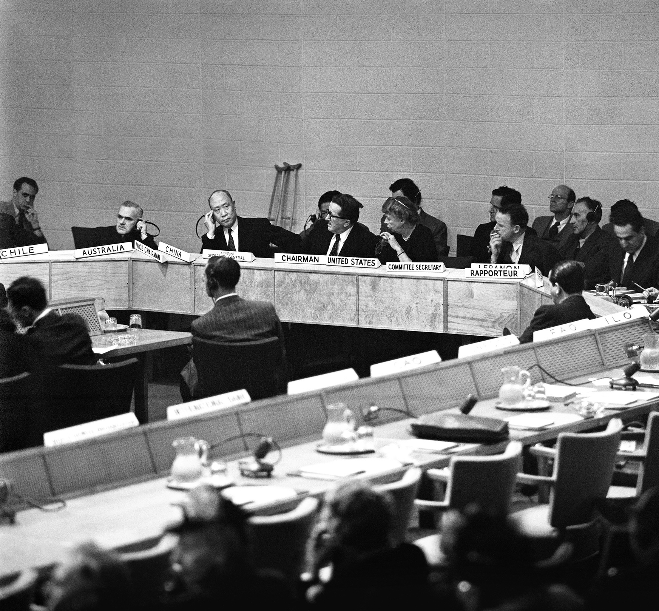
Universal Declaration of Human Rights (UDHR)
“International Bill of Human Rights” =
UDHR +
International Covenant on Civil & Political Rights (ICCPR) +
International Covenant on Economic, Social & Cultural Rights (ICESC)
Drafting committee on the International Bill of Rights, June 1947. Photo credit: United Nations Photo via Flickr (CC BY-NC-ND 2.0)

Slide 4
“Business enterprises should respect human rights. This means that they should avoid infringing on the human rights of others and should address adverse human rights impacts with which they are involved.”

Slide 5
Implementations of the UNGPs

Slide 6
Founded in 2008
Multi-stakeholder
Developed principles in coordination with UNGPs
Accountability: independent assessment every 2 years

Slide 7
Ranks companies on issues like protection against government surveillance and censorship.
Makes the business case for why respecting these fundamental rights are important
Offers valuable case studies for its best practices

Slide 8
Builds on the UN Guiding Principles on Business and Human Rights & the Global Network Initiative principles and implementation guidelines
Draws on a body of emerging global standards and norms around data protection, security, and access to information
Establishes benchmarks and ranks companies on disclosed policies and practices affecting their users’ freedom of expression and privacy rights

Slide 9
What should ICT companies be doing to demonstrate their respect for human rights, and ensure that they do not infringe on user’s rights?

Slide 10
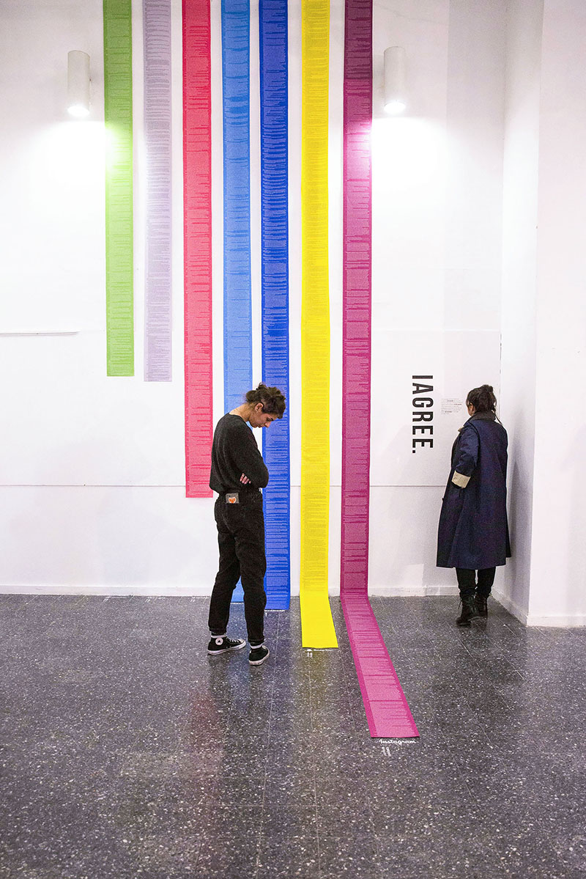
Terms of service & privacy policies
Clear
Easy to understand
Accessible
Credit: Dima Yarovinsky

Slide 11
Terms of Service
Outlines who may use the service
Overview of content and conduct policies
Legal text: warranties, disclaimers, liability
Image Credit: Pexels

Slide 12
USER INFORMATION
Any data that is connected to an identifiable person
Includes, but is not limited to, personal correspondence, user-generated content, account preferences and settings, log and access data, data about a user’s activities or preferences collected from third parties either through behavioral tracking or purchasing of data, and all forms of metadata
Image Credit: Pexels

Slide 13
Third Party Requests
Requests for user information
Requests to remove content or restrict accounts
Requests to shutdown telecommunications networks
Image credit: Paradigm Initiative

Slide 14
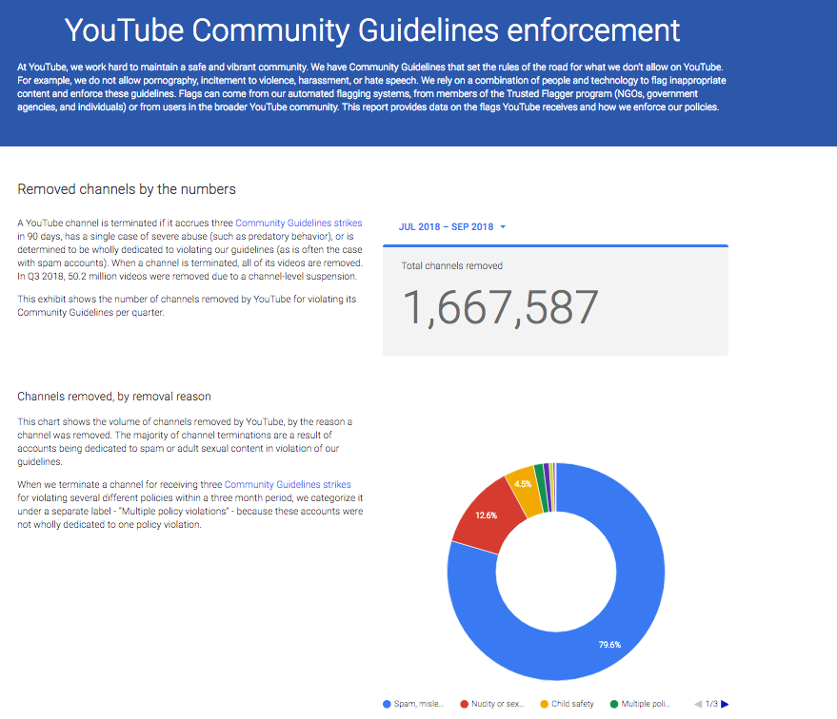
Transparency
Telefónica report on government requests

Slide 15
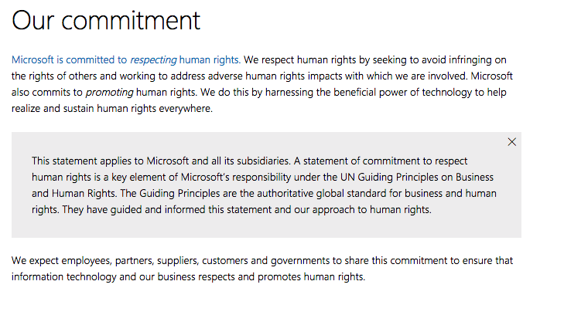
Governance
Commitment to freedom of expression and privacy as human rights
Institutionalization of commitments throughout the company
Senior-level oversight over human rights issues
Employee training
Engagement with a multistakeholder process or organization committed to human rights principles, such as the GNI.
Grievance and remedy mechanism enabling users to notify the company when their freedom of expression and privacy rights have been affected or violated.
Ex) Microsoft’s commitment to respect human rights

Slide 16
Human Rights Due Diligence

Slide 17
UN Guiding Principles #17-21
Principle 17: In order to identify, prevent, mitigate and account for how they address their adverse human rights impacts, business enterprises should carry out human rights due diligence. The process should include:
Assessing actual and potential human rights impacts [Principle 18]
Integrating and acting upon the findings [Principle 19]
Tracking responses [Principle 20]
Communicating how impacts are addressed [Principle 21]
Image Credit: Pexels

Slide 18
Human Rights Impact Assessments (HRIAs)
Should include:
A review UDHR, UNGPs, local laws, and the human rights environment
Risk scenarios based on the company’s particular services or operations
Consultations with stakeholders
Note: There’s no one-size fits all approach to HRIAs. Stakeholder engagement and remedy can present unique challenges to for the ICT sector given the scope of the user base for many of these companies.

Slide 19
“Assessing human rights impacts helps companies proactively shape a strategic approach to human rights based on relevant risks and opportunities rather than reacting to external pressure or unexpected incidents.”
Business for Social Responsibility report
Image Credit: Pexels
Notes:
Definition overlay

Slide 20
Human Rights Impact Assessments (HRIAs)
Resources:
Relevant reports from credible human rights groups include:
Freedom House reports: Freedom in the World; Freedom on the Net
GNI Country Legal Frameworks reports on Freedom of Expression and Privacy in Telecommunications
Reports from Human Rights Watch, Amnesty International, Article 19
Reports from local human rights advocacy groups
How to conduct HRIAs:
Business & Human Rights Resource Centre
The Danish Institute for Human Rights: Human Rights Compliance Assessment tool
Business for Social Responsibility: HRIA Guide
Links & more info provided in your handouts

Slide 21
Case Studies
Image Credit: Pexels

Slide 22
Questions for discussion
What human rights are at risk in this scenario?
How has the company’s policies or actions intersected with or worsened the risks to human rights?
What sorts of questions does this case raise that the company should ask when deciding whether to enter markets or roll out new services in the future? What sorts of questions does it raise about the company’s current operations?
What steps could the company have taken to mitigate their impacts?
What other considerations (legal restrictions, employee safety, operating license) might have factored into the company’s decision making?

Slide 23
Thank you!
Design Template Credit: Kendall Lake and New America’s Open Technology Institute

