Slide 1
Business and Human Rights in the Digital Environment
Module 5: UN Guiding Principles Pillar III: Access to remedy
Global Partners Digital
Notes:
Hi, and welcome to this module which looks at the third pillar of the UN Guiding Principles - access to remedy.

Slide 2
REMEDIES AND INTERNATIONAL HUMAN RIGHTS LAW
Notes:
Let’s start by looking at what we mean by remedy when it comes to international human rights law.

Slide 3
Universal Declaration of Human Rights
Article 8
“Everyone has the right to an effective remedy by the competent national tribunals for acts violating the fundamental rights granted him by the constitution or by law.”
Notes:
The UN Declaration of Human Rights recognises what might seem obvious, namely that it’s not enough just to prohibit human rights violations. Where a human rights violation does take place, something must be done for the victim, and there must be some way that those who violate human rights can be held accountable.
By mandating processes whereby individuals can allege that their human rights have been violated, and obtaining a remedy where that violation is found to have taken place, Article 8 helped make the Universal Declaration more than just a list of rules, but something more practical and enforceable.
It is, of course, however, not a binding treaty and so still relies on the goodwill of the states concerned to put such measures in place.
Article 8 was also limited to those fundamental rights provided in national constitutions or laws, rather than in the UDHR itself.

Slide 4
International Covenant on Civil and Political Rights
Article 2(3)
(a) Each State Party to the present Covenant undertakes (…) to ensure that any person whose rights or freedoms as herein recognized are violated shall have an effective remedy, notwithstanding that the violation has been committed by persons acting in an official capacity.
Notes:
Flash forward to the 1960s, and we see the International Covenant on Civil and Political Rights. Unlike the UDHR, this is very much a binding treaty, although not one which is directly enforceable in most jurisdictions.
The ICCPR goes into a bit more detail than the UDHR on what states must do to ensure that the treaty is enforceable and practical in their jurisdictions.
First, it applies to the human rights in the ICCPR itself, and is not limited to those provided for in national constitutions or laws.
Second, it sets out in Article 2(3)(a), that anyone whose human rights have been violated should have an “effective remedy”, even if that violation was committed by a person acting in an official capacity. So the mere fact that a person was following orders, even lawful orders, will not count as a defence if a human rights violation occurred as a result.

Slide 5
International Covenant on Civil and Political Rights
Article 2(3)
(b) To ensure that any person claiming such a remedy shall have his right thereto determined by competent judicial, administrative or legislative authorities, or by any other competent authority provided for by the legal system of the State, and to develop the possibilities of judicial remedy
(c) To ensure that the competent authorities shall enforce such remedies when granted.
Notes:
Third, Article 2 goes on to say that any person who considers that their human rights have been violated shall be able to bring that claim to a competent judicial, administrative or legislative authority. And fourth, that authority must be able to provide a remedy and enforce it.

Slide 6
Human Rights Committee, General Comment No. 31 (2004)
The state must protect individuals from human rights violations committed by third parties, including businesses.
Remedies must be “accessible and effective”
Remedies must be “appropriately adapted so as to take account of the special vulnerability of certain categories of person, including in particular children”
The remedy must amount to “reparation” which “generally entails appropriate compensation” but can also take other forms
Notes:
So far, so good. But the UN Human Rights Committee has gone even further in explaining what Article 2 requires. In their General Comment No. 31, they made a number of key points:
First, the positive obligations on States Parties to ensure Covenant rights will only be fully discharged if individuals are protected by the State, not just against violations of Covenant rights by its agents, but also against acts committed by private persons or entities that would impair the enjoyment of Covenant rights in so far as they are amenable to application between private persons or entities.
Second, remedies must not only be effective, but accessible, so it’s shouldn’t just be theoretical.
Third, there is not one single form of remedy which will make it effective, and different remedies will be needed to address the violations of different groups. A child who has been in forced labour, for example, will not usually need compensation to help remedy their situation, but protection and support.
Fourth, the remedy must amount to “reparation” i.e. it must as closely as possible put the person in the situation they would have been in, had the violation not occurred. While this will usually involve compensation, it can take other forms as well.

Slide 7
UNGPs
PRINCIPLE 25
Notes:
We’re now going to look at what the UN Guiding Principles say when it comes to the issue of remedies. Principles 25 to 31, the Third Pillar of the UN Guiding Principles, focus exclusively on this issue.

Slide 8
UNGPs: Principle 25
“As part of their duty to protect against business-related human rights abuse, States must take appropriate steps to ensure, through judicial, administrative, legislative or other appropriate means, that when such abuses occur within their territory and/or jurisdiction those affected have access to effective remedy.”
Notes:
Principle 25 focuses on what states must do, and says that as part of their duty to protect against business-related human rights abuses, they must take certain steps to ensure that when human rights abuses occur, that those affected have access to an effective remedy. There are a couple of parts of this principle that are worth exploring a little further.
First, there are a range of different ways that these must be ensured - including judicial and administrative procedures, as well as through legislation.
Second, the human rights abuse has to occur in that state’s territory or jurisdiction. This can make things difficult when it comes to technology since the harm might be suffered in one state, but the cause is a company or individual based in another.

Slide 9
UNGPs: Principle 25: Commentary
The Principles in this Pillar focus on “grievance mechanisms” and the remedies that they should provide.
The overall aim “to counteract or make good any human rights harms that have occurred”.
This may mean more than simply putting the person in the situation they would have been had the human rights harm not occurred.
What might this mean in practice?
Notes:
Interestingly, the commentary says that the overall aim is “to counteract or make good any human rights harms that may have occurred” which sounds like simply putting the person back to the position they would have been in had the garm not occurred. But it then goes on to say that it might in fact mean more than this. This could include:
Apologies, whether in public or private.
Guarantees of non-repetition.

Slide 10
UNGPs: Principle 25: Commentary
Three types of grievance mechanisms:
State-based judicial mechanisms, e.g. a court or tribunal
State-based non-judicial mechanisms, e.g. an ombudsperson offices or a National Human Rights Institution
Non-state-based grievance mechanisms, e.g. a company’s internal complaints procedure
In all cases, the procedures for the provision of remedy should be impartial, protected from corruption and free from political or other attempts to influence the outcome.
Notes:
Principle 25 sets out the three types of grievance mechanisms that exist:
First, the most common are state-based judicial mechanisms such as courts and tribunals.
Second, there are state-based but non-judicial mechanisms. These won’t always exist in every country, but could include ombudsperson officers or national human rights institutions.
Third, there are also non-state-based grievance mechanisms, such as a company’s own complaints procedures, but also regional courts.

Slide 11
UNGPs: Principle 25: Commentary
Remedy may include apologies, restitution, rehabilitation, financial or non-financial compensation and punitive sanctions (whether criminal or administrative, such as fines), as well as the prevention of harm through, for example, injunctions or guarantees of non-repetition.
Notes:
There is no exhaustive list of what kinds of remedies could be offered, and the commentary to Principle 25, echoing the Human Rights Committee’s General Comment, proffers a long list.

Slide 12
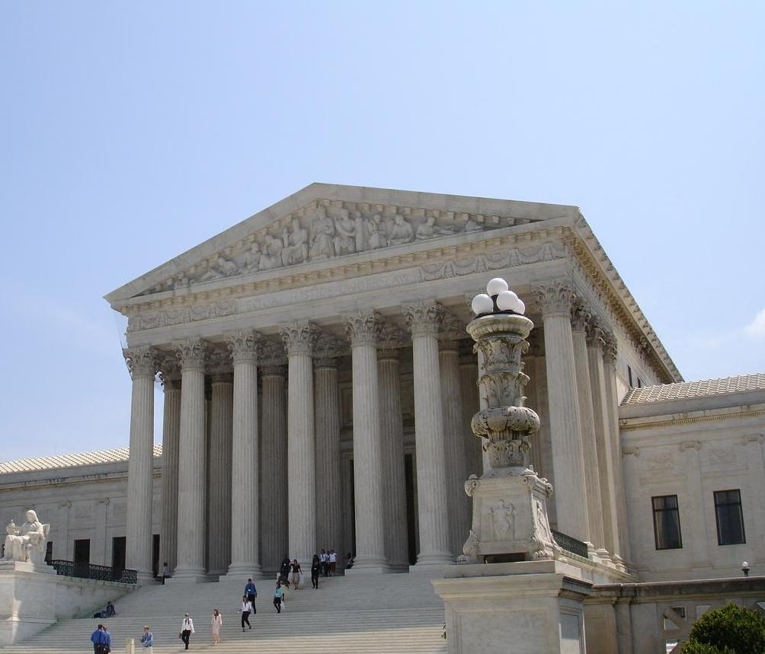
UNGPs: Principle 25 in practice
Enforceable constitutional or legislative duties on businesses to protect human rights:
Article 8(2) of the Constitution of South Africa: “A provision of the Bill of Rights binds a natural or a juristic person if, and to the extent that, it is applicable, taking into account the nature of the right and the nature of any duty imposed by the right.”
Article 20 (1) of the Constitution of Kenya: “The Bill of Rights applies to all and binds all State organs and persons” (and defines “person” as including “a company, association or other body of persons whether incorporated or unincorporated”).
Notes:
One very simple way that businesses can be required to respect human rights is by placing a legal duty on them to do so. This is relatively rare, but there are jurisdictions which provide that their national human rights provisions apply to businesses. There are relatively few instances of individuals bringing claims using these opportunities, however.

Slide 13
UNGPs: Principle 25 in practice
Data protection legislation (right to privacy), e.g. fine of £500,000 imposed upon Facebook by the UK’s data protection authority following the Cambridge Analytica scandal, after Facebook allowed third party developers to access user information without sufficient consent.
Equality or anti-discrimination legislation (rights to equality and non-discrimination), which could potentially be used against algorithms or automated decisionmaking which leads to discriminatory outcomes.
Notes:
Alternatively, states can pass legislation which while not explicitly human rights legislation, can protect individual’s human rights. Privacy or data protection legislation, and equality or anti-discrimination legislation are two of the most common.

Slide 14
UNGPs: Principle 25
What are appropriate remedies likely to be for adverse human rights impacts in the tech sector?
Compensation?
Financial penalties?
An order to review relevant terms of service or policies?
An order to reinstate online content which had been removed, or the de-suspension of an online account?
An order to delete personal data wrongly held or used?
Notes:
Exercise. What are appropriate remedies likely to be for adverse human rights impacts in the tech sector?

Slide 15
UNGPs
PRINCIPLE 26

Slide 16
UNGPs: Principle 26
“States should take appropriate steps to ensure the effectiveness of domestic judicial mechanisms when addressing business-related human rights abuses, including considering ways to reduce legal, practical and other relevant barriers that could lead to a denial of access to remedy.”
Notes:
Principle 25 focuses on the first of the three grievance mechanisms, state-based judicial mechanisms, and how to ensure that these are accessible and effective.

Slide 17
UNGPs: Principle 26: Commentary
The focus of Principle 26 is on ensuring that judicial mechanisms are accessible and effective in addressing human rights abuses caused by businesses.
General requirements include:
The provision of justice should not prevented by corruption of the judicial process
Courts should be independent of economic or political pressures from other State agents and from business actors
The legitimate and peaceful activities of human rights defenders should not be obstructed
Notes:
The commentary to Principle 26 looks at some general requirements which apply whatever kind of business or human rights impact is being considered.

Slide 18
UNGPs: Principle 26: Commentary
Relevant legal barriers could include:
A lack of any legislation which allows individuals to bring claims for human rights abuses by companies, such as constitutional or legislative human rights obligations only applying to the public sector;
Relevant legislation (such as data protection legislation) which only applies to the public sector, which is difficult to enforce, or which does not provide for individual rights to bring an action;
Discriminatory rules which provide a lower level of legal protection for certain groups, particularly indigenous populations, non-citizens and stateless persons.
Notes:
Let’s look at some of the legal barriers which might be particularly relevant when it comes to human rights impacts caused by the tech sector.
The first would be the absence of legislation which provides for individuals to bring claims against companies for particular types of adverse impacts.
The second would be the existence of relevant legislation, but with provisions which mean it doesn’t apply to the private sector, or to all types of businesses, or which can only be enforced by a regulatory body, rather than individual victims.
The third would be discriminatory laws or rules which limit the ability of certain groups to bring cases, such as non-citizens or children.

Slide 19
UNGPs: Principle 26: Commentary
Relevant practical and procedural barriers could include:
High costs involved in bringing a claim and/or a lack of support through legal aid or litigation insurance;
Difficulties in obtaining legal representation;
Difficulties in bringing class actions, collective action claims or representative action by not-for-profit bodies, organisations or associations, when appropriate (such as an incident affecting the personal data of a large group of individuals);
A lack of understanding of business and human rights, or the tech sector specifically, among relevant actors, including the judiciary.
Notes:
Let’s look at some of the practical and procedural barriers which might be particularly relevant when it comes to human rights impacts caused by the tech sector.
High costs involved in bringing a claim
Difficulties in obtaining legal representation
Difficulties in bringing class actions, collective action claims or representative action by not-for-profit bodies, organisations or associations
A lack of understanding of business and human rights, or the tech sector specifically, among relevant actors, including the judiciary

Slide 20
UNGPs
PRINCIPLE 27

Slide 21
UNGPs: Principle 27
“States should provide effective and appropriate non-judicial grievance mechanisms, alongside judicial mechanisms, as part of a comprehensive State-based system for the remedy of business-related human rights abuse.”
Notes:
Basic Text Slide

Slide 22
UNGPs: Principle 27: Commentary
Judicial mechanisms may not always be appropriate. Why?
Alternative, non-judicial mechanisms could include:
National human rights institutions:
Could help facilitate class actions against tech companies where multiple users are affected, or bring cases on their behalf
Can support public awareness of how human rights can be adversely impacted by tech companies, and provide guidance on how to bring claims
Undertake research on the impacts on human rights by tech companies, helping bring evidence of potential abuses to light
Ombudsperson offices
Data protection authorities
Notes:
Basic Text Slide

Slide 23
UNGPs
PRINCIPLE 28

Slide 24
UNGPs: Principle 28
“States should consider ways to facilitate access to effective non-State-based grievance mechanisms dealing with business-related human rights harms.”
Notes:
Basic Text Slide

Slide 25
UNGPs: Principle 28: Commentary
Examples of non-state-based grievance mechanisms include:
Those administered by a business enterprise alone or with stakeholders, by an industry association or a multi-stakeholder group;
Regional and international human rights bodies.
Facilitating access could include:
Information sharing and awareness-raising
Financial support
Notes:
Basic Text Slide

Slide 26
UNGPs
PRINCIPLE 29

Slide 27
UNGPs: Principle 29
“To make it possible for grievances to be addressed early and remediated directly, business enterprises should establish or participate in effective operational-level grievance mechanisms for individuals and communities who may be adversely impacted.”
Notes:
Basic Text Slide

Slide 28
UNGPs: Principle 29
What are the benefits of grievance mechanisms established by, or involving business enterprises?
They support the identification of adverse human rights impacts as a part of an enterprise’s ongoing human rights due diligence, by providing a channel for those directly impacted by the enterprise’s operations to raise concerns.
They make it possible for grievances, once identified, to be addressed and for adverse impacts to be remediated early and directly by the business enterprise, thereby preventing harms from compounding and grievances from escalating.
Notes:
Basic Text Slide

Slide 29
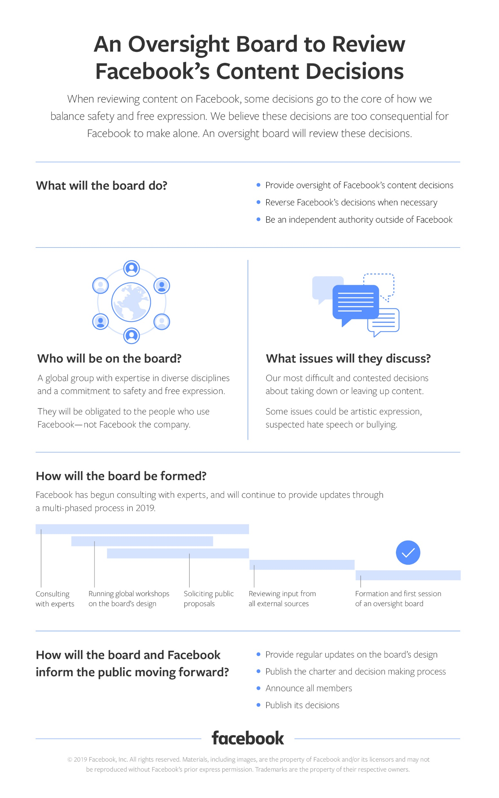
UNGPs: Principle 29 in practice
Examples of grievance mechanisms offered by tech companies
Online platforms providing users the opportunity to challenge removals
Facebook’s proposed Oversight Board to independently review content moderation decisions
Tech companies using personal data allowing users to know what data is used, for what purposes, and to have it corrected or deleted
Notes:
Basic Text Slide

Slide 30
UNGPs
PRINCIPLE 30

Slide 31
UNGPs: Principle 30
“Industry, multi-stakeholder and other collaborative initiatives that are based on respect for human rights-related standards should ensure that effective grievance mechanisms are available.”
Notes:
Basic Text Slide

Slide 32
UNGPs: Principle 30 in practice
Examples of grievance mechanisms in the tech sector:
The Global Network Initiative:
Reviews commitment of members against privacy and freedom of expression principles (but reports are private)
Allows members to challenge others on human rights concerns (but, again, only privately)
Notes:
Basic Text Slide

Slide 33
UNGPs
PRINCIPLE 31

Slide 34
UNGPs: Principle 31
“a) Legitimate: enabling trust from the stakeholder groups for whose use they are intended, and being accountable for the fair conduct of grievance processes
b) Accessible: being known to all stakeholder groups for whose use they are intended, and providing adequate assistance for those who may face particular barriers to access
c) Predictable: providing a clear and known procedure with an indicative time frame for each stage, and clarity on the types of process and outcome available and means of monitoring implementation”
Notes:
Basic Text Slide

Slide 35
UNGPs: Principle 31
“d) Equitable: seeking to ensure that aggrieved parties have reasonable access to sources of information, advice and expertise necessary to engage in a grievance process on fair, informed and respectful terms
e) Transparent: keeping parties to a grievance informed about its progress, and providing sufficient information about the mechanism’s performance to build confidence in its effectiveness and meet any public interest at stake”
Notes:
Basic Text Slide

Slide 36
UNGPs: Principle 31
“f) Rights-compatible: ensuring that outcomes and remedies accord with internationally recognized human rights
g) A source of continuous learning: drawing on relevant measures to identify lessons for improving the mechanism and preventing future grievances and harms
h) Based on engagement and dialogue: consulting the stakeholder groups for whose use they are intended on their design and performance, and focusing on dialogue as the means to address and resolve grievances”
Notes:
Basic Text Slide

Slide 37
SCENARIOS

Slide 38
Scenario 1
You are a user of a video-sharing platform and post a video of police brutality. The platform removes the video and notifies you that it has removed the video for violating its graphic content policy.
Notes:
Basic Text Slide

Slide 39
Scenario 2
You, along with tens of thousands of other users of a mobile shopping app, have been the victim of a data breach due to poor security practices. Your credit card details were taken and used by the hackers causing financial loss. Your efforts to contact the company have been ignored.
Notes:
Basic Text Slide

Slide 40
Scenario 3
Legislation allows for law enforcement agencies in the country to demand user data from companies for reasons of “national security”. You are a human rights activist, and colleagues of yours have faced persecution and harassment from police officers and you find out that they have done so using geolocational and communications data provide by a messaging app that the activists use. The company, when you complain to them, says that they're simply following the law.
Notes:
Basic Text Slide

